Slide 1
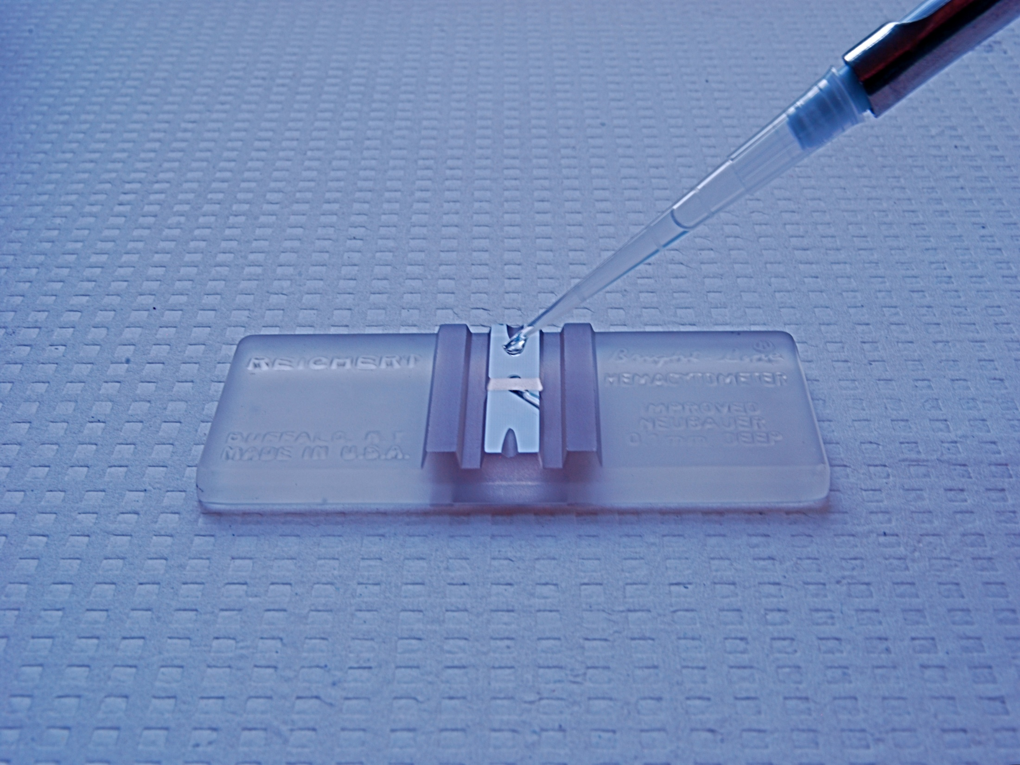
Counting Cells
Using a haemocytometer

Slide 2
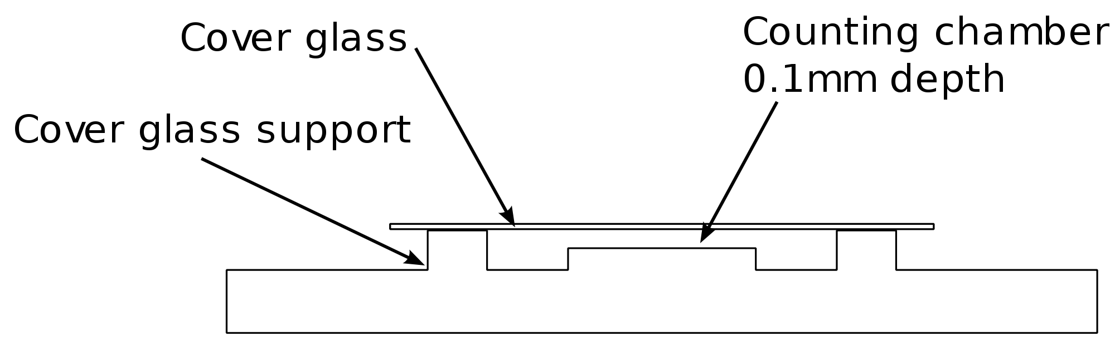
Using a haemocytometer
As the haemocytometer is of a known depth, the sample being studied is of a known volume.
The sample is drawn in using capillary action.
Trypan blue stains dead cells while live viable cells remain unstained.

Slide 3
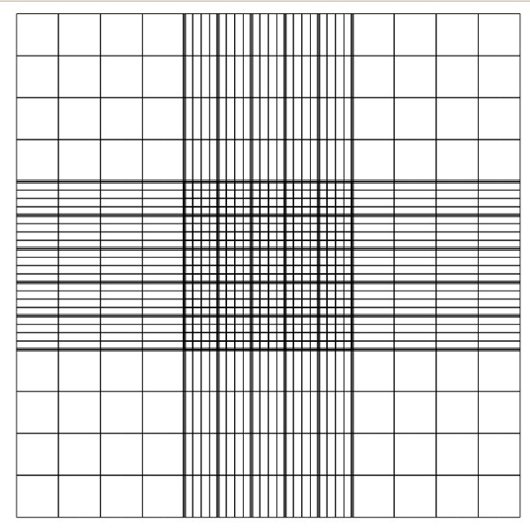
Using a haemocytometer
When viewed under the microscope, a grid is viewed.
The grid will not be seen in its entirety.
Haemocytometers can differ in their specifications according to manufacturer and purpose but the principle is the same.
Exact procedures will differ from laboratory to laboratory.
Sometimes, only the corner 4x4 sections are used.
Any dilution factors due to staining need to be considered.
You are likely to use the entire grid in an examination question and the volume of the sample will be given.

Slide 4
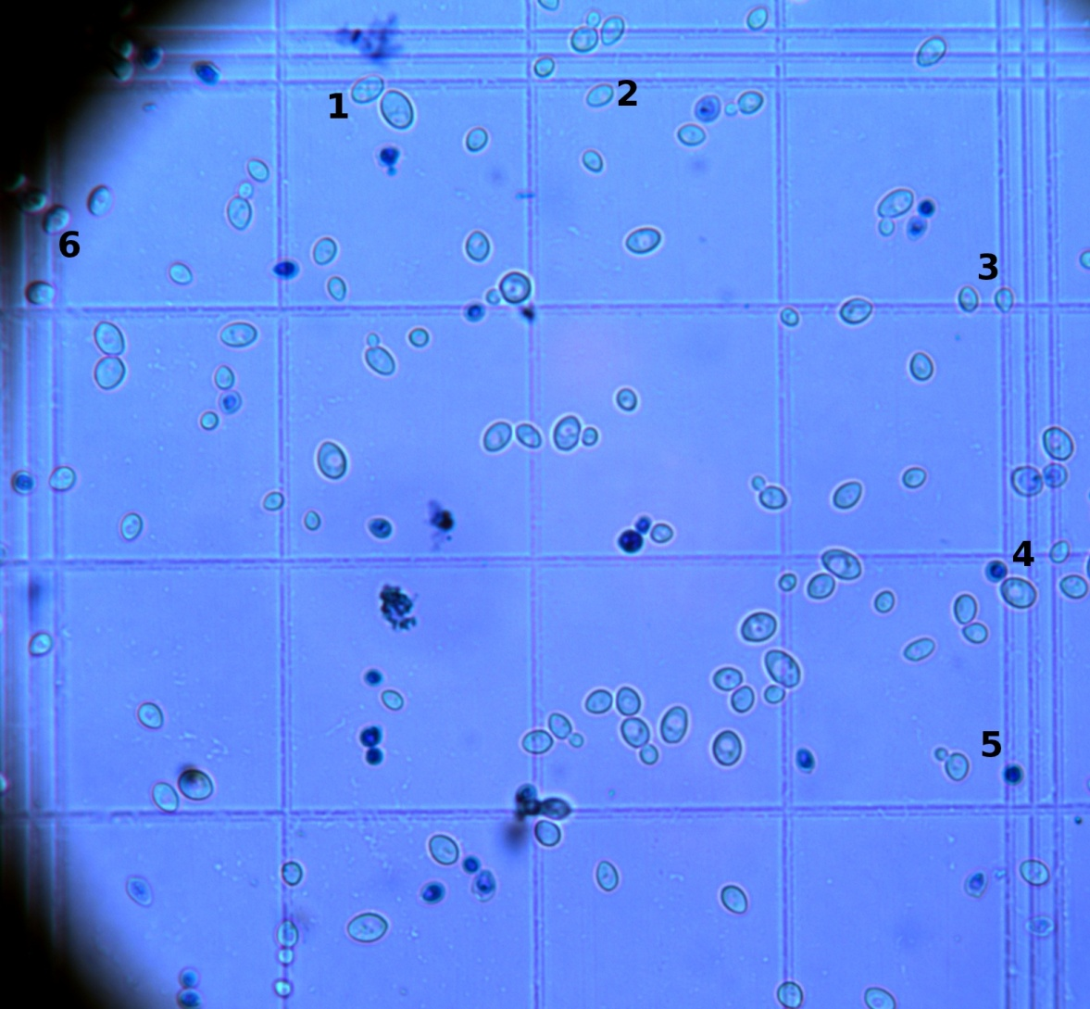
Illustration
Here, trypan blue has been added to yeast cells with a dilution factor of 2.
Any dead cells appear dark blue while viable cells remain unstained.
Cells on the lines are counted for two of the cells, we will say top and right as they are visible in this image.
# viable = 100 # dead = 30

Slide 5
Calculation
Step one: The sample has been diluted by a factor of 2 so we will double our values.
# viable = 200 # dead = 60
This will probably not be considered in an exam question, so it should be ignored.

Slide 6
Calculation
# viable = 200 # dead = 60
Step two: Here, the volume studied is 0.00011..ml
# cells = cells counted x 1ml
0.00011..ml
# viable = 200 x 1ml = 1 800 018/ml
0.00011..ml
Lets say 1.8 million/ml
# dead = 60 x 1ml = 545 455/ml
0.00011…ml
Lets say 0.5 million/ml

Slide 7
Problem
The cells have been stained with trypan blue:
Viable cells
Dead cells
The volume of the haemocytometer is 0.001ml
Determine the number of viable and dead cells per ml.

Slide 8
Problem
The cells have been stained with trypan blue:
Viable cells
Dead cells

Slide 9
Applications
Blood counts: for patients with abnormal blood cells, where automated counters don't perform well.
Sperm counts
Cell culture: when sub-culturing or recording cell growth over time.
Beer brewing: for the preparation of the yeast.
Measurement of cell size: in a micrograph, the real cell size can be inferred by scaling it to the width of a hemocytometer square, which is known.

