Slide 1
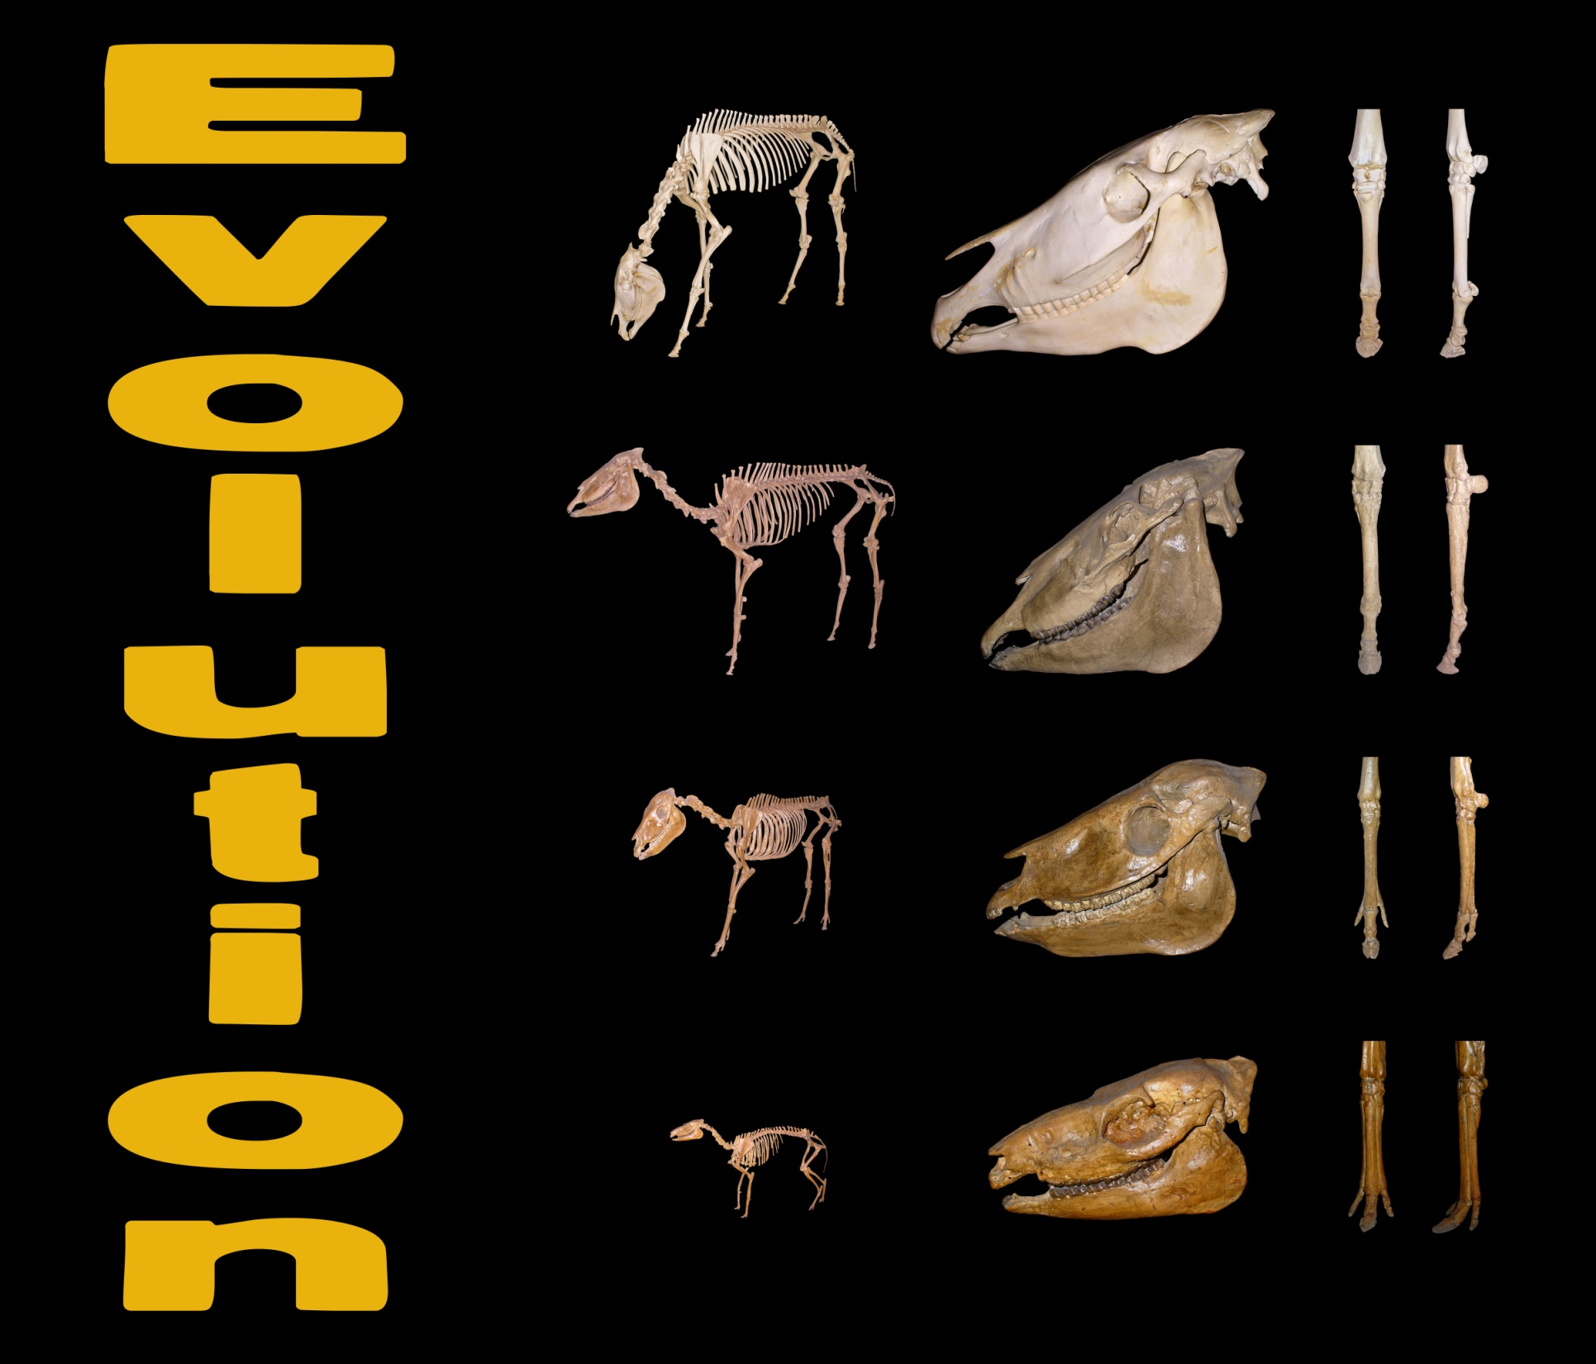

Slide 2
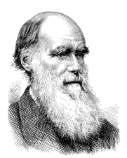
Define evolution.
7a
Evolution — the changes in organisms over generations as a result of genomic variations..
An important aspect of this is NATURAL SELECTION.
A species produces more offspring than the resources can support.
This leads to competition within a species as well as between species.
Some individuals have an advantage when it comes to evading predators.
Only those that survive are able to pass their genes on to future generations.
It is important to realise that evolution does not take place along a single path but that populations of a species can diverge along different paths rather like the branches of a tree.
Some of these branches terminate as a species becomes extinct.
Evolution suggests a common ancestry supported by the fact that DNA is universal – that is DNA is the genetic material found in all living things.

Slide 3
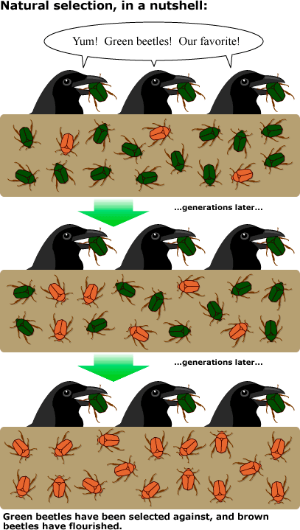
Natural selection
7c
Population growth produces more offspring than the carrying capacity of an environment can support.
If there is an over production of offspring this will result in a struggle for survival within the species as the resources become scarce and individuals in the population will start to compete for these.
This results in an increase in mortality rate as the weaker individuals in the population will lose out on these vital resources that are essential for their survival. Hence “survival of the fittest”.

Slide 4
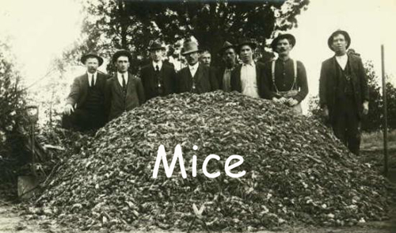
Populations produce more offspring than can survive

Slide 5
Within a population, there is variation (size, colour, resistance to disease etc)

Slide 6
Limited resources creates a struggle for survival.

Slide 7
Some are better adapted to their environment (including drought or extreme cold) and survive.

Slide 8
The best adapted individuals survive and pass on their genes.

Slide 9
Over time, the characteristic that helped individuals to survive increases in the population.

Slide 10
This results in small changes at each generation, eventually leading to new species.

Slide 11
In sexual selection (usually males), there is selection for those animals that either:
are more attractive
more successful at establishing it’s physical superiority

Slide 12
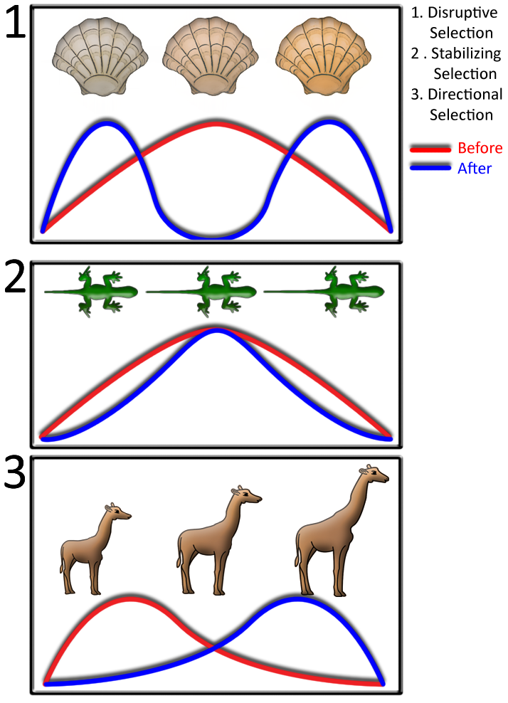
Mechanisms of speciation
All the organisms on the left show variation.
Selection can work in a number of ways.
Those with extremes of colour are best camouflaged, perhaps depending on the seabed (sand or rock). This can result in two forms that eventually follow two evolutionary paths and form new sub-species and then species.
Sometimes the average is best, providing optimum balance and therefore the most agile movement.
For giraffes, having the longest necks is clearly an advantage when reaching for leaves. Sometimes the selection of extremes is due to mate selection such as with peacocks.

Slide 13
Evolution
The frequency of a gene can change either due to natural selection of genetic drift.

Slide 14
Genetic Drift
Genetic drift (or allelic drift) is the change in the frequency of a gene variant (allele) in a population due to random sampling of organisms. The alleles in the offspring are a sample of those in the parents, and chance has a role in determining whether a given individual survives and reproduces.
The number of dots shows the number of times a bead was selected

