Slide 1
Quadrats
Advanced Higher Biology

Slide 2
What is a quadrat?
A quadrat is a square frame, often 0.5m x 0.5m (0.25m²) but can be 1m x 1m. Sometimes it contains a grid of smaller squares.
50cm
50cm

Slide 3
Method
Decide on your research question.
Select the locations to be surveyed.
Select two or more species to include in your surveys (if you are comparing biodiversity, you will need to include all species)
Mark out the area in a grid. The area will depend on the locations and the time available. The grid can take a long time but not so long if you cooperate and work together well.
Generate random numbers – numbers out of a hat or use the random number function on your calculators. These numbers provide your coordinates where you will place your quadrat.
Count the numbers of the selected species of plants in each quadrat. Always count the number of plants, not the flower heads!
Process your raw data and compare.

Slide 4
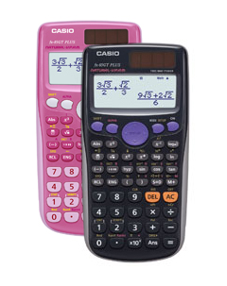
Generating Random Numbers

Slide 8
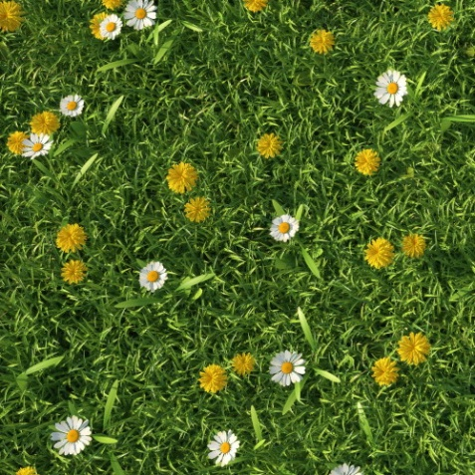
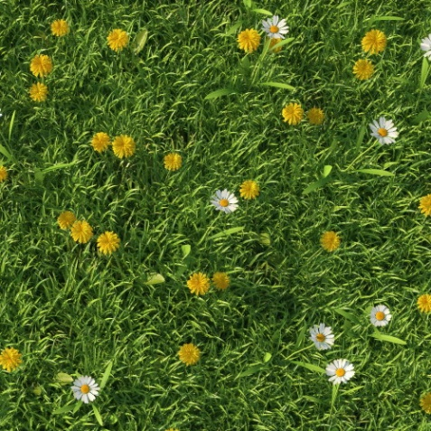
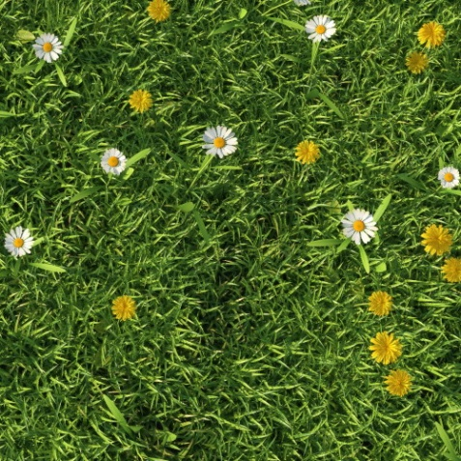
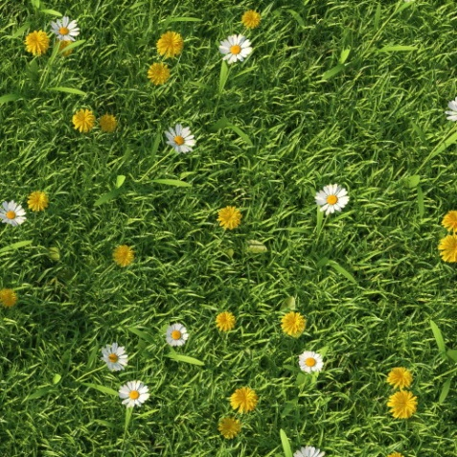
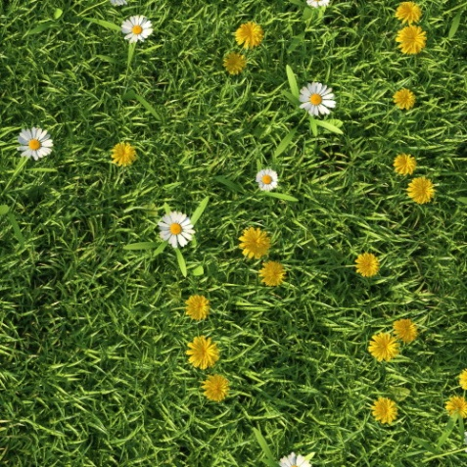
Results
3,5
For illustrative purposes, in spite of what I have said, I will count the flowers as I am not able to sort out the stems with my fingers. Remember though that some plants may not be in flower. I have placed the coordinates where there are no daisies or dandelions.
5,1
2,6
Coordinates | Daisies | Dandelions
5,1 | 6 | 34
2,6 | 8 | 25
3,3 | 11 | 18
3,5 | 11 | 20
4,3 | 7 | 11
6,1 | 6 | 19
4,3
3,3
6,1

Slide 9
Data Processing
Coordinates | Daisies | Dandelions
5,1 | 6 | 34
2,6 | 8 | 25
3,3 | 11 | 18
3,5 | 11 | 20
4,3 | 7 | 11
6,1 | 6 | 19
Average | 8.17 | 21.17
Remember these are estimates!
Population Density
Population Density =
Daisies = = 32.68m⁻²
Dandelions = = 84.68m⁻²
Total Population
Total population = Population density x total area
The total area may extend beyond the grid marked on the ground.
average per quadrat
area of the quadrat
8.17
0.25
21.17
0.25

Slide 10
Cumulative Frequency
The data below is for Ranunculus acris counted within an area of un-grazed meadow
Quadrat number | Number of Ranunculus acris | Mean of the numbers counted | Estimate of Population density m⁻²
1 | 9 | 9.0 | 36.0
2 | 17 | 13.0 | 52.0
3 | 12 | 12.7 | 50.7
4 | 18 | 14.0 | 56.0
5 | 15 | 14.2 | 56.8
6 | 8 | 13.2 | 52.7
7 | 16 | 13.6 | 54.3
8 | 9 | 13.0 | 52.0
9 | 10 | 12.7 | 50.7
10 | 15 | 12.9 | 51.6
11 | 13 | 12.9 | 51.6
12 | 10 | 12.7 | 50.7
After 10 quadrat samples, any further samples are unlikely to have any significant effect on the overall estimate, so 10 samples would be considered sufficient. This is an alternative approach to surveying the suggested area of 20%. We can use an estimate of 51m⁻².

Slide 11
Biodiversity
In reality an area usually contains more than two species and we may want to compare the biodiversity between two areas either to study the effect of a human activity or as part of a study into succession (climax communities usually have a higher biodiversity). This area contains plantain, buttercups, clovers, various types of grasses and probably (on close inspection) some mosses. Biodiversity considers both the number of species and the eveness in population size. If one species dominates, the biodiversity is low.

Slide 12
Cumulative Total Number of Species
After 8 quadrat samples, the total number of species found is 18. Further sampling does not find any further species. While we cannot eliminate the possibility of another rare species within the survey area, 8 quadrat sites are considered to be sufficient to sample the area. Further sampling would be a waste of time.

Slide 13
Determination of the Simpson’s Diversity Index
Species | Quadrat number
 | 1 | 2 | 3 | 4 | 5 | 6 | 7 | 8 | Total
Ranunculus acris | 8 | 3 | 9 | 12 | 14 | 5 | 16 | 4 | 71
Taraxacum officinale | 9 | 15 | 12 | 14 | 12 | 15 | 12 | 13 | 102
Bellis perennis | 10 | 15 | 12 | 14 | 9 | 8 | 16 | 12 | 96
Plantago major | 5 | 6 | 4 | 2 | 6 | 1 | 0 | 4 | 28
Lolium perenne | 26 | 21 | 19 | 31 | 14 | 16 | 15 | 26 | 168
Trifolium repens | 15 | 23 | 24 | 21 | 16 | 1 | 9 | 29 | 138
Trifolium pratense | 12 | 16 | 5 | 4 | 9 | 19 | 12 | 2 | 79
Dactylis glomerata | 4 | 3 | 9 | 8 | 2 | 7 | 2 | 2 | 37
Phleum pratense | 12 | 14 | 18 | 17 | 10 | 20 | 4 | 5 | 100
Agrostis capillaris | 6 | 4 | 3 | 9 | 1 | 7 | 5 | 6 | 41
Anthoxanthum odoratum | 4 | 6 | 2 | 8 | 0 | 1 | 3 | 4 | 28
Cynosurus cristatus | 1 | 0 | 2 | 0 | 1 | 3 | 2 | 0 | 9
Centaurea cyanus | 0 | 0 | 2 | 0 | 0 | 1 | 0 | 4 | 7
Urtica dioica | 0 | 1 | 2 | 1 | 0 | 1 | 2 | 1 | 8
Onopordum acanthium | 8 | 2 | 1 | 0 | 1 | 2 | 0 | 1 | 15
Dactylorhiza fuchsii | 0 | 0 | 0 | 2 | 3 | 0 | 0 | 4 | 9
Lychnis flos-cuculi | 0 | 0 | 4 | 2 | 2 | 4 | 1 | 0 | 13
Ajuga reptans | 0 | 0 | 0 | 0 | 5 | 0 | 2 | 0 | 7
N(N-1)
D = Diversity index
N= total number of organisms of all species found
n= number of individuals of a particular species
D =
Σn(n-1)

Slide 14
Determination of the Simpson’s Diversity Index
Species | # of each species | n(n-1)
Ranunculus acris | 71 | 4970
Taraxacum officinale | 102 | 10302
Bellis perennis | 96 | 9120
Plantago major | 28 | 756
Lolium perenne | 168 | 28056
Trifolium repens | 138 | 18906
Trifolium pratense | 79 | 6162
Dactylis glomerata | 37 | 1332
Phleum pratense | 100 | 9900
Agrostis capillaris | 41 | 1640
Anthoxanthum odoratum | 28 | 756
Cynosurus cristatus | 9 | 72
Centaurea cyanus | 7 | 42
Urtica dioica | 8 | 56
Onopordum acanthium | 15 | 210
Dactylorhiza fuchsii | 9 | 72
Lychnis flos-cuculi | 13 | 156
Ajuga reptans | 7 | 42
 | N(N-1)=912980 | Σn(n-1) =92550
N(N-1)
D =
Σn(n-1)
D = Diversity index
N= total number of organisms of all species found
n= number of individuals of a particular species
912980
D = = 9.86
92550

