Slide 1
Scientific Principles and Process
ADVANCED HIGHER BIOLOGY

Slide 2
Scientific Method
Scientific method
Scientific cycle — construction of a testable hypothesis, experimental design, gathering, recording, analysis of data, evaluation of results, conclusions and the formation of new hypotheses where necessary. The null hypothesis.

Slide 3
Scientific Method

Slide 4
Forming a hypothesis
Features of a sound hypothesis:
It is based on observations and prior knowledge of the system.
It offers an explanation for an observation.
It refers to only one independent variable.
It is written as a definite statement and not as a question.
It is testable by experimentation.
It leads to predictions about the system.

Slide 5
Forming a null hypothesis
A hypothesis based on observations is used to generate the null hypothesis (H₀); the hypothesis of no difference or no effect.
Hypotheses are expressed in the null form for the purposes of statistical testing.
H₀ may be rejected in favour of accepting the alternative hypothesis, H_{A}.

Slide 7
Question
Amelia wants longer fingernails. She wants to do an experiment on herself that proves that taking a Vitamin B supplement daily will grow her fingernails faster than if she doesn't take any vitamin supplement.
State Amelia’s null hypothesis

Slide 8
Question
In a scientific experiment, what is the researcher usually trying to disprove?
A] The theory
B] The alternative hypothesis
C] The null hypothesis

Slide 9
CASE STUDY
Case study on the successive evidence-based models of the structure of the plasma membrane to illustrate refinement of scientific knowledge through a framework of experimentation.

Slide 10
1920
1930
1940
1950
1960
1970
1980
1990
2000
Gorter and Grendel publish their paper indicating the possibility of a bilayerof lipids (1924)
Danielli and Davson propose their original model of the membrane (1935)
First electronmicroscope images of cell membranes produced
Danielli and Davson publish a revised version of their model (1954)
Freeze etching techniques developed giving images of membrane faces
Singer and Nicholson publish fluid mosaic model (1972)
NMR and X-ray diffraction techniques are developed sufficiently to provide evidence about the movement of lipids in the membrane
Gunther Blobel receives a Nobel Prize for his pioneering work on the mechanisms by which proteins integrate with the membrane (1999)

Slide 11
Gorter & Grendel
Gorter and Grendel obtained the membranes of red blood cells. They calculated the area of the red blood cell membrane and then extracted the lipids that were present. These were dissolved in petroleum ether and allowed to spread into a layer one molecule thick on a surface of water and the area was measured.
Animal | Total surface area of the red blood cell membrane (A) μm² | Surface area occupied by the lipids extracted (B) μm² | Factor B/A
Dog | 6.2 | 12.2 | 2
Rabbit | 4.9 | 8.8 | 2
Guinea Pig | 0.52 | 1.02 | 2
Goat | 0.33 | 0.66 | 2
Man | 0.47 | 0.92 | 2
Conclusion: ‘It is clear that all our results fit in well with the supposition that the erythrocytes (red blood cells)
are covered by a layer of fatty substances that is two molecules thick.’
(From Gorter. E. and Grendel. F. Bimolecular layers of lipoids on the chromocytes of the blood, 1924.)

Slide 12
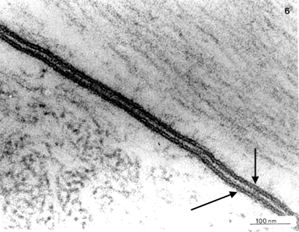
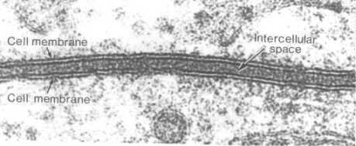
ELECTRONMICROGRAPH EVIDENCE
During the late 1930s and early 1940s, electronmicroscopy techniques were developed
which provided much more detailed resolution of the structure of a cell. Early micrographs
were obtained by staining a very thin section of tissue with heavy metal salts. These are
absorbed in different amounts by different parts of the cell, giving contrasting degrees of
electron scattering. The parts that take up the most stain appear the darkest on the image.
These early micrographs showed the cell membrane as two dark lines with a lighter inner core. N.B. Both these images show the membranes of two adjacent cells with the intercellular space in between.

Slide 13
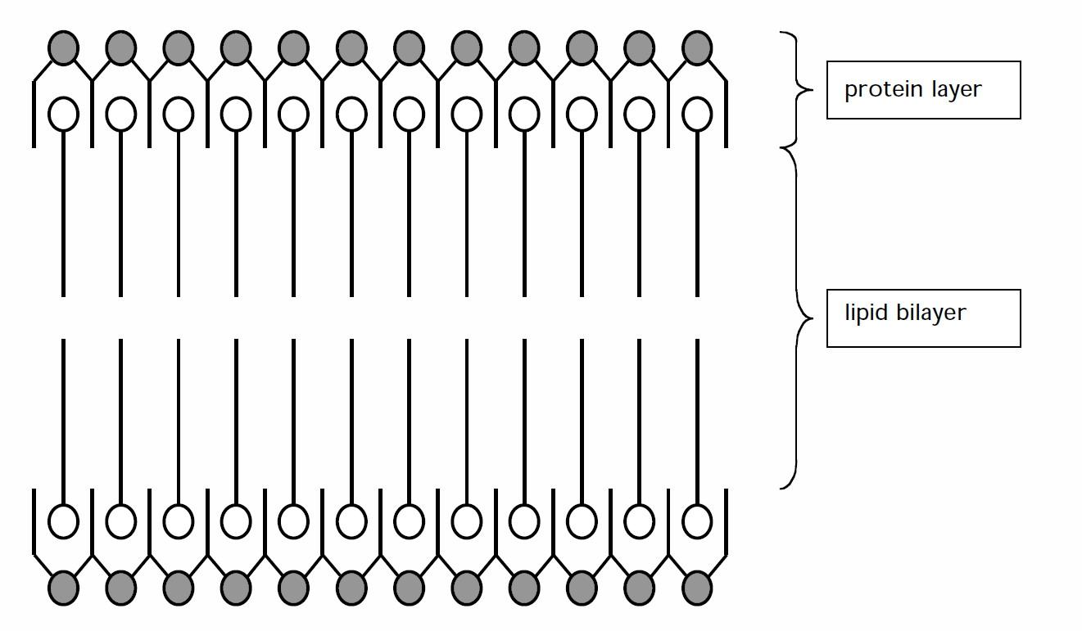
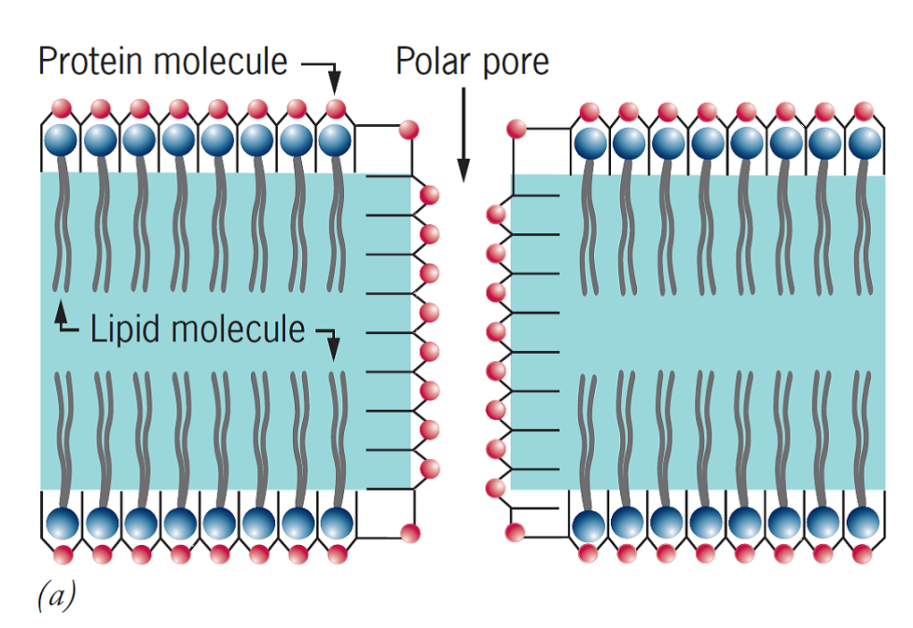
DANIELLI AND DAVSON MODEL
Danielli and Davson proposed their initial model in 1935 and refined it to the diagram below in 1954.
This did not explain how water soluble/polar substances including water were able to pass through membranes!
The model was further revised to the one on the right. This is the model I learnt at school some ten years after Singer and Nicholson proposed their fluid mosaic model. It often takes time for new ideas to filter down to school level!

Slide 14
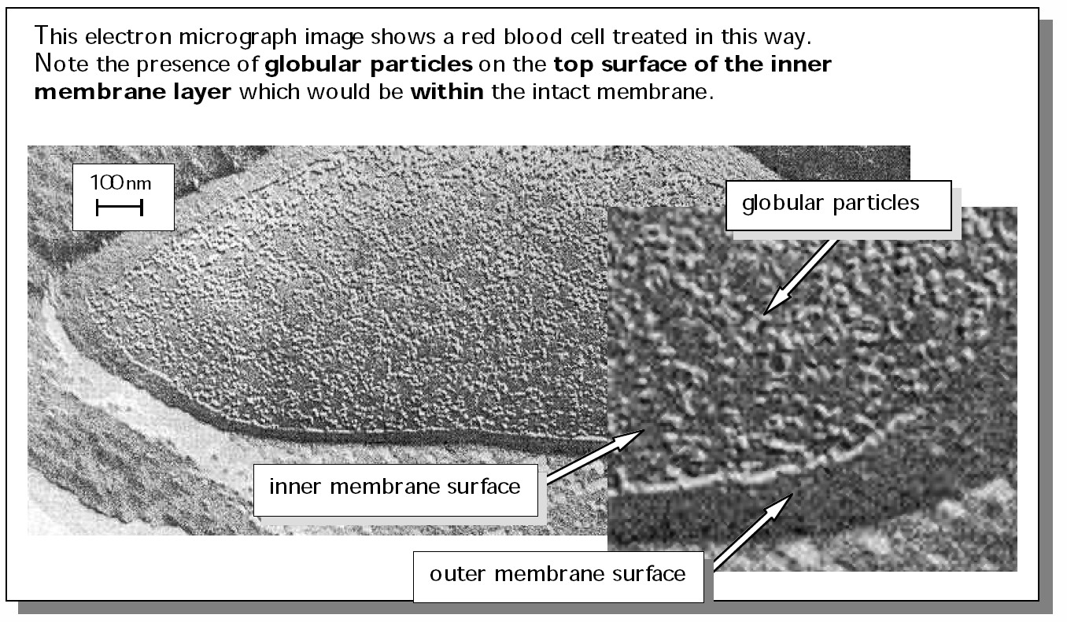
FREEZE FRACTURE ELECTRONMICROGRAPH EVIDENCE
In the freeze fracture technique, the sample is frozen and then cut with a microtome knife to split the cell. This exposes the membrane’s layered structure showing the outer and inner layers.

Slide 15
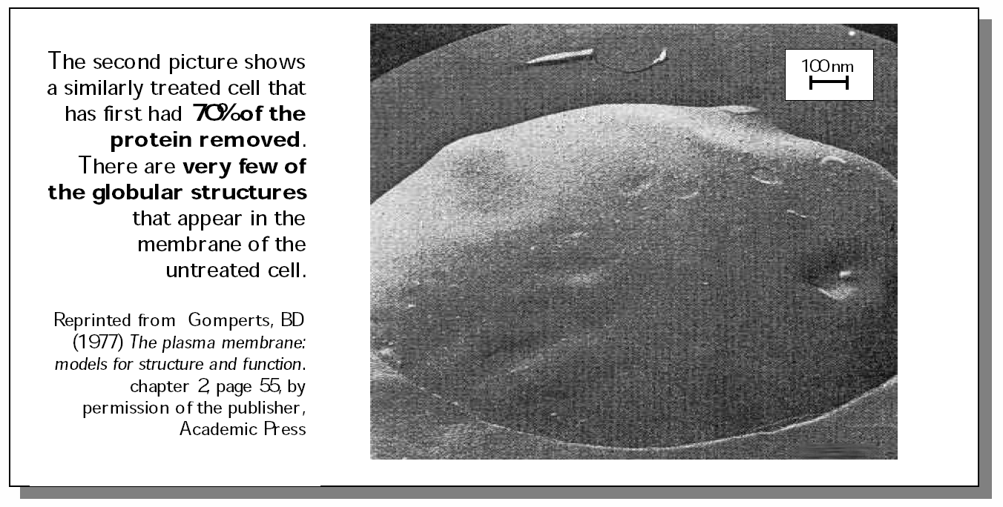
This suggested that the proteins were integral to the membrane structure and not positioned outside of the lipid bilayer, though there are additional periferal proteins. This contributed to Singer & Nicholson’s Fluid mosaic model.
Nuclear Magnetic Resonance (NMR) has shown that the lipids are moving while x-ray diffraction shows that at higher temperatures lipids give off diffraction patterns similar to those of liquid paraffins. However at low temperatures this movement is lost.
This combined evidence means that Singer and Nicholson’s model has stood the test of time!

Slide 16
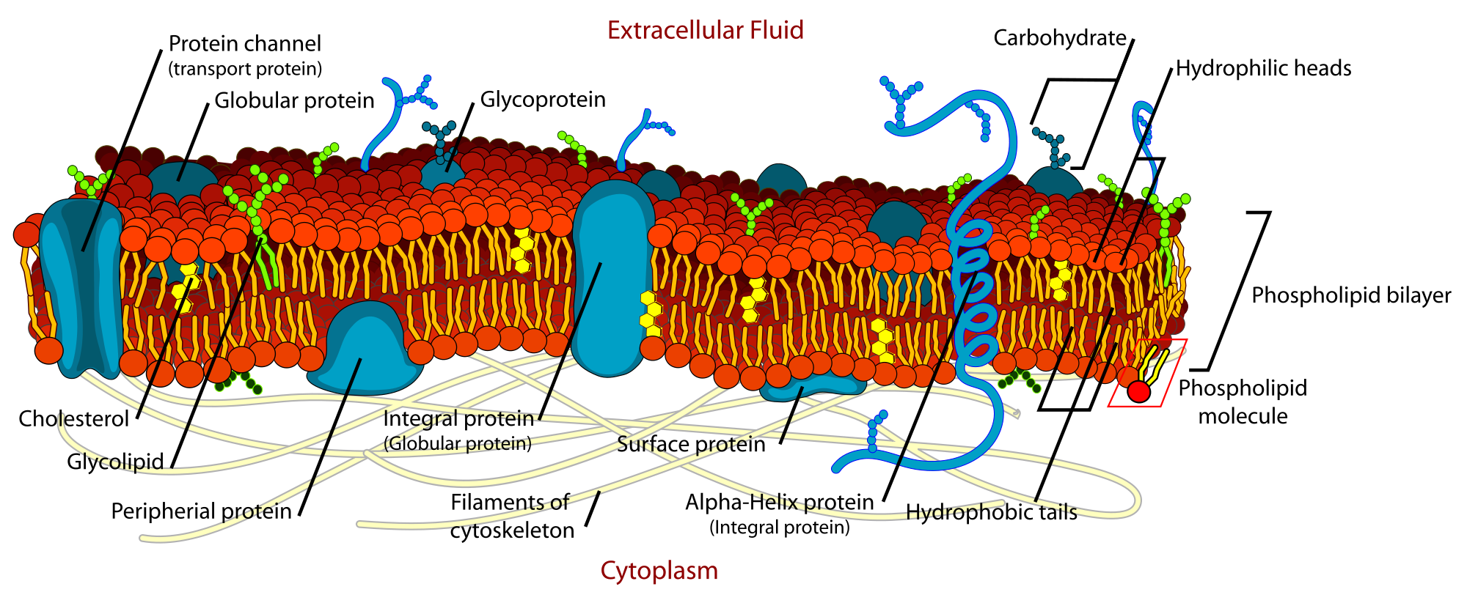
FLUID MOSAIC MODEL

Slide 17
Scientific Process
Science is the gathering and organisation of testable and reproducible knowledge. In the scientific cycle, hypothesis testing involves the gathering, recording and analysis of data, followed by the evaluation of results and conclusions. New hypotheses may then be formulated and tested.

Slide 18
Falsifiability
Discuss importance of publication of negative results in the fields of pharmaceutical or medical research, for example. Consider Karl Popper’s concept of falsifiability as the basis for scientific thinking.
Falsifiability or refutability of a statement, hypothesis, or theory is the inherent possibility that it can be proven false. A statement is called falsifiable if it is possible to conceive of an observation or an argument which negates the statement in question. In this sense, falsify is synonymous with nullify, meaning to invalidate or "show to be false".

Slide 19
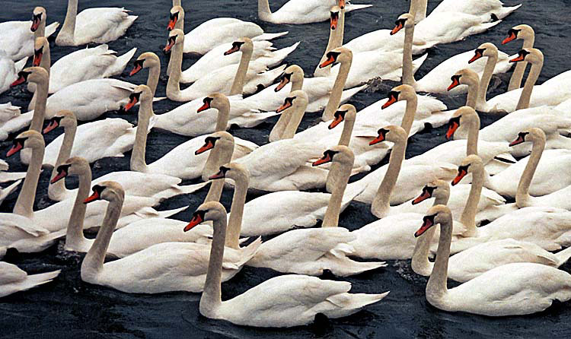
Hypothesis
All swans are white

Slide 20
Null hypothesis
Not all swans are white

Slide 21
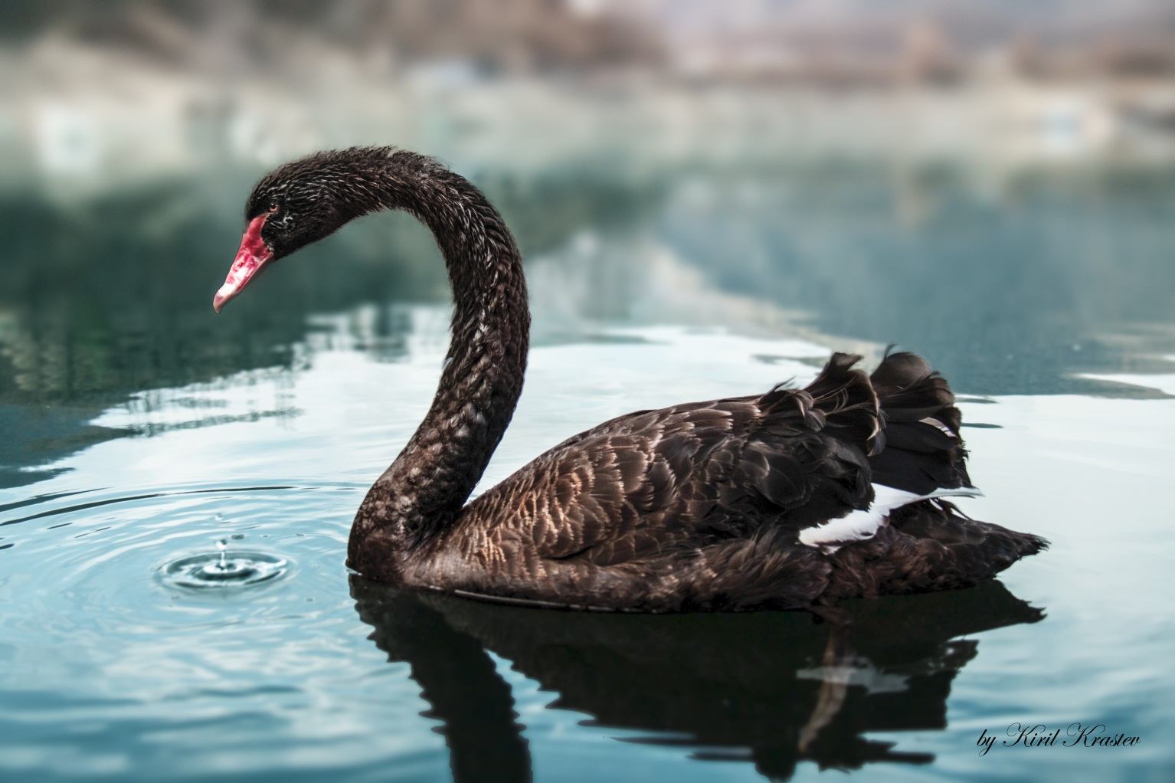
Hypothesis
All swans are white
The hypothesis is false. Evidence supports the null hypothesis

