Slide 1
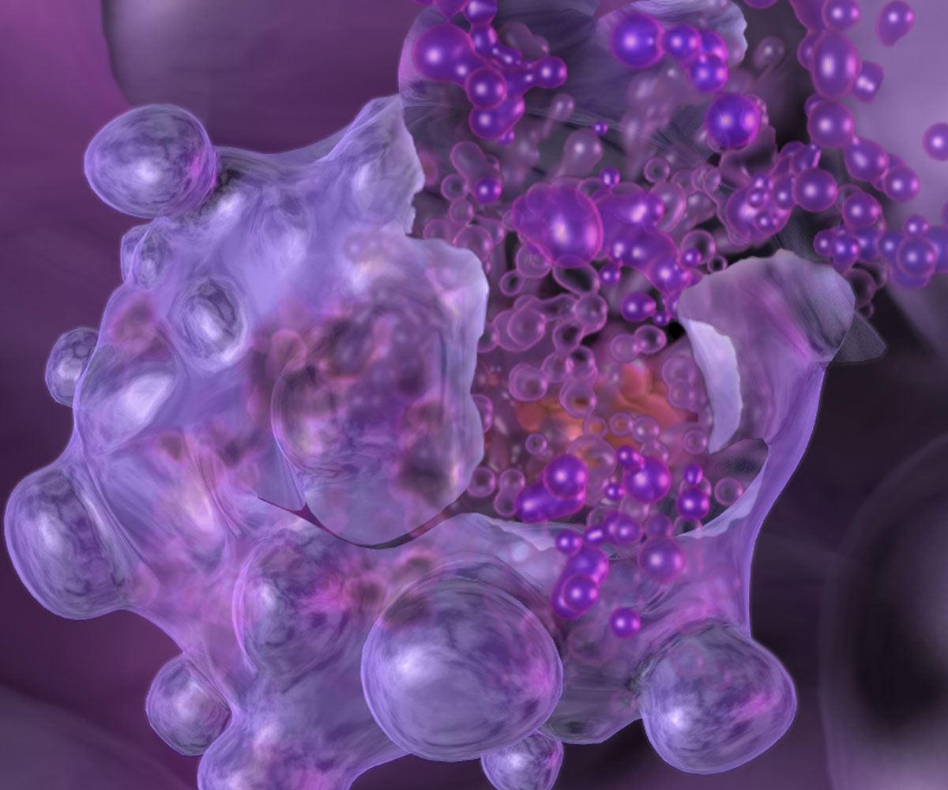
Apoptosis

Slide 2
Apoptosis
Programmed cell death (apoptosis) is triggered by cell death signals that activate inactive forms of DNAase and proteinases (caspases) that destroy the cell.

Slide 3
Apoptosis
Cell death signals may originate outwith the cell (for example from lymphocytes) and bind to a surface receptor protein to activate a protein cascade that produces active caspases.

Slide 4
Apoptosis
Death signals may also originate within the cell, for example as a result of DNA damage the presence of p53 protein can activate a caspase cascade.

