Slide 1
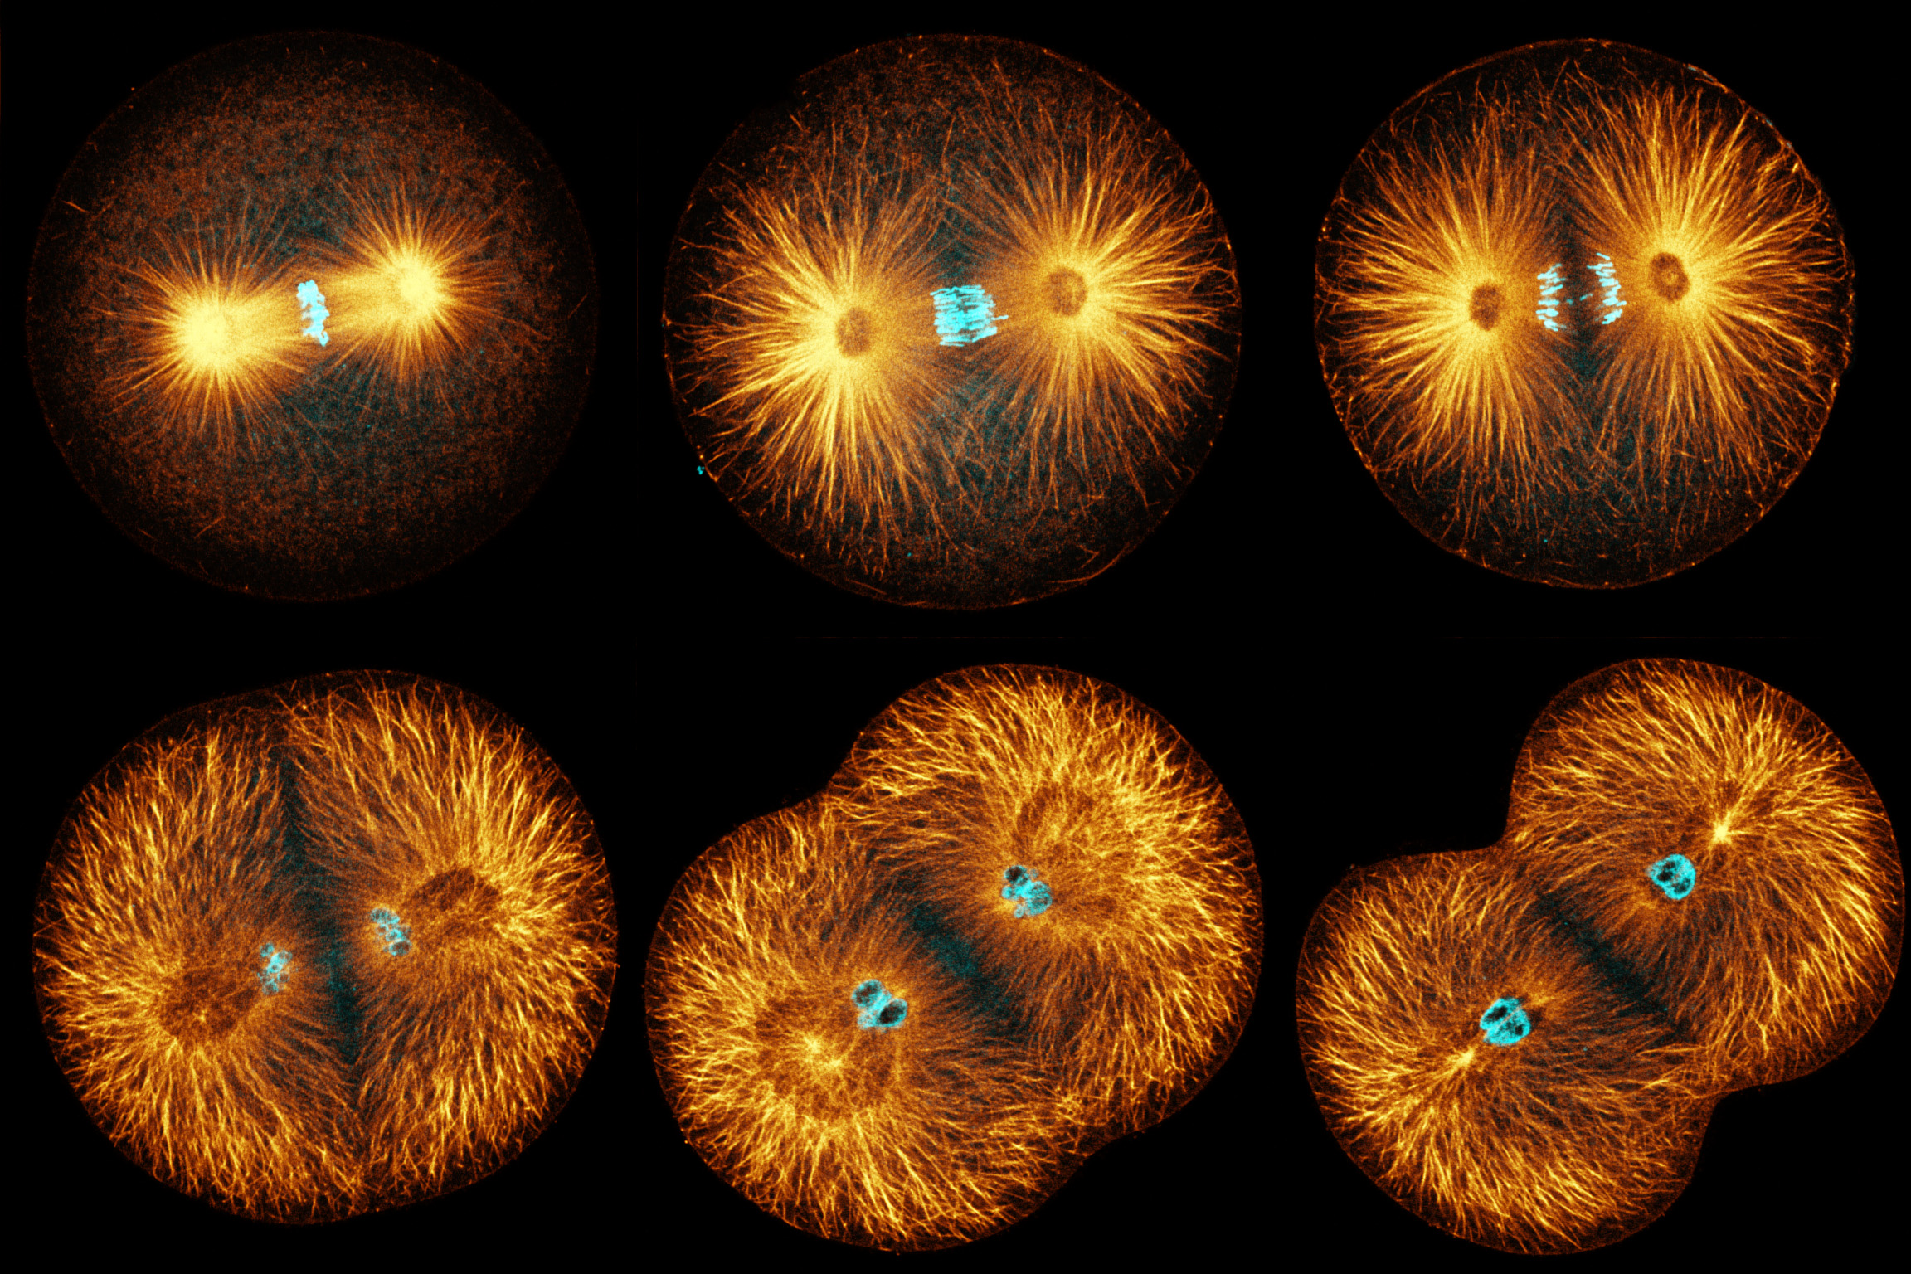
Protein control of cell division

Slide 2
Protein control of cell division
Cell division requires the remodelling of the cell’s cytoskeleton
The cytoskeleton gives mechanical support and shape to cells.
The cytoskeleton consists of different types of proteins extending throughout the cytoplasm.
Microtubules composed of hollow straight rods made of globular proteins called tubulins govern the location and movement of membrane-bound organelles and other cell components.
Microtubules are found in all eukaryotic cells and radiate from the centrosome (the microtubule organising centre).
Microtubules form the spindle fibres, which are active during cell division.

Slide 3
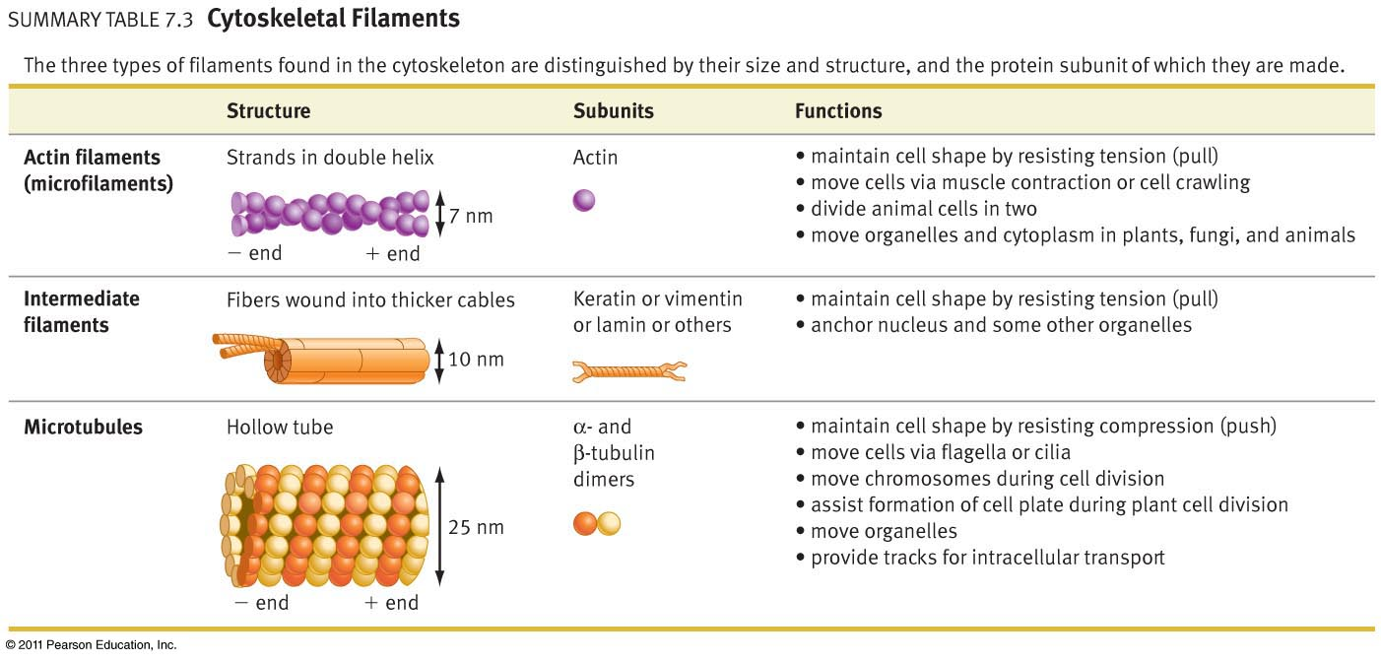
What is the cell’s cytoskeleton?

Slide 4

Protein control of cell division

Slide 5
Consider the effects of colchicine and paclitaxel on the cytoskeleton.
Eukaryotic cells contain microtubules.
They are made of subunits of globular protein called tubulin.
Growth of microtubules occurs at one end by the addition of tubulin subunits.
This process is inhibited by colchicine.
Paclitaxel is a medication used to treat a number of types of cancer.
Paclitaxel's mechanism of action involves interference with the normal breakdown of microtubules during cell division.

Slide 6
The cell cycle
The cell cycle regulates the growth and replacement of genetically identical cells
throughout the life of the organism.

Slide 7
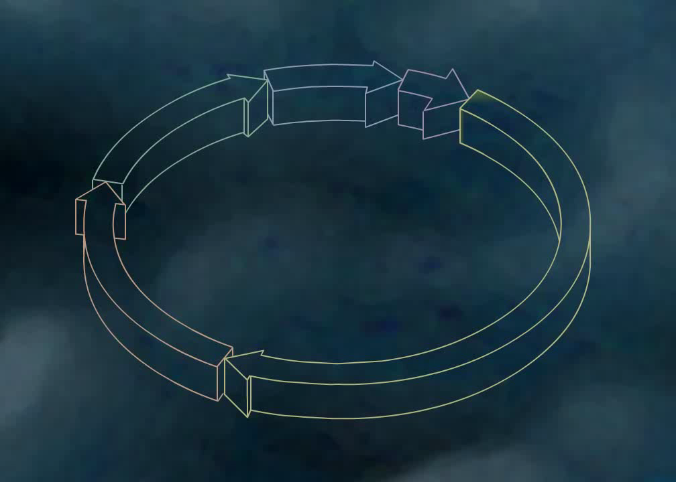
The cell cycle

Slide 8
The cell cycle
An uncontrolled reduction in the rate of the cell cycle may result in degenerative disease.
An uncontrolled increase in the rate of the cell cycle may result in tumour formation.

Slide 9
RESEARCH
How an uncontrolled reduction in the rate of the cell cycle may result in degenerative disease.
How an uncontrolled increase in the rate of the cell cycle may result in tumour formation.
Examine the role of cell cycle regulators in degenerative diseases such as Alzheimer’s and Parkinson’s.
Examine the action of chemotherapy in the treatment of cancers.

