Slide 1
Detecting and amplifying an environmental stimulus

Slide 2
Cell Signaling
In order to respond to changes in their immediate environment, cells must be able to receive and process signals that originate outside their borders.
But cells aren't just targets. They also send out messages to other cells both near and far.

Slide 3
What Kind of Signals Do Cells Receive?
Most cell signals are chemical in nature. For example, prokaryotic organisms have sensors that detect nutrients and help them navigate toward food sources. In multicellular organisms, growth factors, hormones, neurotransmitters, and extracellular matrix components are some of the many types of chemical signals cells use. These substances can exert their effects locally, or they might travel over long distances.

Slide 4
How Do Cells Recognize Signals?
Cells have proteins called receptors that bind to signaling molecules and initiate a physiological response. Different receptors are specific for different molecules. Dopamine receptors bind dopamine, insulin receptors bind insulin, nerve growth factor receptors bind nerve growth factor, and so on. In fact, there are hundreds of receptor types found in cells, and varying cell types have different populations of receptors. Receptors can also respond directly to light or pressure, which makes cells sensitive to events in the atmosphere. Receptors are generally transmembrane protein

Slide 5
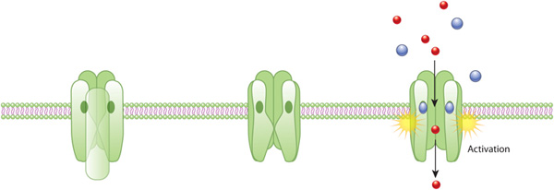
How Do Cells Recognize Signals?
An acetylcholine receptor (green) forms a gated ion channel in the plasma membrane. This receptor is a membrane protein with an aqueous pore, meaning it allows soluble materials to travel across the plasma membrane when open. When no external signal is present, the pore is closed (center). When acetylcholine molecules (blue) bind to the receptor, this triggers a conformational change that opens the aqueous pore and allows ions (red) to flow into the cell.

Slide 6
How Do Cells Respond to Signals?
Once a receptor protein receives a signal, it undergoes a conformational change, which in turn launches a series of biochemical reactions within the cell. These intracellular signaling pathways, also called signal transduction cascades, typically amplify the message, producing multiple intracellular signals for every one receptor that is bound.

Slide 7
How Do Cells Respond to Signals?
Activation of receptors can trigger the synthesis of small molecules called second messengers, which initiate and coordinate intracellular signaling pathways. For example,cyclic AMP (cAMP) is a common second messenger involved in signal transduction cascades. (In fact, it was the first second messenger ever discovered.) cAMP is synthesized from ATP by the enzyme adenylyl cyclase, which resides in the cell membrane. The activation of adenylyl cyclase can result in the manufacture of hundreds or even thousands of cAMP molecules. These cAMP molecules activate the enzyme protein kinase A (PKA), which then phosphorylates multiple protein substrates by attaching phosphate groups to them. Each step in the cascade further amplifies the initial signal

Slide 8
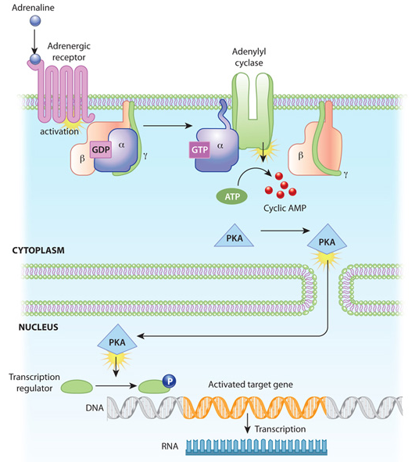
The binding of adrenaline to an adrenergic receptor initiates a cascade of reactions inside the cell. The signal transduction cascade begins when adenylyl cyclase, a membrane- bound enzyme, is activated by G-protein molecules associated with the adrenergic receptor. Adenylyl cyclase creates multiple cyclic AMP molecules, which fan out and activate protein kinases (PKA, in this example). Protein kinases can enter the nucleus and affect transcription.

Slide 9
How Do Signals Affect Cell Function?
Protein kinases such as PKA and PKC catalyze the transfer of phosphate groups from ATP molecules to protein molecules. Within proteins, the amino acids serine, threonine, and tyrosine are especially common sites for phosphorylation. These phosphorylation reactions control the activity of many enzymes involved in intracellular signaling pathways. Specifically, the addition of phosphate groups causes a conformational change in the enzymes, which can either activate or inhibit the enzyme activity. Then, when appropriate, protein phosphatases remove the phosphate groups from the enzymes, thereby reversing the effect on enzymatic activity.

Slide 10
Conclusion
Cells typically receive signals in chemical form via various signalling molecules. When a signalling molecule joins with an appropriate receptor on a cell surface, this binding triggers a chain of events that not only carries the signal to the cell interior, but amplifies it as well. Cells can also send signaling molecules to other cells. Some of these chemical signals — including neurotransmitters — travel only a short distance, but others must go much farther to reach their targets.

