Slide 1
GENETICS
The patterns of inheritance from generation to generation

Slide 2
Learning objectives
Understand and define the terms used in genetics
Distinguish between dominant and recessive alleles
Deduce the characteristics resulting from different genotypes
Use a Punnet square to predict the outcomes of different genetic crosses

Slide 3
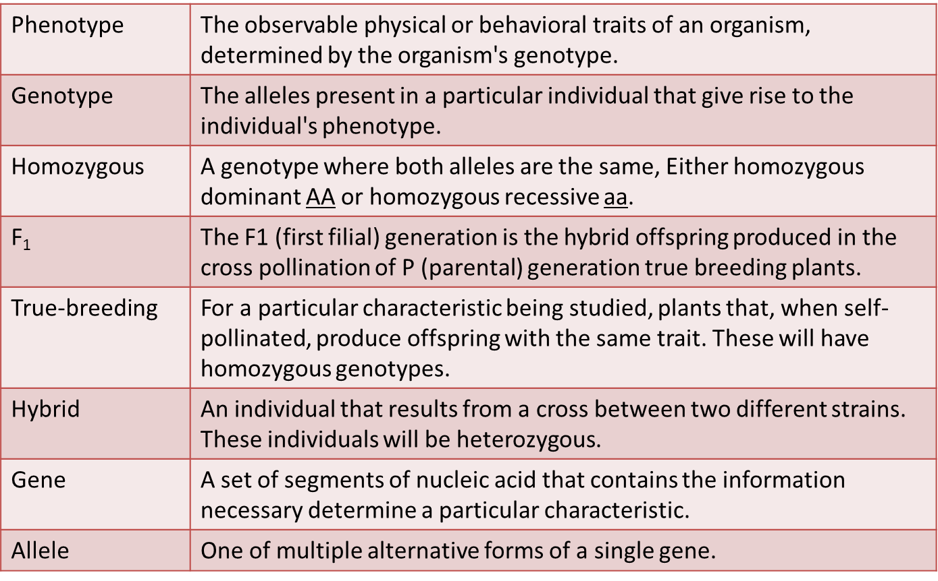
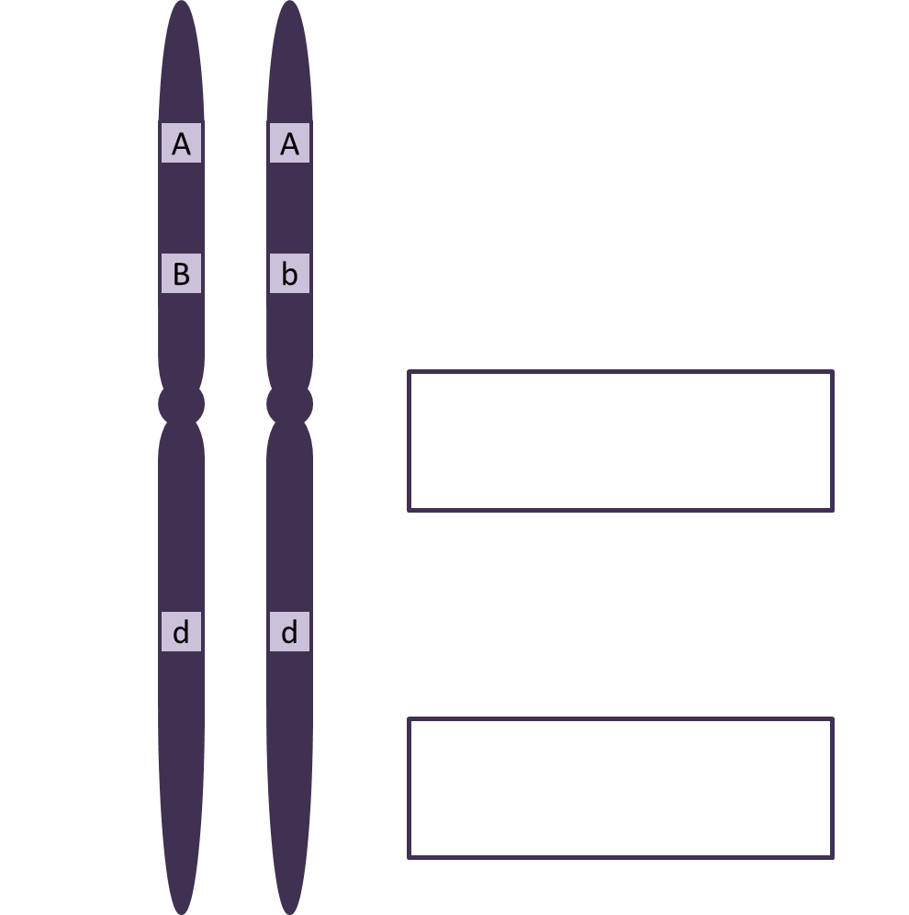
Glossary

Slide 4
Glossary
True Breeding
Allele
Gene
Genotype
Phenotype
Hybrid
Homozygous
F₁
 | The observable physical or behavioral traits of an organism, determined by the organism's genotype.
 | The alleles present in a particular individual that give rise to the individual's phenotype.
 | A genotype where both alleles are the same, Either homozygous dominant AA or homozygous recessive aa.
 | The F1 (first filial) generation is the hybrid offspring produced in the cross pollination of P (parental) generation true breeding plants.
 | For a particular characteristic being studied, plants that, when self-pollinated, produce offspring with the same trait. These will have homozygous genotypes.
 | An individual that results from a cross between two different strains. These individuals will be heterozygous.
 | A set of segments of nucleic acid that contains the information necessary determine a particular characteristic.
 | One of multiple alternative forms of a single gene.

Slide 5
Genotypes
A genotype is represented by two letters because chromosomes are found in pairs
Consider the example of freckles: Let A be the allele for no freckles and a be the allele for freckles
Which allele is dominant?
Complete the table
Genotype | Shown as: | Characterisitics
Homozygous dominant |  | No freckles
Heterozygous | Aa
 | aa | freckles

Slide 6
Link

Slide 7
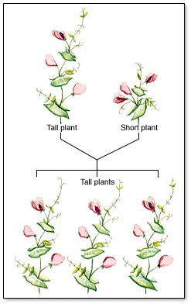
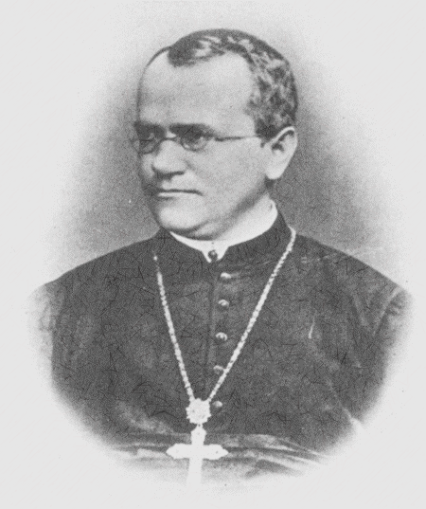
Monohybrid Inheritance in Pea Plants
When Gregor Mendel crossed true-breeding tall plants with true-breeding short plants, the resulting offspring were all tall. These are the F₁ plants.
It is clear from this that the allele for tall is dominant over the allele for short, so we will assign the letter T for tall and t for short.

Slide 8
Genetic Diagram
Give the phenotypes
Show the genotypes
Write out the gametes
Draw a Punnet square
State the ratios
Tall
Short
TT
tt
T
T
t
t
pollen
T
t
ova
T
Tt
Tall
t
Tt
Tall
Tt
Tall
All tall plants
Tt
Tall

Slide 9
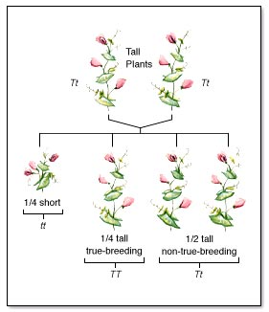
Monohybrid Inheritance in Pea Plants
When he self-crossed the F₁ plants, the resulting F₂ pea plants were a mixture of tall and short plants in approximately a 3 tall:1 short ratio.
Similar ratios were obtained when studying other pea characteristics.

Slide 10
Genetic Diagram
Give the phenotypes
Show the genotypes
Write out the gametes
Draw a Punnet square
State the ratios
Tall
Tall
Tt
Tt
T
t
T
t
pollen
T
T
ova
t
TT
Tall
t
Tt
Tall
Tt
Tall
3 Tall: 1 Dwarf
tt
Dwarf

Slide 11
Learning Objectives
Use counters to determine the outcomes of genetic crosses
Show the importance of there being a large number of offspring in obtaining reliable genetic ratios
Distinguish between homozygous and heterozygous
Suggest possible genotypes for dominant and recessive phenotpes
Use punnet squares to determine phenotypic ratios
Give the genotypic and phenotypic outcomes as percentages

Slide 12
Crossing Tt with Tt (Two tall pea plants)
Egg | Sperm | Genotype | Phenotype

Slide 13
Crossing Tt with Tt (Two tall pea plants)
Group | Tall | Short
1 | 16 | 4
2 | 13 | 7
3 | 15 | 5
4 | 15 | 5
5 | 13 | 7
Totals | 72 | 28
This gives an approximate ratio of:

Slide 14
Crossing Tt with tt (Tall vs short)
Egg | Sperm | Genotype | Phenotype

Slide 15
Crossing Tt with tt (Tall vs short)
Group | Tall | Short
1
2
3
4
5
Totals
This gives an approximate ratio of:

Slide 16
Crossing Tt with tt (Tall vs short)
Parent 1 | Parent 2 | Ratio
Tall TT | Tall TT | All tall TT
Tall TT | Tall Tt | All tall TT/Tt
Tall TT | Short tt | All tall Tt
Tall Tt | Tall Tt | 3 tall : 1 short
Tall Tt | Short tt | 1 Tall : 1 short
Short tt | Short tt | All short tt
If we know the genotypes of the parents we can predict the ratios of the offspring
By looking at the phenotypic ratios of the offspring, we can deduce (work out) the genotypes of the parents

