Slide 1
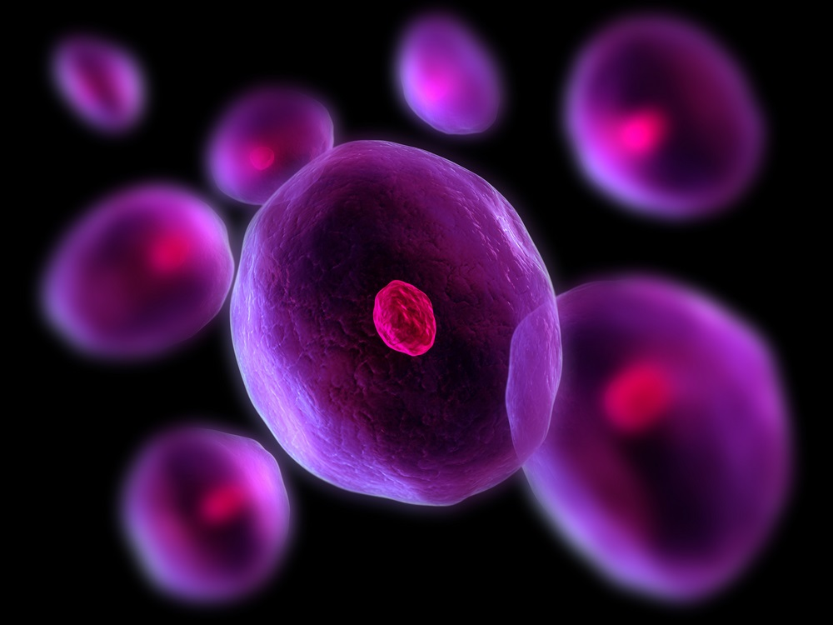
Cells
GHS S1

Slide 2
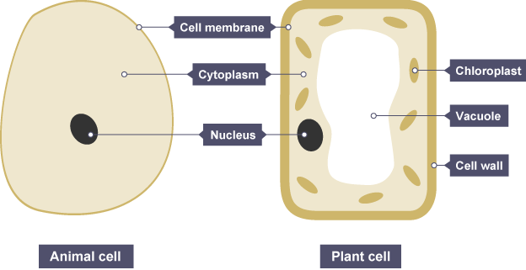
Cell Structure

Slide 3
Page
1
2
3
4
5
Cell Parts
Part | Function | Found in
Cell membrane | Controls what substances can get into and out of the cell. | Plant and animal cells
Cytoplasm | Jelly-like substance, where chemical reactions happen. In plant cells there's a thin lining, whereas in animal cells most of the cell is cytoplasm. | Plant and animal cells
Nucleus | Controls what happens inside the cell. Carries genetic information. | Plant and animal cells
Chloroplast | Where photosynthesis happens – chloroplasts contain a green substance called chlorophyll. | Plant cells only
Vacuole | Contains a liquid called cell sap, which keeps the cell firm. | Plant cells only
Cell wall | Made of a tough substance called cellulose, which supports the cell. | Plant cells only

Slide 4
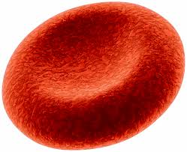
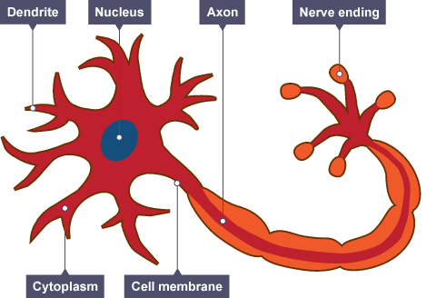
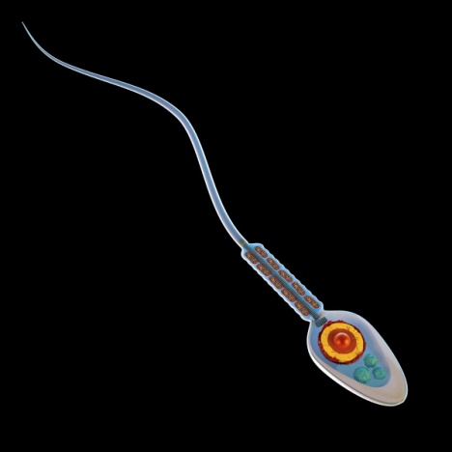
Types of Animal Cells
Large surface area, for oxygen to pass through
Contains haemoglobin, which joins with oxygen
Long
Connections at each end
Can carry electrical signals
red blood cell
Long tail for swimming
Head for getting into the female cell
nerve cell
sperm cell

Slide 5
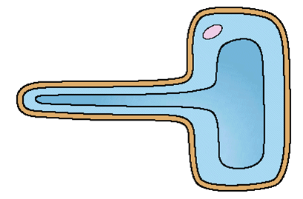
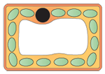
Types of Plant Cells
Hollow tubes to transport water
Large surface area to absorb water
root hair cell
Lots of chloroplasts to absorb light for photosynthesis
xylem
pallisade cell

