Slide 1
Selective breeding
Feeding the world and raising profits
Notes:
Grasslands
(Basic)
Note: This template is optimized for PowerPoint 2010 and uses a video background. If used in PowerPoint 2007, video elements will play, but all content will be covered by video background when in slideshow. If used in PowerPoint 2003, video will not play, but the poster frame of the videos will remain in place as a static image.
The video:
Plays automatically after each slide transition.
Is 30 seconds long.
Seamlessly loops for infinite playback.
To add slides or change layout, do the following:
To add a new slide, on the Home tab, in the Slides group, click the arrow under New Slide, then click under Motion Background Theme select the desired layout.
To change the layout of an existing slide, on the Home tab, in the Slides group, click Layout, then select the desired layout.
This template uses the “Pushpin” Theme Font. To access or change the Theme Font, do the following:
On the View tab in the Master Views group, select Slide Master.
In the Slide Master view, select slide 1 (the Master Slide for Master Layouts that use the video background).
On the Slide Master tab, in the Edit Theme group, click Fonts, and then select new theme fonts.
Using animated elements:
Any animated element will begin after the slide transition and the background video has started.

Slide 2
Learning objectives
Explain the process of selective breeding
Give examples of how plants and animals of agricultural importance have been altered to suit our needs.

Slide 3
Outline
CATTLE
PIGS
SHEEP
POULTRY
HORSES
MAIZE
WHEAT
POTATOES
TOMATOES
BEETROOT

Slide 4
Outline
CATTLE
PIGS
SHEEP
POULTRY
HORSES
MAIZE
WHEAT
POTATOES
TOMATOES
BEETROOT
What are each of the domesticated animals bred for?
How was it achieved?

Slide 5
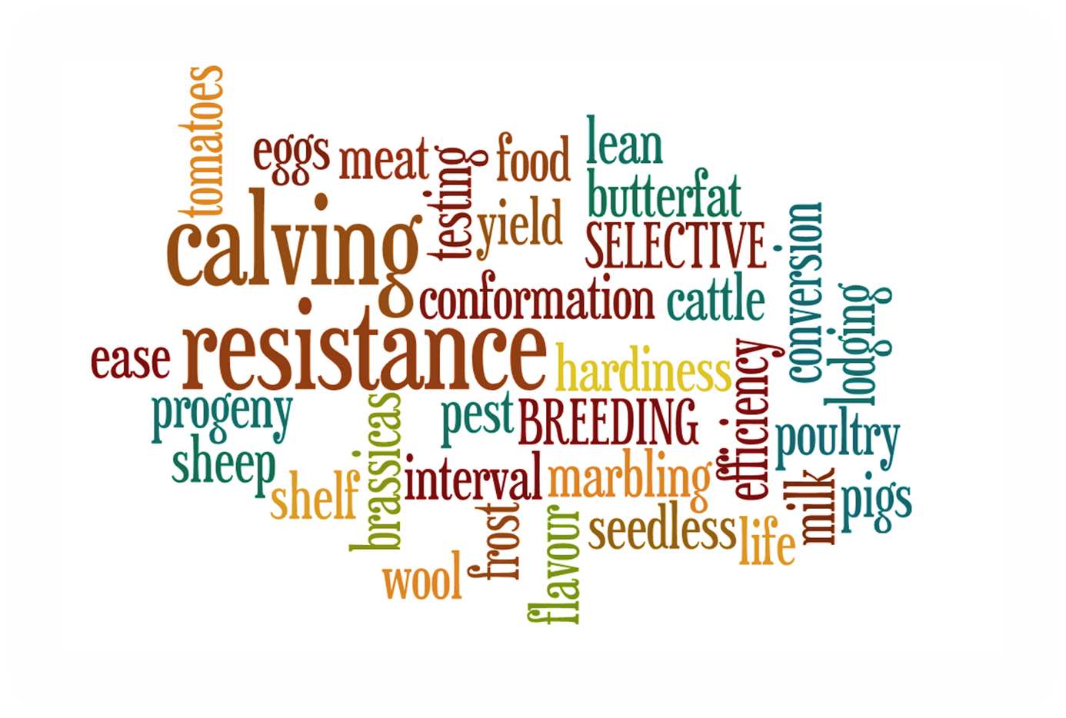

Slide 6
Selective Breeding

Slide 7
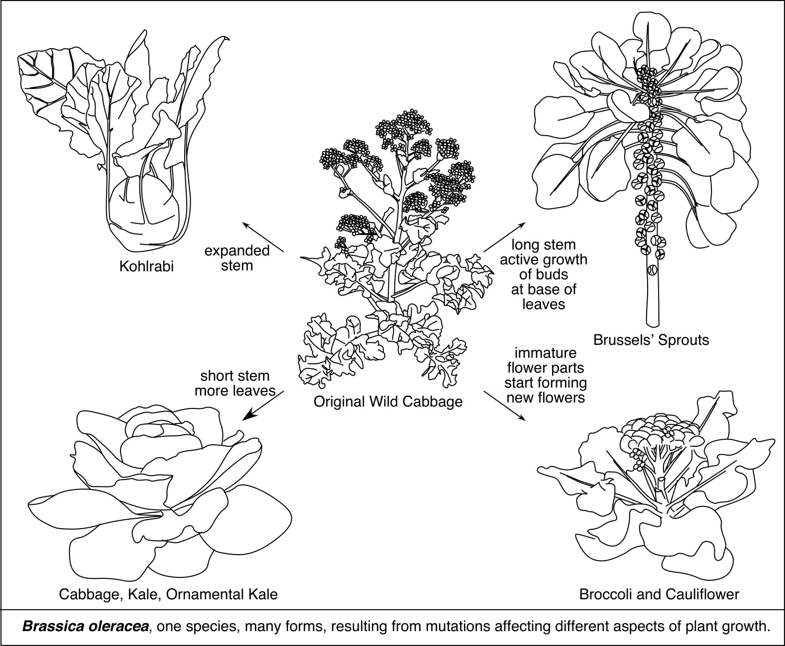
Selective Breeding of the Cabbage Plant
This has taken place over many generations to produce plants with different nutritional benefits.

Slide 8
Selective breeding
Higher yield per unit area
Faster maturation allowing more than one crop during the growing season
Improved nutritional value
Resistance to frost
Drought resistance
Pest resistance
Reduced lodging
Resistance to herbicide
Selective Breeding of crops

Slide 10
Example – Conqueror wheat
High yield
Vigorous when sown late – quick to get going in spring
Resistant to Orange Wheat Blossom Midge (OWBM)

Slide 11
Example – King Edward Potatoes
King Edwards are not particularly prolific in terms of yield, but many people still grow them for their floury texture and their taste

Slide 12
Task
Photocopied sheets “In search of useful plants”
Read and answer questions 2, 5 & 6
Copy and complete “What you need to remember”.

Slide 13
Learning objectives
Explain the process of selective breeding
Give examples of how plants and animals of agricultural importance have been altered to suit our needs.

Slide 14
Selective Breeding

Slide 15
Example – Belgian Blue
Fast maturing
High yield (double muscling)
Difficulty of calving, often requiring a caesarean.

Slide 16
Example – Aberdeen Angus
Hardiness
High quality meat
Lower fat
Slow maturing

Slide 17
Example – Dorset Horn
High lambing rate
High yield
Not particularly hardy

Slide 18
Example – Scottish Blackface
Quality meat
Slow maturing
Very hardy

Slide 19
Example – Zwartbles
Producing milk
Quality meat
Good wool

Slide 20
Example – Large White
Quality meat
Good conformation (long shape with big rumps
Usually crossed with Landrace

Slide 21
Task
Photocopied sheets “Breeding the cattle we want”
Read and answer questions 3, 4 & 5
Copy and complete “What you need to remember”.

Slide 22
Learning Objectives
Outline the basic principles of genetic engineering
Give an example of genetic modification, explaining it’s benefits to mankind

Slide 24
Genetic Modification

Slide 25
Genetic Modification

Slide 26
Genetic Modification

Slide 27
Biotechnology marketplace
Student research activity

Slide 28
MARKET PLACE
Work in pairs.
Choose a genetically modified organism.
Explain how the organism has been modified.
What qualities does the breed or variety have?
What are the benefits to mankind or the farmer?
Why should the customer buy your product?

Slide 29
Transgenic cows for pharming
Flavr Savr tomatoes
Humulin
Transgenic pigs for xenotransplantation
Golden Rice
Bt Maize
Glofish
Roundup Ready Soybean
Banana vaccines
Enviropigs

Slide 30
MARKET PLACE
Decide who in the pair is going to be the seller and who the buyer.
The sellers stay at their tables.
The buyers move from desk to where the sellers explain the merits of their genetically modified organism. (2mins for each station).
The buyer becomes the seller and vice versa.

Slide 31
Quiz
Write the title quiz and date.
Write the numbers 1-10 down the margin.
Answer the questions.

Slide 32
QUIZ
Where in one of a body's cells are chromosomes found?
The nucleus
The cell wall
The cell membrane

Slide 33
QUIZ
What is genetic information carried by?
Lipids
DNA
Complex sugars

Slide 34
QUIZ
What sort of organisms can be genetically engineered?
Plants only
Animals only
Plants and animal

Slide 35
QUIZ
Which best describes genetic engineering?
Removal of a gene
Transfer of a gene between species
Altering DNA using x-rays

Slide 36
QUIZ
What does “GM” stand for in “GM crops”.
General motors
Genetic mutation
Genetically modified

Slide 37
QUIZ
Which is the result of selective breeding?
Highland Cattle
Spider Goats
Arctic Apples

Slide 38
QUIZ
Which of the following is a genetically modified organism?
King Edward Potato
Arctic King Lettuce
Flavr Savr Tomato

Slide 39
QUIZ
What is the meaning of “enucleated”?
To blow up with a big bomb
To remove the nucleus from a cell
To insert a nucleus into a cell

Slide 40
QUIZ
Which statement is true about spider goats?
They have eight legs
They only appear in comic books
They produce the spider web protein in their milk

Slide 41
QUIZ
How are Arctic Apples different to other apples?
They grow in very cold conditions
They do not turn brown when cut
They need to be transported on large lorries

Slide 42
Presentation
LESS-FLATULENT COWS
Title page - Give an example of genetic modification
Explain how the GM organism was developed was developed
State the benefits
Poster advertising your GM product
MEDICINAL EGGS
FLAVR SAVR TOMATO
Bt Maize
BANANA VACCINES
ARCTIC APPLES
GLOFISH
HUMULIN
SPIDER GOATS
ENVIROPIG

Slide 43
Cloning
At the end of this lesson you will be able to:
Explain why cloning can be of value
Describe how Dolly the sheep was produced
List some of the existing concerns about cloning

Slide 44
Cloning

Slide 45
Cloning

Slide 46
For
Normal breeding gives unpredictable results. Cloning gives a known genetic result.
A “supercow” can be cloned to produce more “supercows”. This will help to solve the world’s food problems and strengthens a nations economy.

Slide 47
Against
At least 95% of mammalian cloning experiments have resulted in failures.
Cloning is viewed as “playing God” by not allowing the normal random mixing of genes.
Cloning technology could be used to clone humans. Who should be cloned?

Slide 48
I think I’m a clone now

