Slide 1
Measuring and recording animal behaviour
AH Biology

Slide 2
Ethograms
An ethogram is a catalogue or inventory of behaviours or actions exhibited by an animal used in ethology. The behaviours in an ethogram are usually defined to be mutually exclusive and objective, avoiding subjectivity and functional inference as to their possible purpose.

Slide 4
Ethograms
An ethogram of the behaviours of a species in the wild context allows the construction of time budgets.
Sea lion Time Budget

Slide 5
Time Budgets
Time Budgets (or energy budgets) can be derived from focal studies. A time budget indicates the amount or proportion of time that animals spend in different behaviours, or in performing different classes of behaviour. To construct a time budget, you must add the time spent on each behaviour for each individual squirrel. Then calculate the proportion of time spent on particular behaviours, out of the total observation time. When you are able to observe several different individuals, then each individual can be a "replicate" or independent estimate of time allocation to the behaviour of interest. You summarize your data by doing a time budget for each individual, then calculating mean values for each behavioural measure of interest.

Slide 6
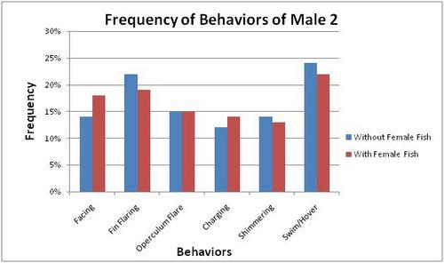
Measurements
Frequency
How often a behaviour occurs within a given time

Slide 7
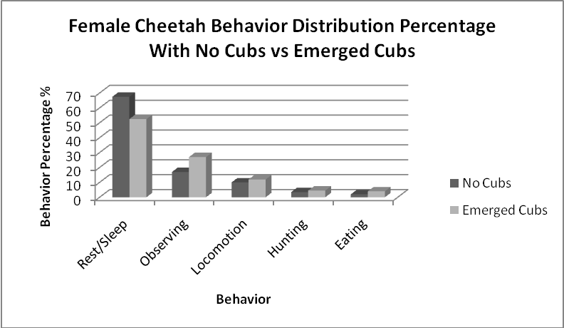
Measurements
Duration
How long the behaviour lasts for

Slide 8
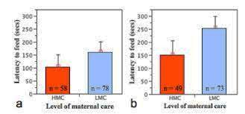
Measurements
Latency
Latency recording is a d type of duration recording that involves an observer measuring how long it takes for a behaviour to begin after a specific verbal demand or event has occurred.

Slide 9
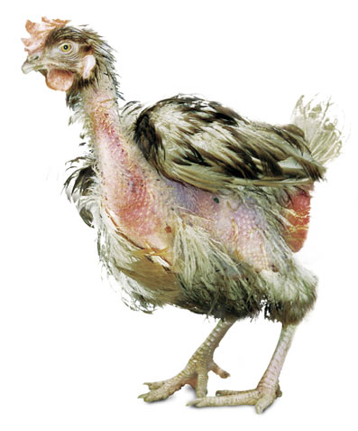
Applications
The effects of animal husbandry e.g. feather pecking and cannibalism.
Investigating the effects of isolation on aggressive behaviours using model organisms.

Slide 11
Anthropomorphisms
anthropomorphism definition. (an-thruh-puh-mawr-fiz-uhm) The attributing of human characteristics and purposes to inanimate objects, animals, plants, or other natural phenomena, or to God.

Slide 12
Anthropomorphisms
anthropomorphism definition. (an-thruh-puh-mawr-fiz-uhm) The attributing of human characteristics and purposes to inanimate objects, animals, plants, or other natural phenomena, or to God.
AVOID!

