Slide 1
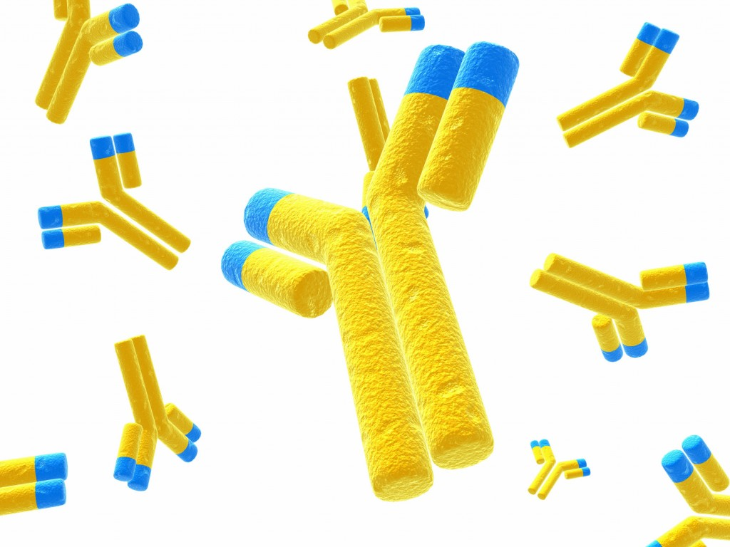
Monoclonal Antibodies
NIS Uralsk

Slide 2
Medical use of Antibodies
Monoclonal antibodies (mAbs) are pure, single antibody types that are industrially produced.
Clones of one type of immune cell.Typical production:
Monoclonal antibodies = Tumour (cancer) cells + antigen immunized mouse spleen cells.
Monoclonal antibodies can be used for diagnostic tests, treatment and research.

Slide 3
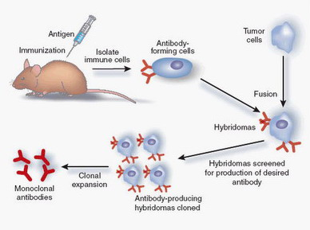
Production of Monoclonal Antibodies

Slide 5
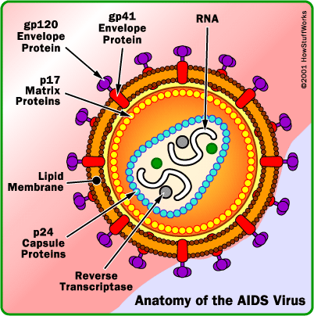
Diagnostics
In an ELISA test, a person's serum is diluted and applied to a plate to which HIV antigens have been attached. If antibodies to HIV are present in the serum, they may bind to these HIV antigens.
A second enzyme linked antibody that binds to human antibodies is then applied to the plate, followed by another wash. The plate will contain enzyme in proportion to the amount of secondary antibody bound to the plate.
Chromagen is applied and if present the enzyme linked to the antibody catalyses a colour change.
ELISA results are reported as a number depending on the intensity of the colour change.
Monoclonal antibody
HIV antigen
Chromagen
Enzyme linked antibody
If positive:

Slide 7
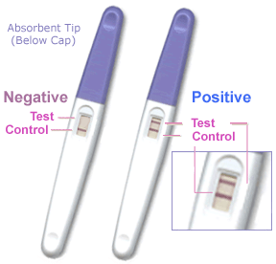
Pregnancy Testing Kits
The pregnancy tests on the market today are manufactured with monoclonal antibodies that detect minute traces of HCG* in the woman’s urine.
When the tester is dipped in the woman’s urine, a control line appears and if the woman is pregnant a second line will appear. This second line is caused when the HCG in the urine reacts with the monoclonal antibodies, creating a distinct colour change. The colour of this line will vary in intensity based on how much HCG is in the urine.
*HCG = Human Chorionic Gonadotrophin which is produced in the placenta

Slide 8
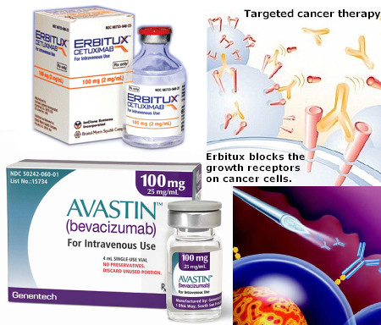
Medical Treatments Using Monoclonal Antibodies
Can be used to reduce transplant rejection.
Rheumatoid arthritis therapy.
Cancer treatment: Cancer cells can be targeted by monoclonal antibodies if they bind to specific cancer antigens and target those cells for destruction.

Slide 9
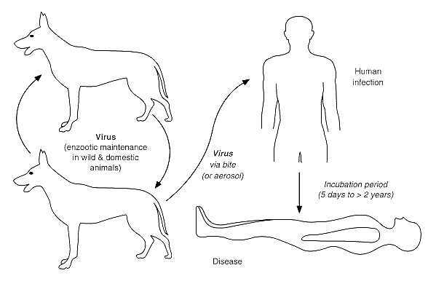
Treatment of Rabies
Rabies infection can be quickly an effectively treated by the direct injection of antibodies
The antibodies are synthesised by monoclonal antibody technology
This is an effective treatment for a very serious infection.

Slide 10
Links:
http://www.accessexcellence.org/RC/VL/GG/monoclonal.php
http://www.sumanasinc.com/webcontent/animations/content/monoclonalantibodies.html
http://www.mayoclinic.com/health/monoclonal-antibody/CA00082
http://en.sevenload.com/shows/Digital-Health-Network/episodes/wogeamQ-Monoclonal-Antibodies
http://www.youtube.com/watch?v=hjDPCoj4ElA
http://nature.com/focus/antibodies/index.htm

