Slide 1
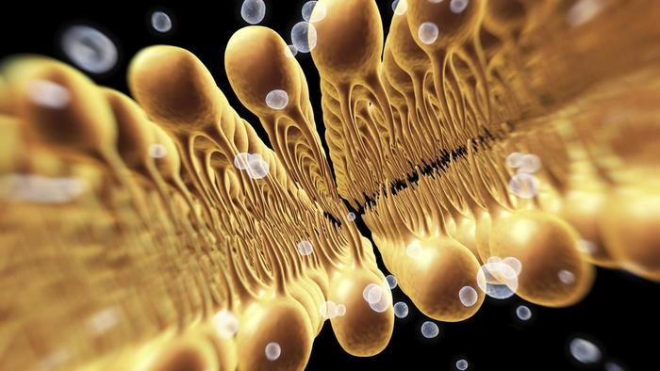
Cell Membranes
IGCSE

Slide 2
Cell membrane structure

Slide 3
Cell membrane structure

Slide 4
Transport across membranes
ACTIVE
TRANSPORT
DIFFUSION

Slide 5
Sodium-potassium pumps
Three sodium ions out and two potassium ions in using ATP

Slide 6
The effect of heat on cell membranes
Beetroot contains betalains

Slide 7
The effect of heat on cell membranes
BETALAINS

Slide 8
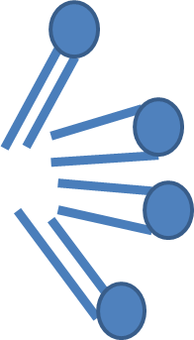
Heat disrupts the cell membranes and the betalains escape
BETALAINS

Slide 9
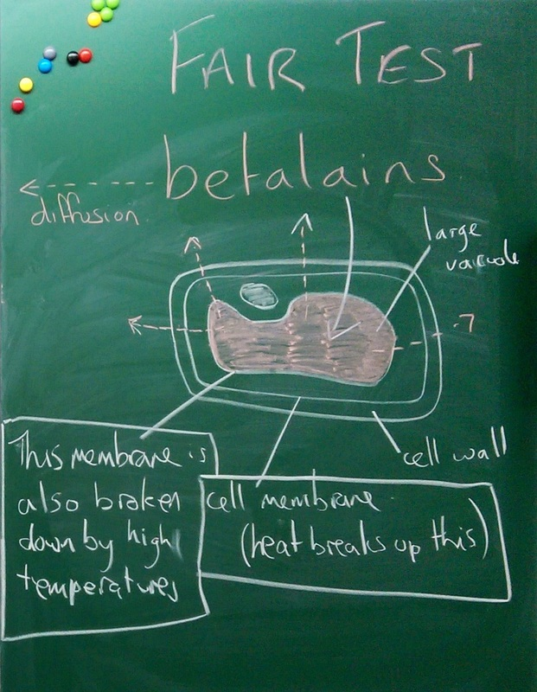

Slide 10
