Slide 1
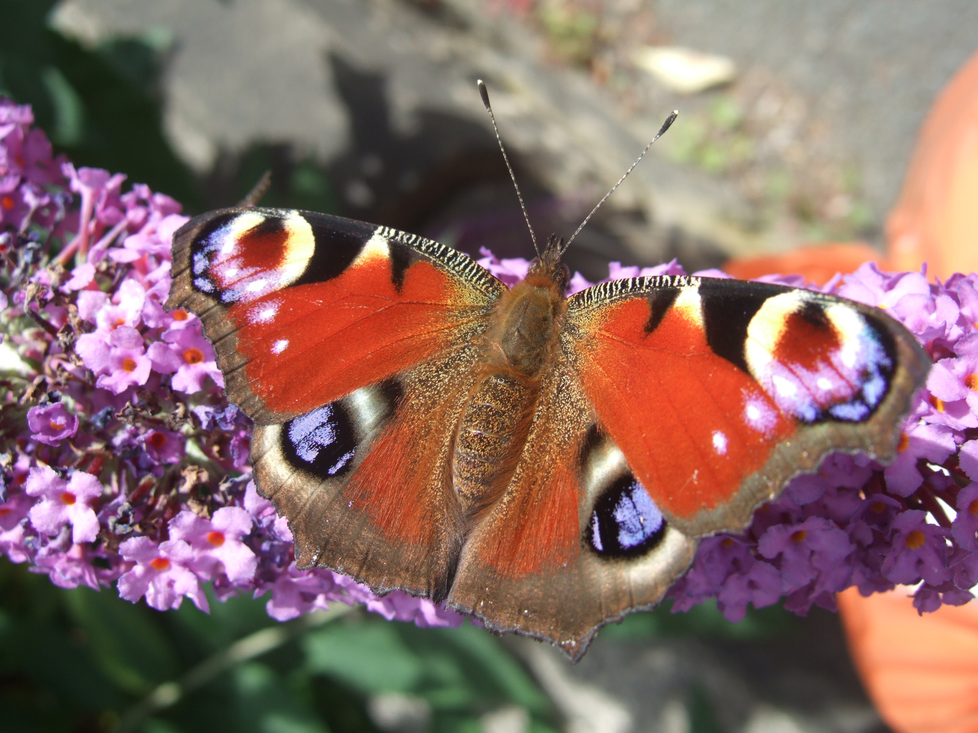
Classification
S2 Science

Slide 2
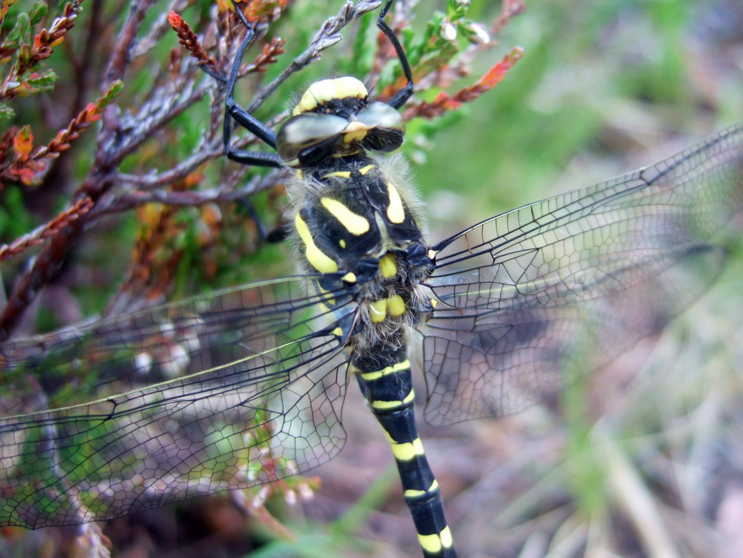
Binomial Nomenclature

Slide 3
Cordulegaster boltonii
Binomial names printed in italics
Genus begins with a capitol letter
Species name begins with a lower-case letter
When written by hand the name should be underlined
Cordulegaster boltonii

Slide 4
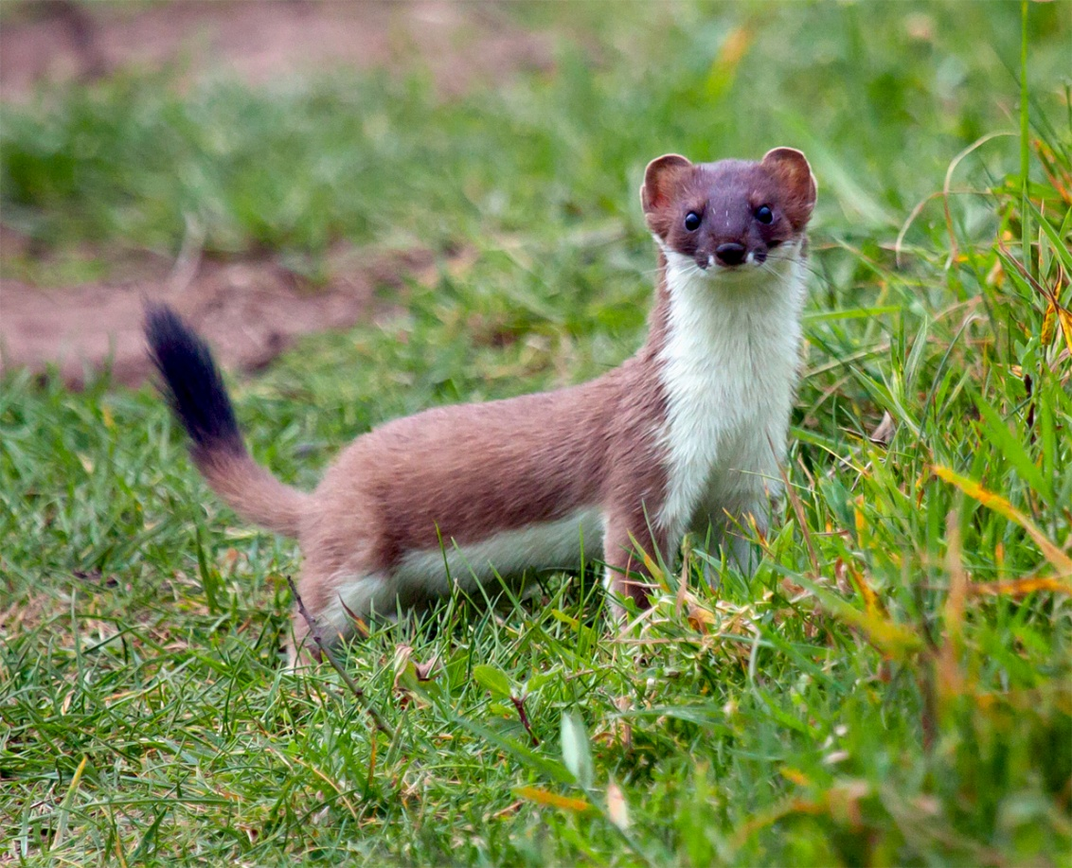
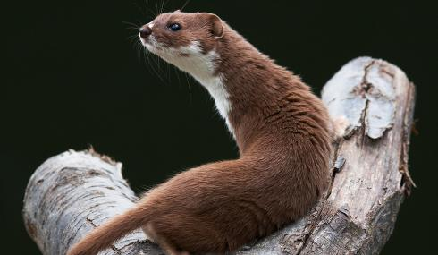
Mustela erminea
Mustela nivalis

Slide 5
What is the difference between a weasel and a stoat?

Slide 6
A weasel is weasily identified and a stoat is stoataly different!

Slide 7
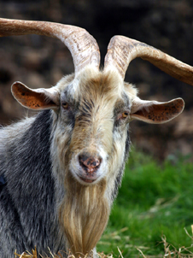
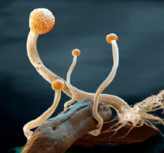

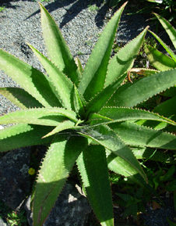
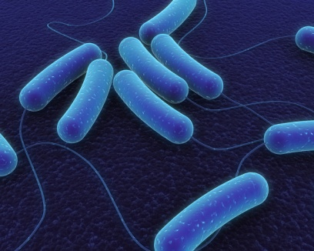
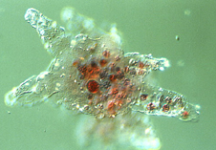
The Five Kingdoms
Animals
Fungi
Prokaryotes
Plants
Protoctists

Slide 8
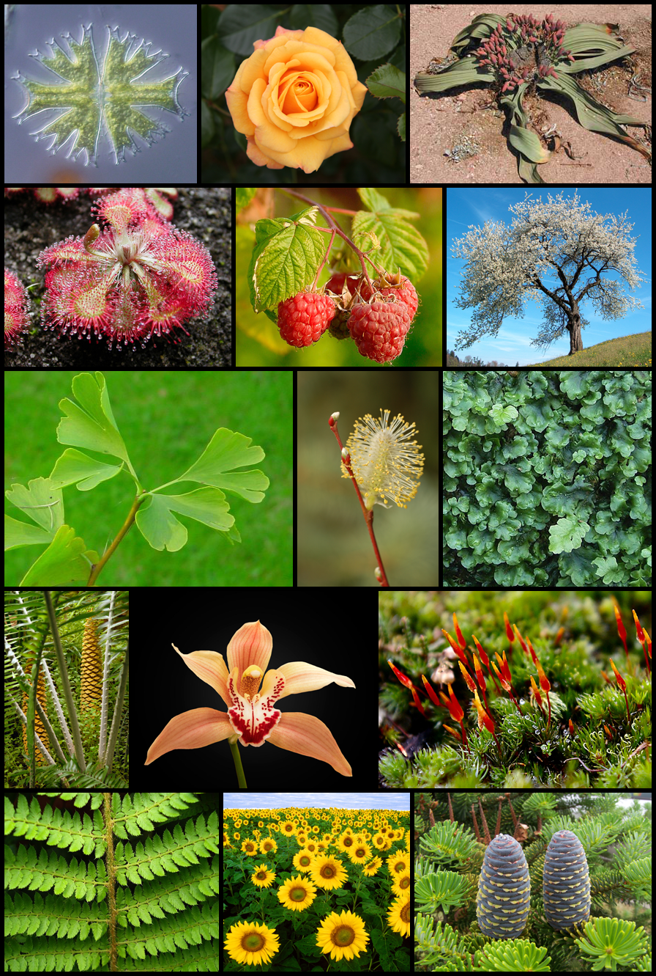
Kingdom Plantae
Phylum | Common Name | Features
bryophyta | Mosses and liverworts | No true roots Produce spores Grow in damp places
filicinophyta | Ferns | True roots Produce spores Leaves form fonds
coniferophyta | Conifers | Needle-like leaves ‘Naked’ seeds
angiospermophyta | Flowering Plants | Produce flowers Produce seeds within a fruit

Slide 9
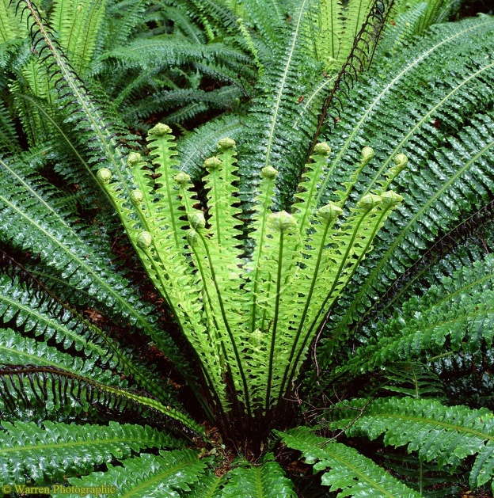
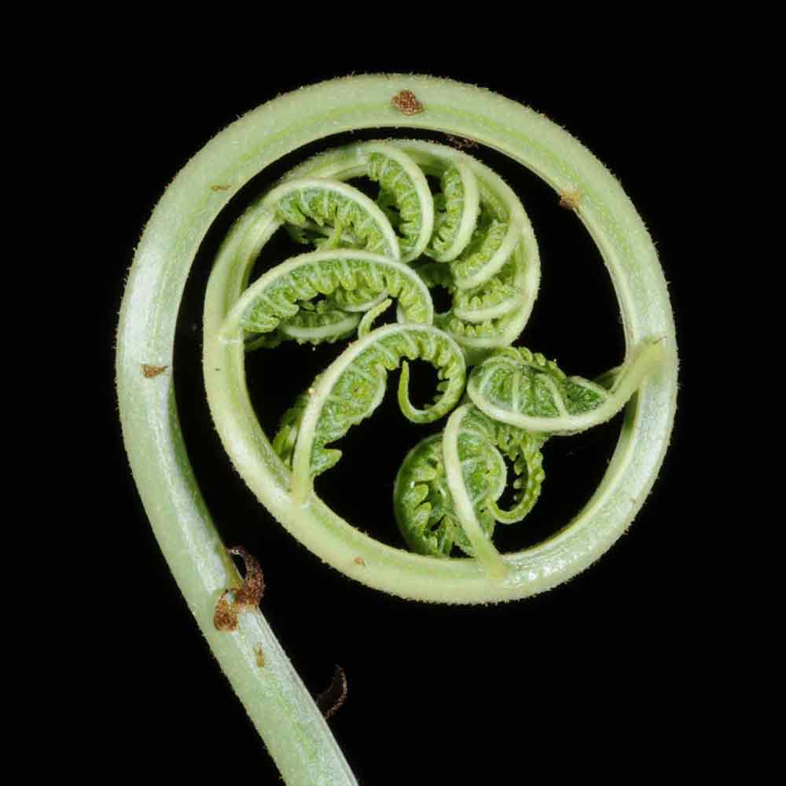
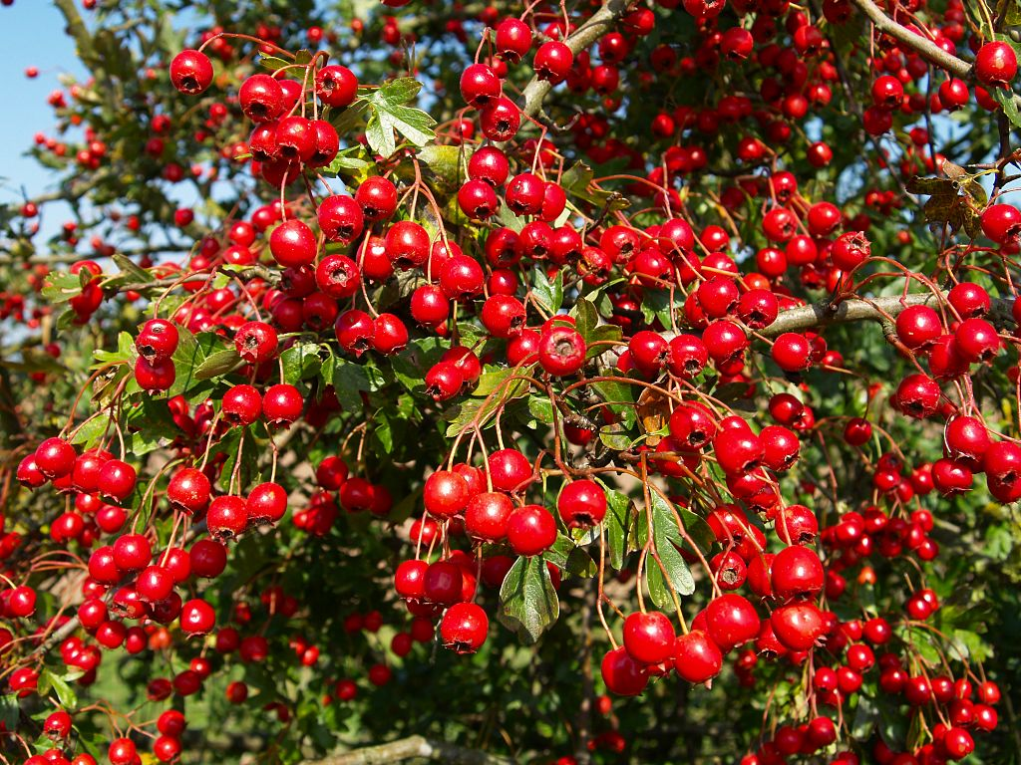
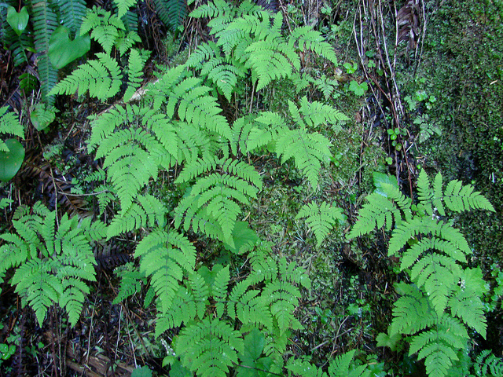
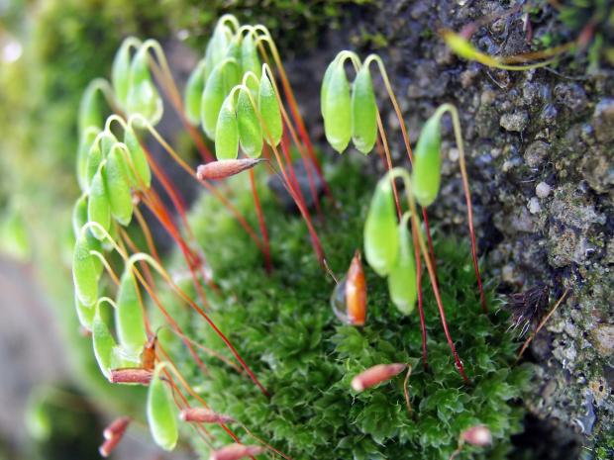
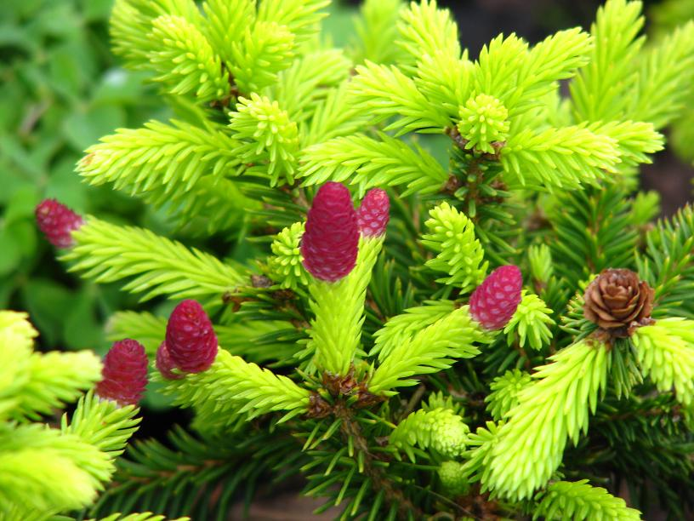
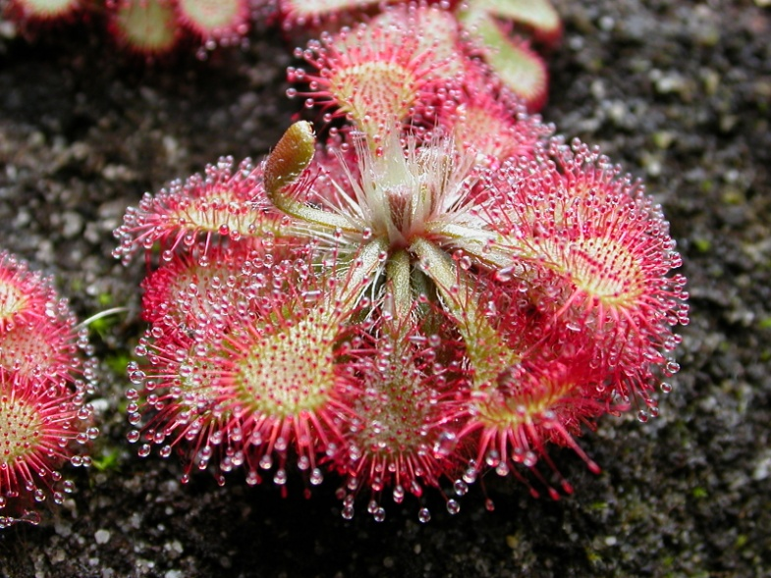
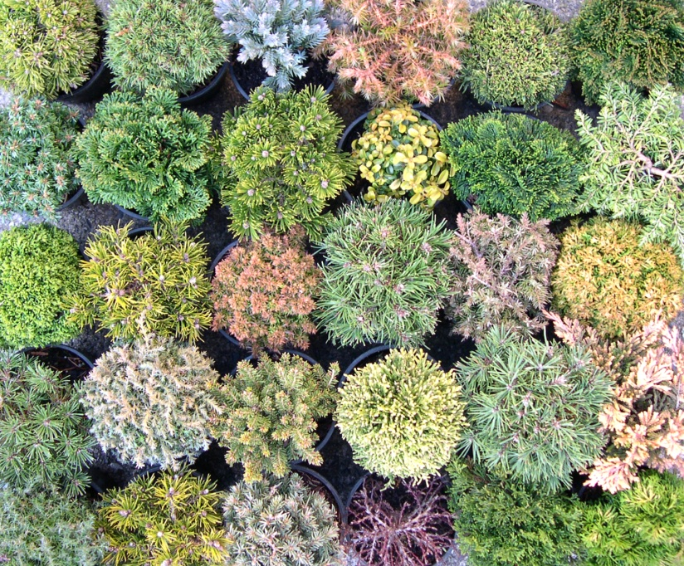
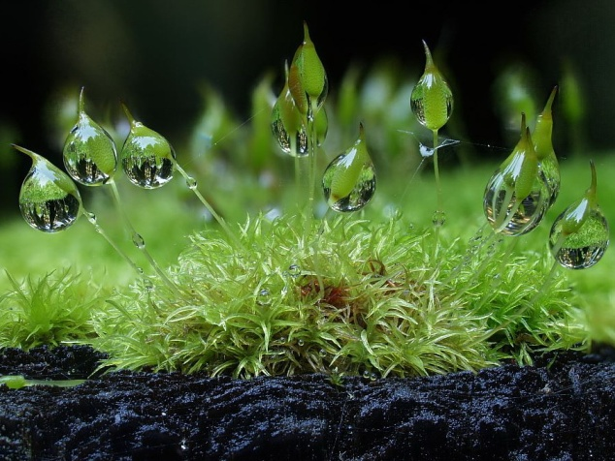
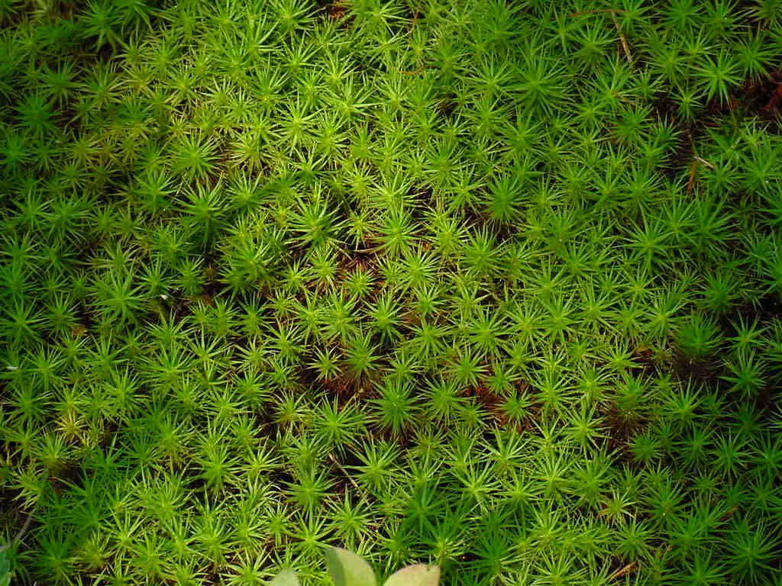
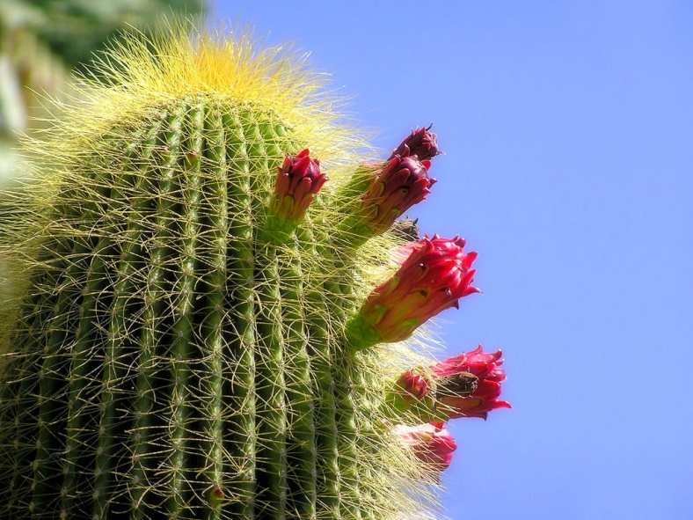
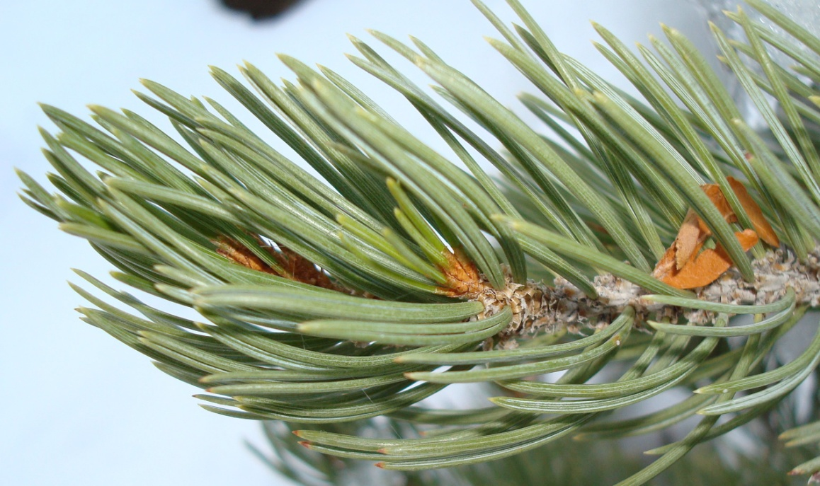
Mosses
Ferns
Conifers
Flowering plants

Slide 10
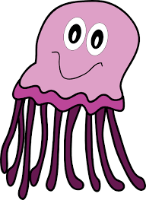
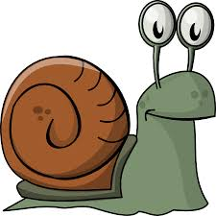
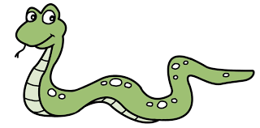


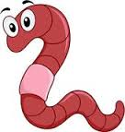
Animal groups
Molluscs
Echinoderms
Annelids
Cnidaria
chordate
arthropod

Slide 11
Which phylum do I belong to?
Animal | Phylum
My name is Cepaea nemoralis and I have a soft unsegmented body with a shell
My name is Ophionereis reticulata and my body has a pattern of 5 parts. I have a tough, spiny skin and move around on tube feet
My name is Hirudo medicinalis and I have a soft segmented body
My name is Hydra oligactis and I have tentacles with stinging cells that paralyse my prey
My name is Bufo marinus and I have a spinal cord surrounded by bone
My name is Apis mellifera and I have a hard exoskeleton. I have jointed legs and my body is split into segments

Slide 12
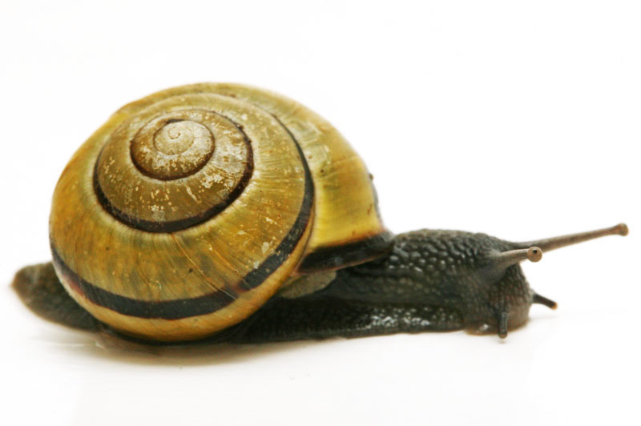
Cepaea nemoralis

Slide 13
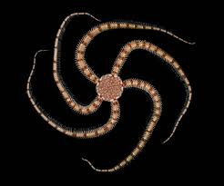
Ophionereis reticulata

Slide 14
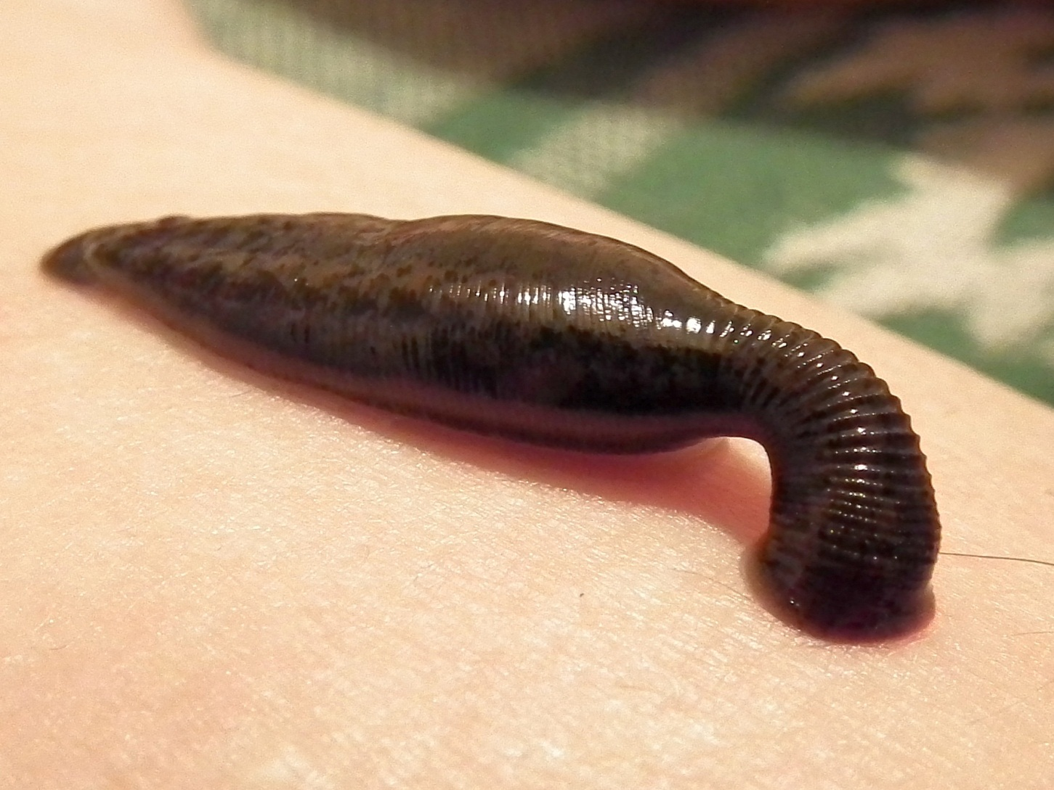
Hirudo medicinalis

Slide 15
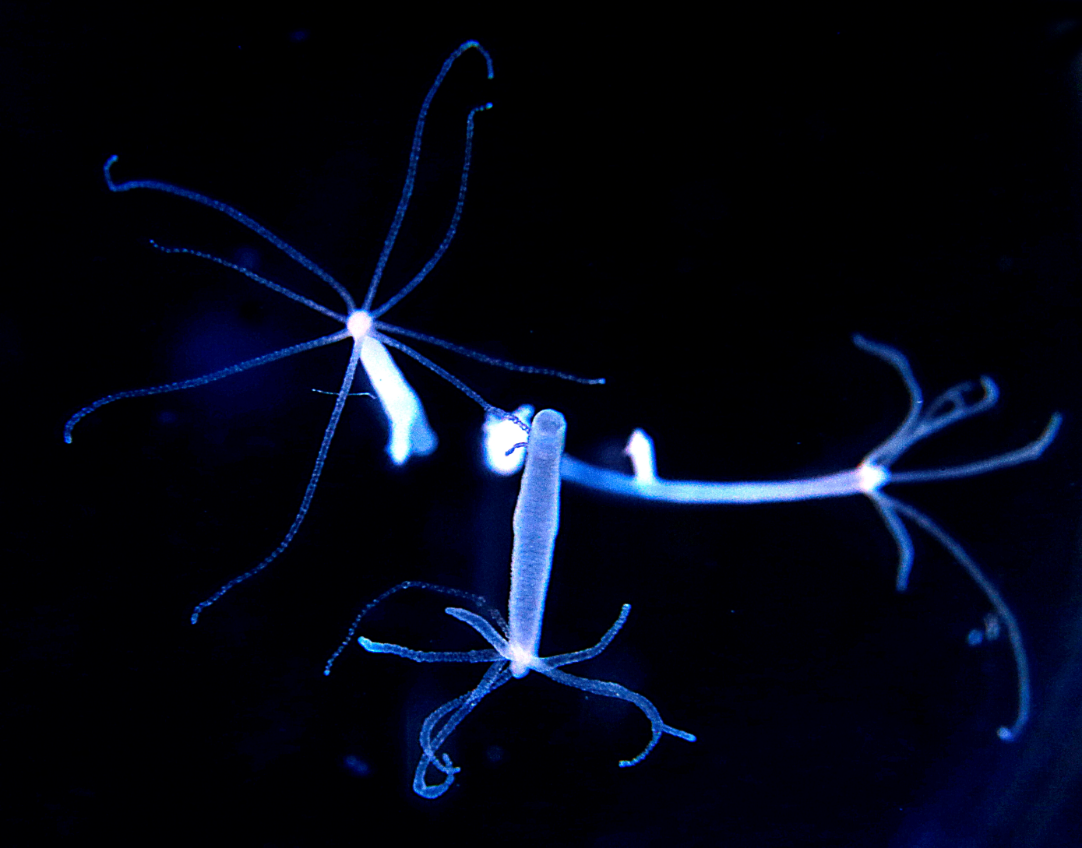
Hydra oligactis

Slide 16
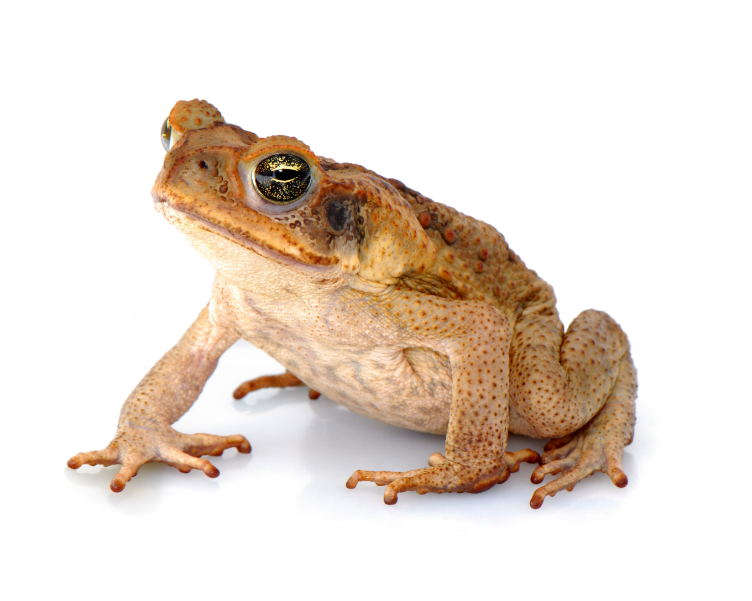
Bufo marinus

Slide 17
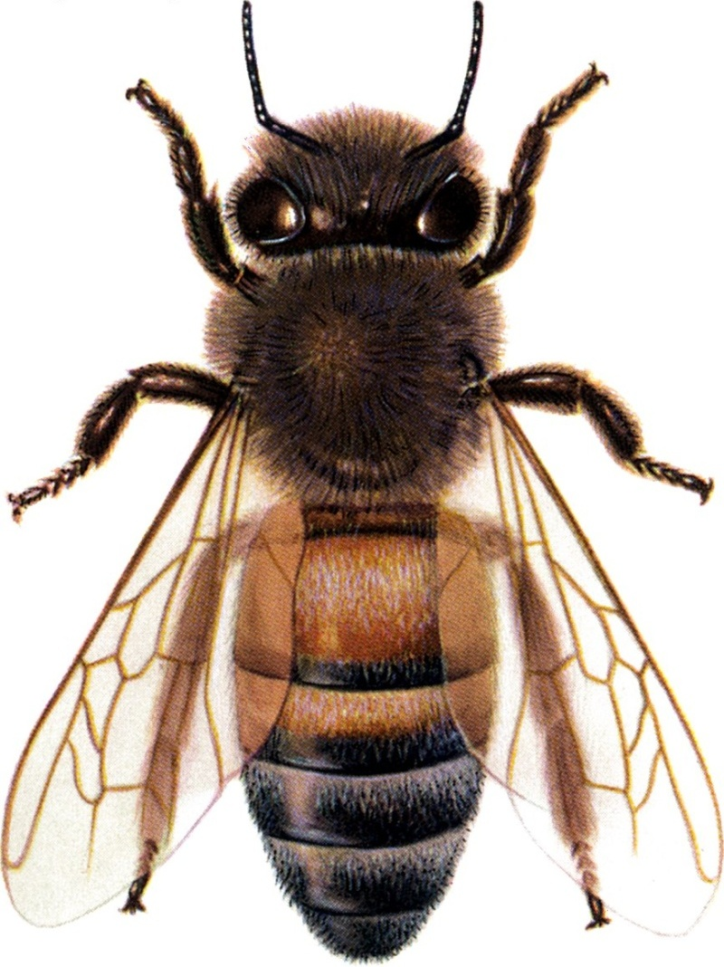
Apis mellifera

Slide 18
Which phylum do I belong to?
Animal | Phylum
My name is Cepaea nemoralis and I have a soft segmented body with a shell | Molluscs
My name is Ophionereis reticulata and my body has a pattern of 5 parts. I have a tough, spiny skin and move around on tube feet | Echinoderms
My name is Hirudo medicinalis and I have a soft segmented body | Annelids
My name is Hydra oligactis and I have tentacles with stinging cells that paralyse my prey | Cnidaria
My name is Bufo marinus and I have a spinal cord surrounded by bone | Chordates
My name is Apis mellifera and I have a hard exoskeleton. I have jointed legs and my body is split into segments | Arthropods

Slide 19
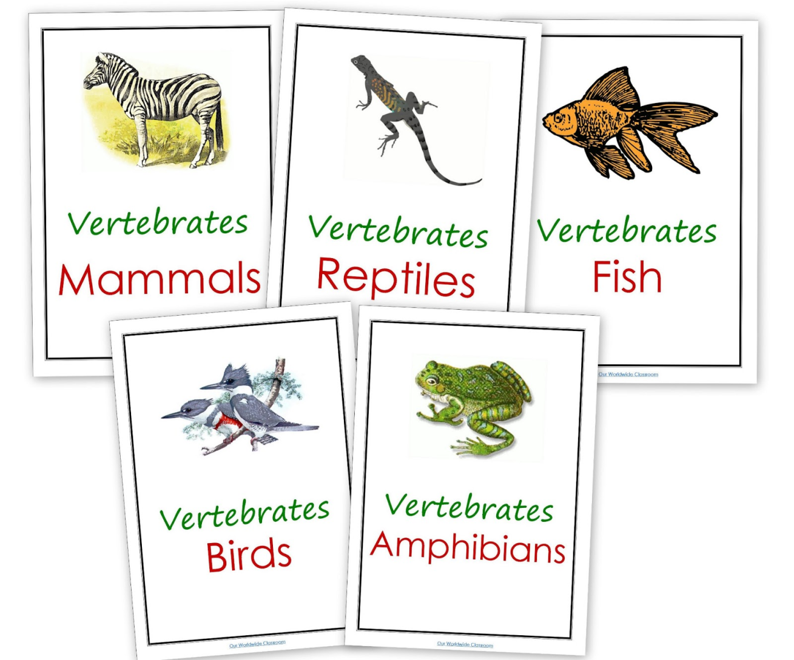
Chordates

Slide 20

Chordate Snap

Slide 21

KEYS

Slide 22

KEYS
LEARNING OBJECTIVES
Use keys to identify living things and other non-living examples
Produce simple keys

Slide 23
KEYS

Slide 24
KEYS

Slide 25
KEYS

Slide 26
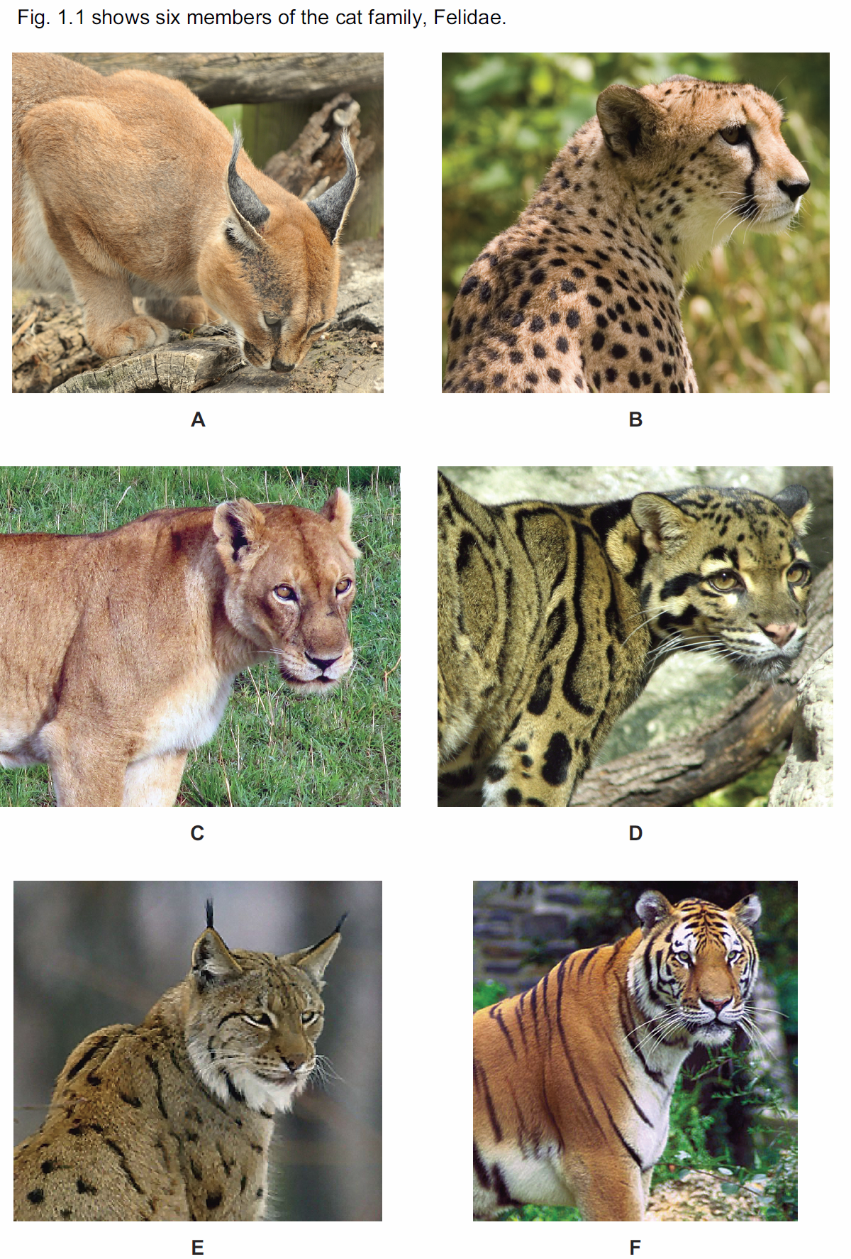
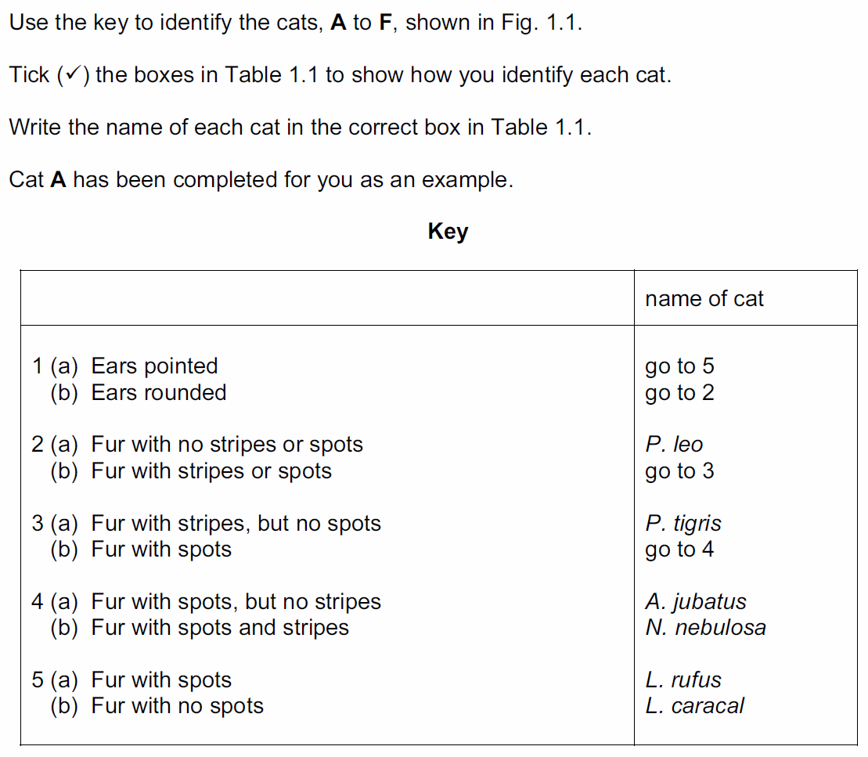

Slide 27
THREE KEYS

Slide 28
KEYS

Slide 29
KEYS

Slide 30
MAKING KEYS

Slide 31
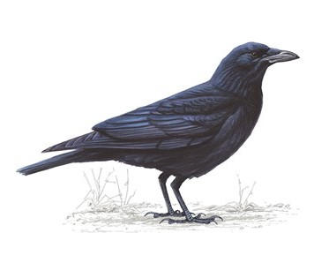
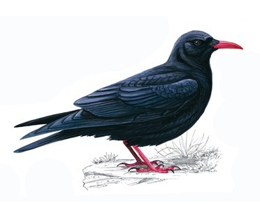

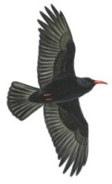
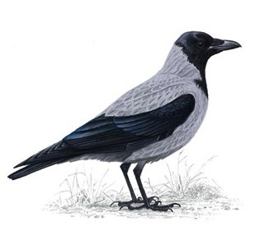
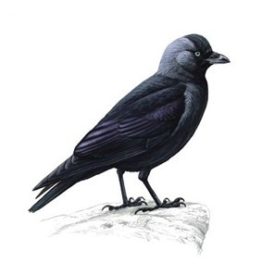
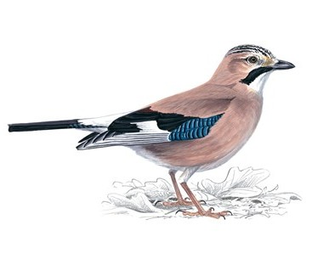
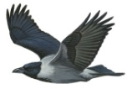

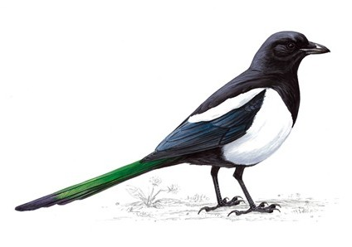
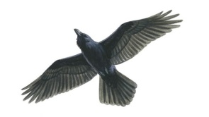
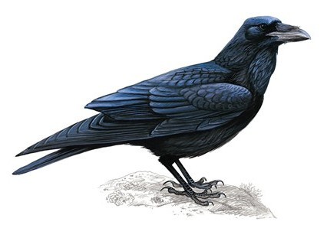
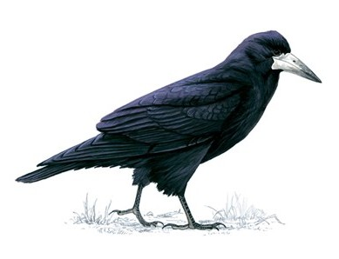

Making Keys
Corvus corone
Pyrrhocorax pyrrhocorax
Carrion Crow
Chough
Corvidae
Hooded Crow
Corvus cornix
Corvus monedula
Garrulus glandarius
Jackdaw
Jay
Magpie
Raven
Pica pica
Corvus corax
Rook
Corvus frugilegus

