Slide 1
Food chains and webs
GHS S2

Slide 2
Food chains and webs
Define and use many of the words associated with the feeding relationships within an ecosystem
Show food chains in terms of energy flow
Present more complex feeding relationships as foodwebs

Slide 3
Producer
Plants make their own food by photosynthesis. This traps the sun’s energy in food.

Slide 4
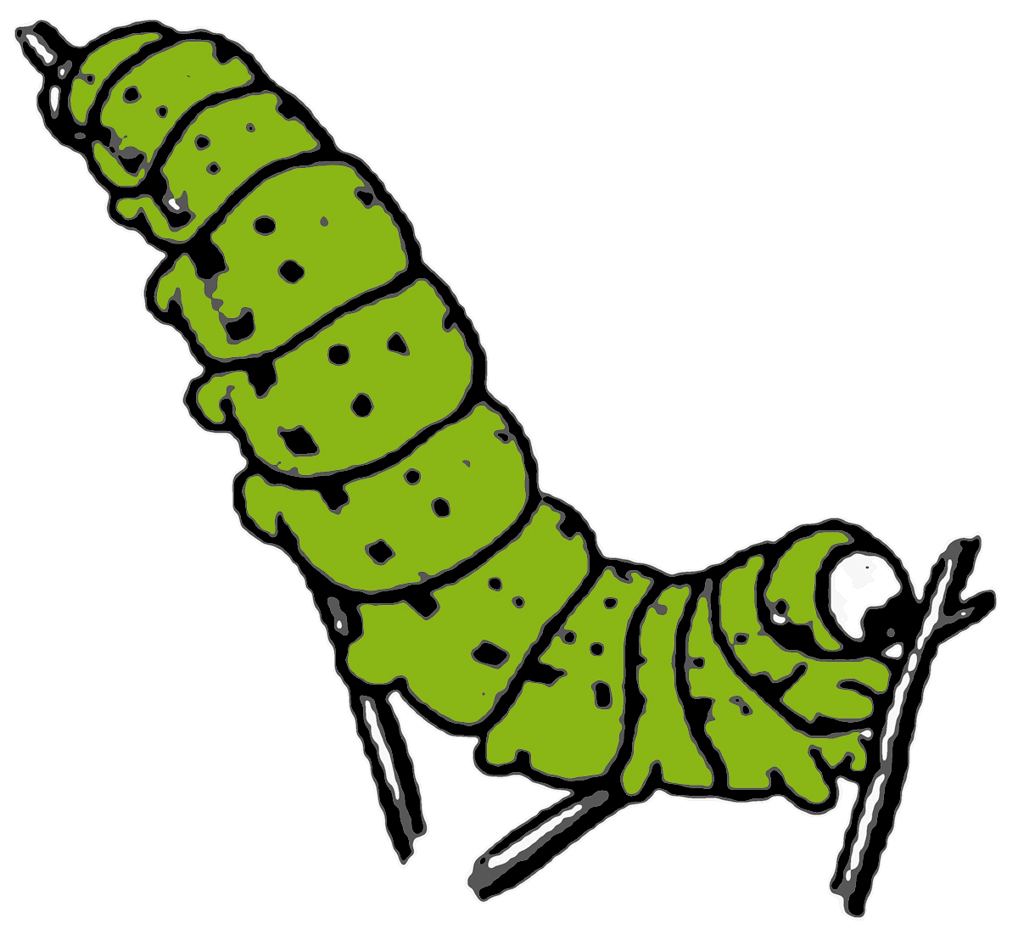
Herbivore
Herbivores eat plants. They are also primary consumers.

Slide 5
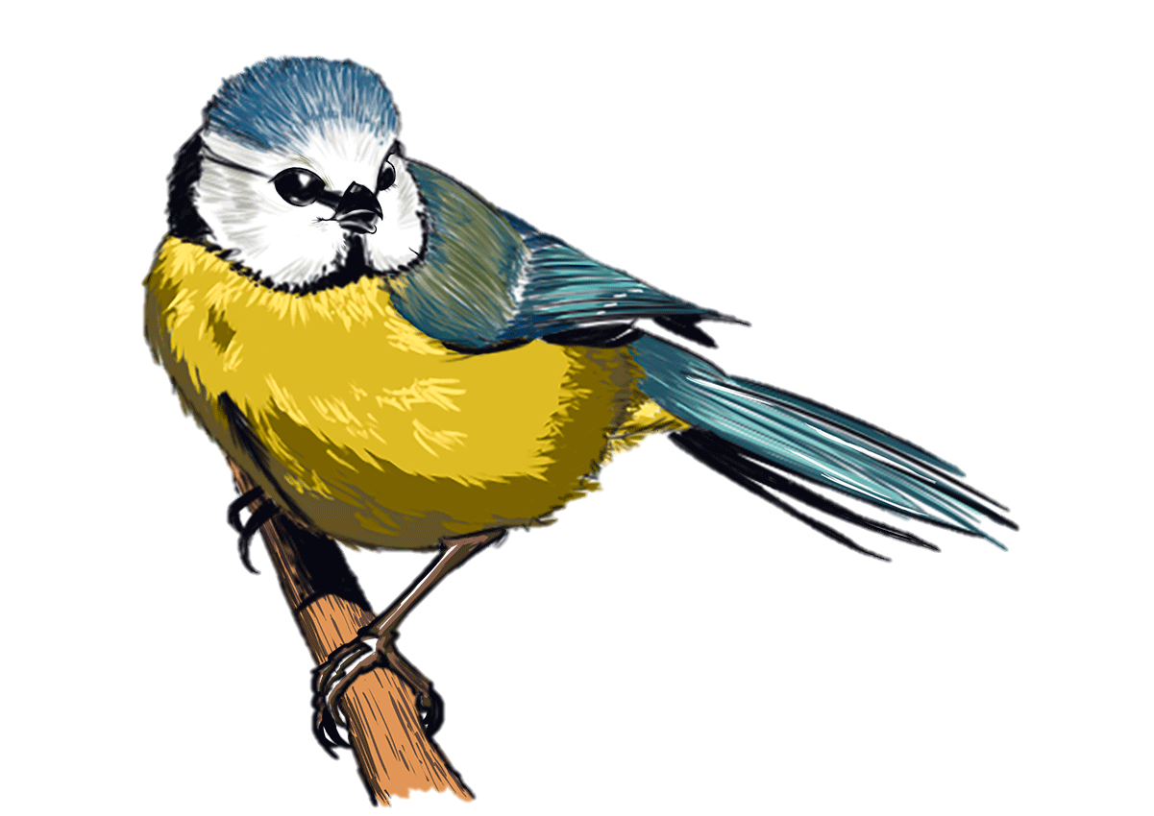
Carnivore
Carnivores eat other animals. They are secondary consumers.

Slide 6
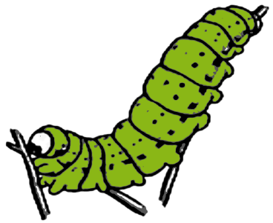
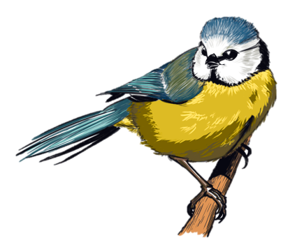
Food chain
A food chain shows the flow of ENERGY through living things. The arrows therefore go from the organism being eaten to the organism that is eating it.

Slide 7
Food chain
Copy out the food chain below (words will suffice). Then add the words from the word bank.
HERBIVORE ENERGY SOURCE
CARNIVORE PRODUCER
Sun
Oak
Caterpillar
Blue tit

Slide 8
Food chain
Write out three food chains of your own.
Each food chain needs to be from a different biome.
Avoid being vague – use kelp rather than seaweed
HERBIVORE ENERGY SOURCE
CARNIVORE PRODUCER

Slide 9
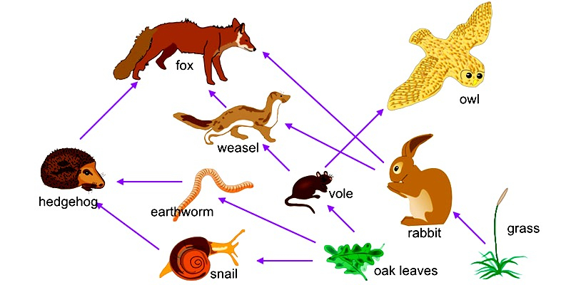
Food web
Most living things eat more than one thing. Possible exceptions being pandas and bamboo shoots and koalas and eucalyptus.

Slide 10
Food web
Write out a food chain from the diagram above
List the producers
List the consumers
Name a herbivore
State two top carnivores
Suggest how infecting the rabbits with myxomatosis might affect the owl.

