Slide 1
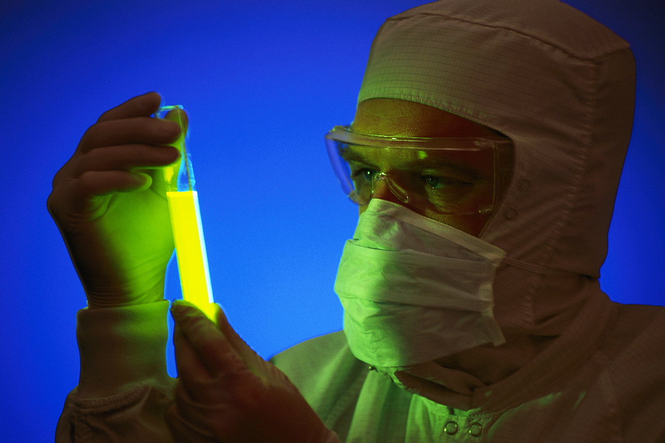
Biological Controversies

Slide 2
Outcomes and Experiences
I can debate the moral and ethical issues associated with some controversial biological procedures.
SCN 4-13c

Slide 3
Learning Outcomes
If successful, I will be able to:
list a variety of controversial areas within modern medicine and research.
Research and present one of these areas including the arguments for and against.

Slide 4
Task
You will be shown video clips about controversial biological procedures
Write a title for each example
Explain the procedure What are scientists doing? (All)
Explain the benefits. (Most)
Explain why it is controversial. (Some)

Slide 5
Presentation
Topic given
Maximum 4 slides
Font size 24 or bigger
Only use words that you understand!

