Slide 1
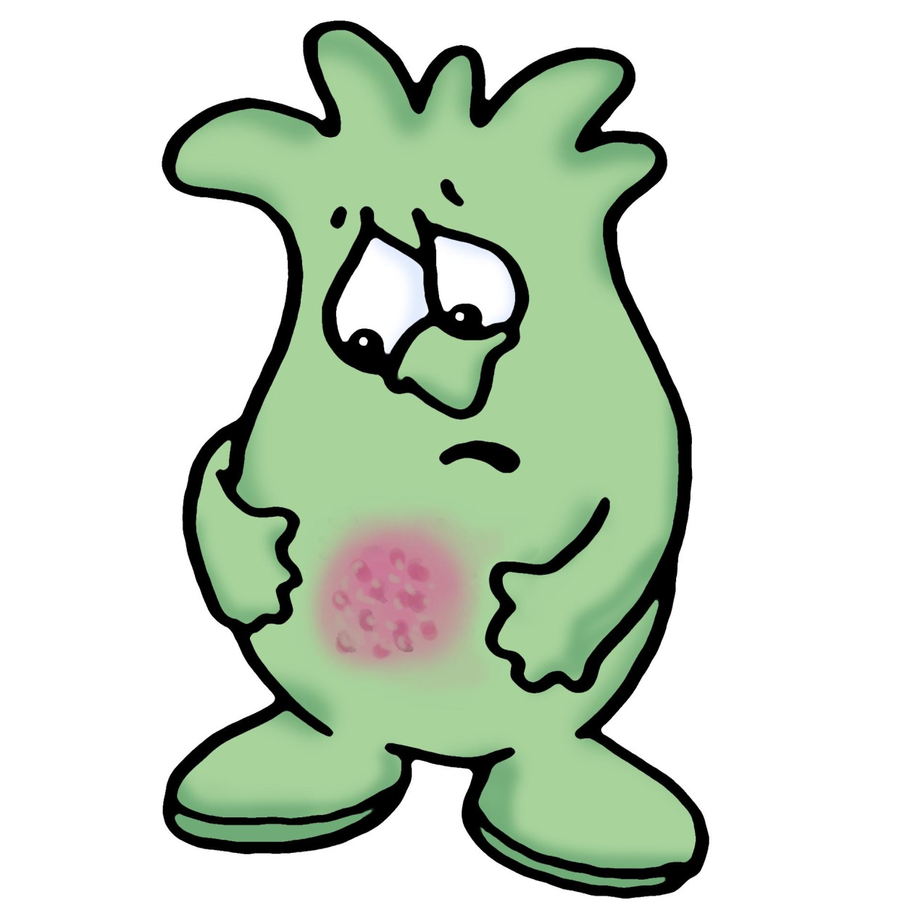
Microbes and Disease
S2 Science

Slide 2
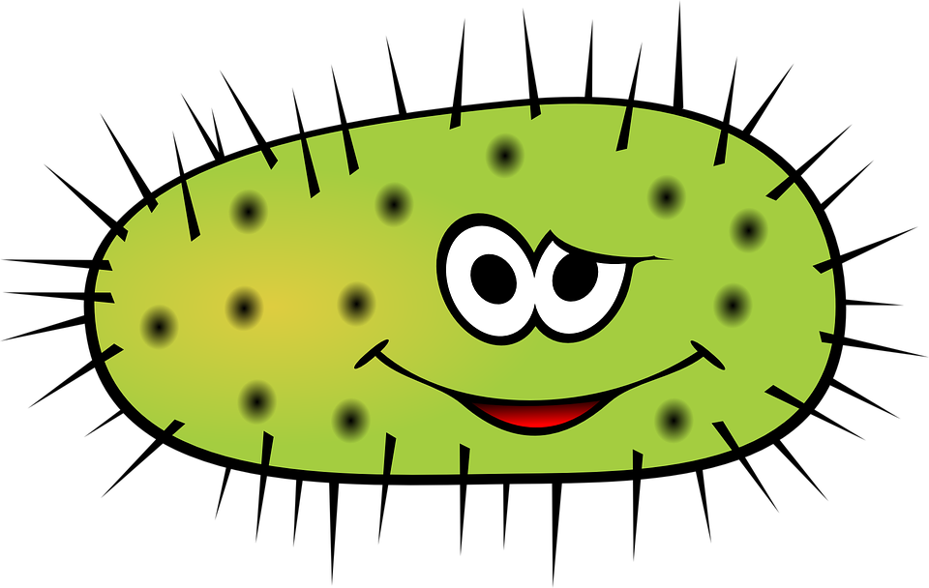
Outcomes and Experiences
I know the symptoms of some common diseases caused by germs. I can explain how they are spread and discuss how some methods of preventing and treating disease benefit society.
SCN 1-13a

Slide 3
Learning Objectives
Identify examples of poor hygiene
Produce a poster to remind shop employees of ways to ensure good hygiene.

Slide 4
Hygeine
Imagine that you are a Health Inspector.
1. Issue a warning letter that lists your concerns about hygiene in MacMicrobe’s General Stores.
2. Produce a poster that reminds Mick MacMicrobe of good shopkeeping practicies.

Slide 5
Learning Objectives
Define the word pathogen
Name the three main types of pathogen
Identify the structures found in bacteria, fungi and viruses.
Identify key words

Slide 6
How?
Labelled drawings
Worksheet
Video
Quiz
Video

Slide 7
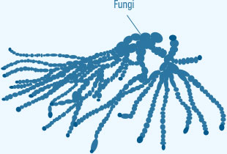
Pathogens
Microbes that cause disease
Bacteria
Virus
Fungus

Slide 8
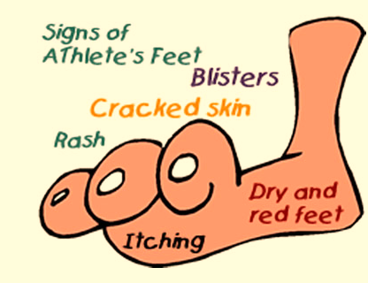
Pathogens
Microbes that cause disease
Bacteria
Virus
Fungus

Slide 9
TASK
Exploring Science 8 page 37: Draw and label a virus, bacterium and yeast (fungus)
Ask for a “Microbe Quest” worksheet

Slide 10
Microbe Quest

Slide 11
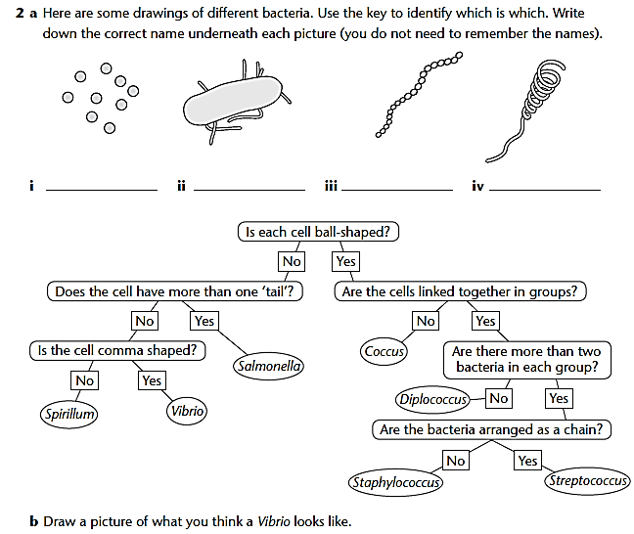
Microbe Quest

Slide 12
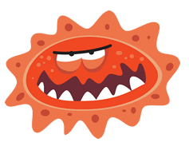
1.QUIZ
What is a pathogen?

Slide 13
2.QUIZ
What are the smallest types of pathogens?

Slide 14
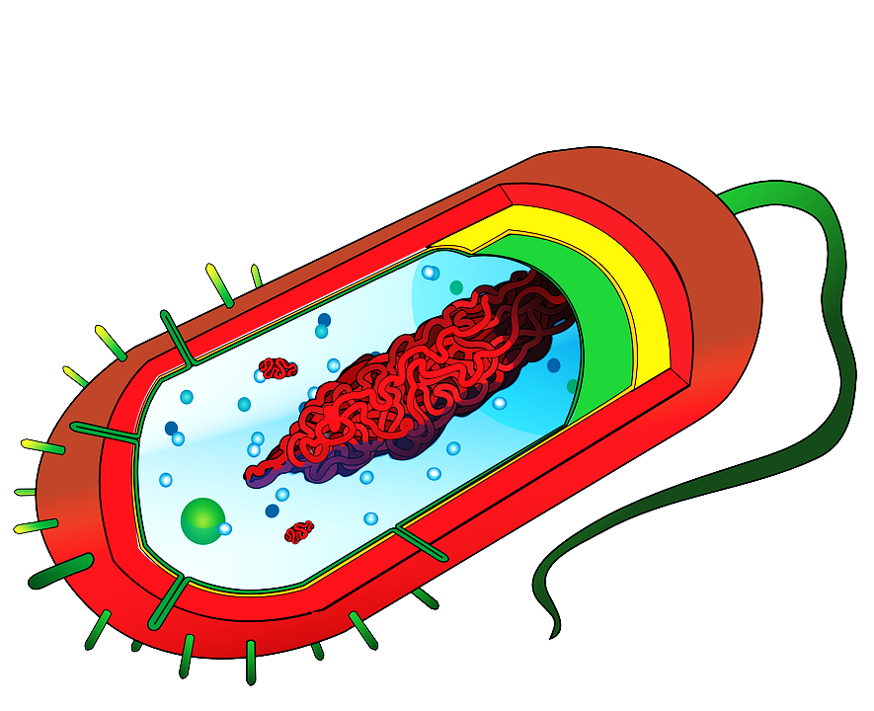
3.QUIZ
Identify the structure?

Slide 15
4.QUIZ
Identify the structure?

Slide 16
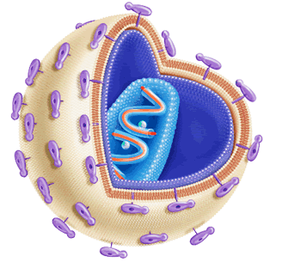
5.QUIZ
Identify the structure?

Slide 17
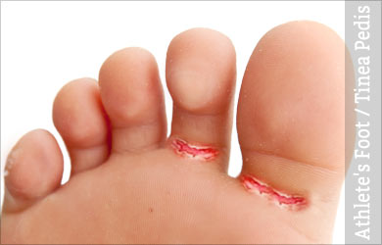
6.QUIZ
State the type of organism that causes athlete’s foot?

Slide 18
QUIZ
For the following questions use your key on the worksheet to identify the type of baceria.

Slide 19
7.QUIZ

Slide 20
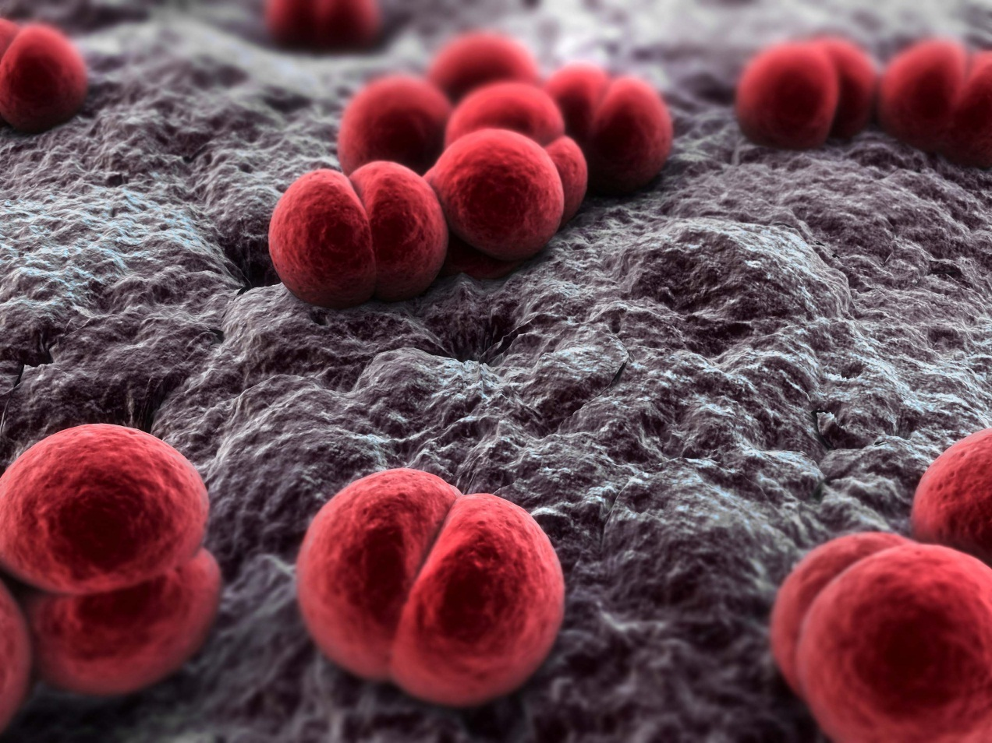
8.QUIZ

Slide 21
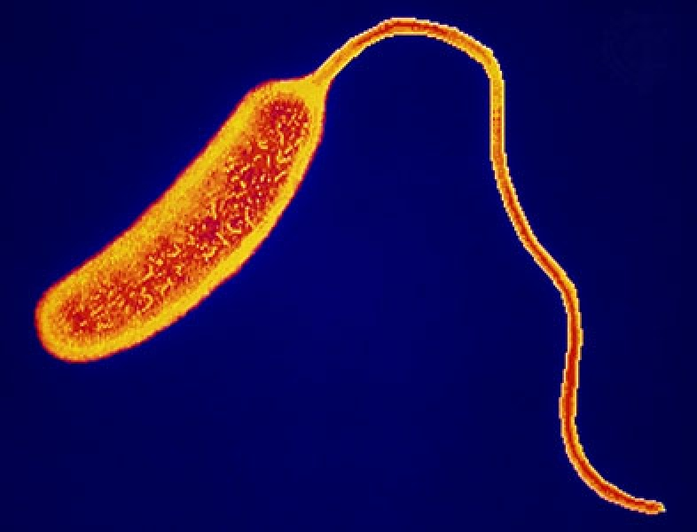
9.QUIZ

Slide 22
10.QUIZ
One bacterium divides every hour? How many will there be after one day?
In the event of nobody obtaining the correct answer, the nearest will be awarded the point!

Slide 23
1.QUIZ
What is a pathogen?

Slide 24
1.QUIZ
Something that causes an infectious disease

Slide 25
2.QUIZ
What are the smallest types of pathogens?

Slide 26
2.QUIZ
Viruses

Slide 27
3.QUIZ
Identify the structure?

Slide 28
3.QUIZ
Chromosome or DNA

Slide 29
3.QUIZ
Identify the structure?

Slide 30
3.QUIZ
Chromosome or DNA

Slide 31
4.QUIZ
Identify the structure?

Slide 32
4.QUIZ
Flagellum

Slide 33
5.QUIZ
Identify the structure?

Slide 34
5.QUIZ
Protein Coat

Slide 35
6.QUIZ
State the type of organism that causes athlete’s foot?

Slide 36
6.QUIZ
Fungus

Slide 37
QUIZ
For the following questions use your key on the worksheet to identify the type of baceria.

Slide 38
7.QUIZ

Slide 39
7.QUIZ
Spirillum

Slide 40
8.QUIZ

Slide 41
8.QUIZ
Diplococcus

Slide 42
9.QUIZ

Slide 43
9.QUIZ
Vibrio

Slide 44
10.QUIZ
One bacterium divides every hour? How many will there be after one day?
In the event of nobody obtaining the correct answer, the nearest will be awarded the point!

Slide 45
10.QUIZ
16 777 216
(almost 17 million!!!!)

