Slide 1
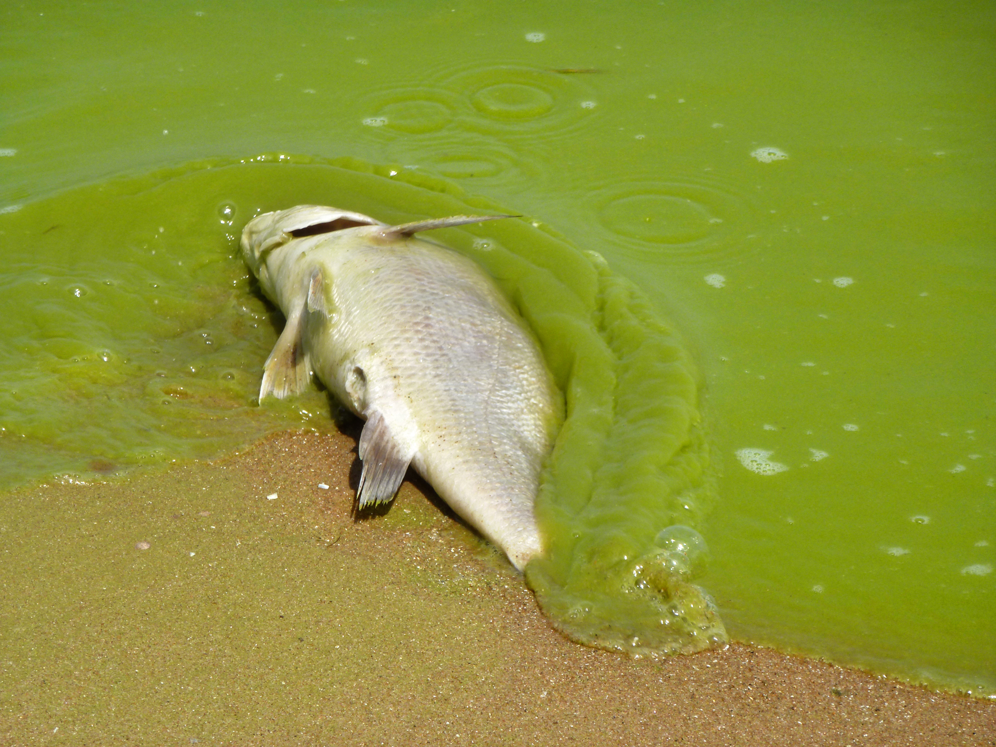
EUTROPHICATION

Slide 2
Learning Objectives
Explain how fertilisers cause pollution (eutrophication)
Interpret graphs showing the relationship between algae and fish populations.
Process data that shows the effects of adding sewage to a river

Slide 3
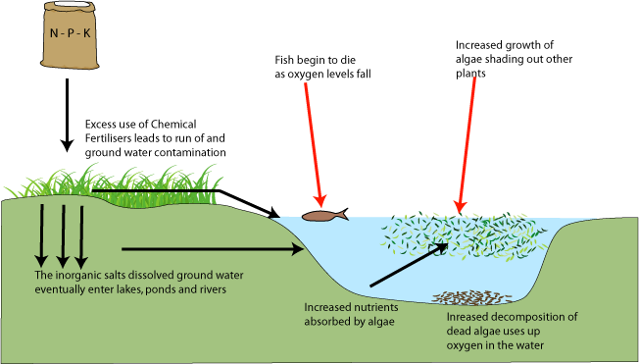
Eutrophication

