Slide 1
BIOMAGNIFICTION

Slide 2
BIOMAGNIFICTION
State the effects of insecticides on wildlife
Explain how insecticide becomes more concentrated higher in the food chain

Slide 3
BIOMAGNIFICTION
The insecticide becomes more concentrated as it passes through the food chain

Slide 4
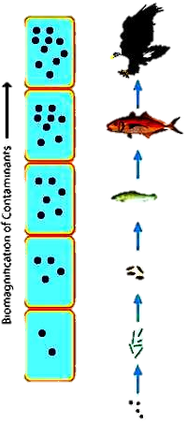
BIOMAGNIFICTION
Persistent – not excreted as DDT is fat soluble and stored in the animals fat tissues
Non-biodegradable – cannot be broken down and remains in the environment

