Slide 1
GHS S3 Science

Slide 2
Learning objectives
Define plant hormones
Outline some of the effects of plant hormones
Give examples of how they are used in food production

Slide 3
Plant hormones
Plant hormones are chemicals that control the growth and development of plants.
They include chemicals called auxins that make shoots grow upwards and roots grow downwards.
Some are gaseous and released into the air. E.g bananas release ethylene which makes other fruit in the same bowl ripen faster.

Slide 4
Plant hormones

Slide 5
Tropisms
Growth towards or away from a stimulus is known as a __________.
Growth of the shoots towards light is __________.
Growth of the roots downwards due to gravity is __________.
Growth towards water is ________.
Geotropism phototropism
Hydrotropism tropism

Slide 6
Weed killers
Selective weed killers attack some plants but not others. This can be useful for getting rid of dandelions in a lawn without killing the grass, or getting rid of thistles in a field without killing the wheat plants. The selective weed killer contains growth hormone that causes the weeds to grow too quickly. The weed killer is absorbed in larger quantities by the weeds rather than the beneficial plants

Slide 7
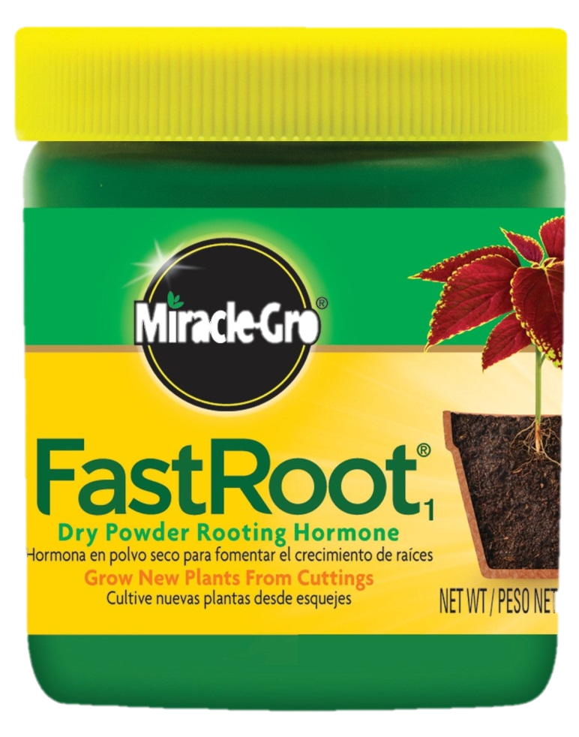
Rooting Powder
Rooting powder makes stem cuttings quickly develop roots. Rooting powder contains growth hormones.

Slide 8
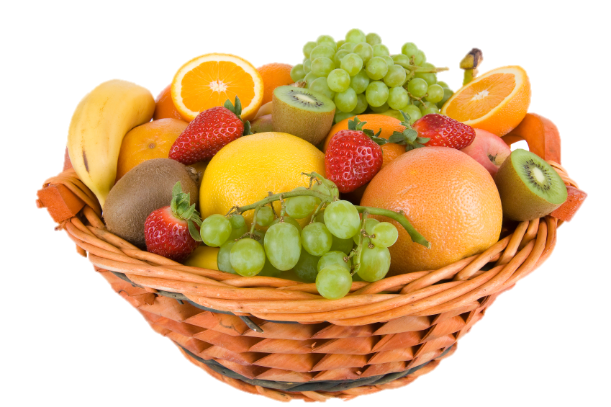
Fruit ripening
Some hormones slow the ripening of fruits and others speed it up. These hormones and their inhibitors are useful for delaying ripening during transport or when fruit is displayed in shops.

Slide 9
dormancy
Dormancy stops seeds germinating until conditions are ideal for growth. Hormones can be used to remove the dormancy of a seed so it can germinate at all times of year. Buds and flowers can also be naturally dormant. Hormones can also be used to make plants grow bushier or make them flower.

Slide 10
Quickfire questions
This A is a plant hormone that controls growth
1 POINT!

Slide 11
Quickfire questions
This A is a plant hormone that controls growth
auxins

Slide 12
Quickfire questions
This B releases large amounts of ethylene that makes fruit ripen too fast
1 POINT!

Slide 13
Quickfire questions
This B releases large amounts of ethylene that makes fruit ripen too fast
Bananas

Slide 14
Quickfire questions
This G describes the growth of roots towards gravity
1 POINT!

Slide 15
Quickfire questions
This G describes the growth of roots towards gravity
geotropism

Slide 16
Quickfire questions
This D describes a period when seeds do not germinate
1 POINT!

Slide 17
Quickfire questions
This D describes a period when seeds do not germinate
dormancy

Slide 18
Quickfire questions
Draw these three seeds after they haver germinated and label the roots and shoots
3 POINTs!

Slide 19
Quickfire questions
Shoots always grow upwards!
Roots always grow downwards!

Slide 20
Quickfire questions
List 3 stimuli that make shoots grow up and roots grow down
3 POINTs!

Slide 21
Quickfire questions
List 3 stimuli that make shoots grow up and roots grow down
Light
Gravity
water

