Slide 1
S3 Transport in Plants
Celery xylem

Slide 2
Learning intentions
Develop microscope skills
Remove xylem from celery and prepare a microscope slide
Identify the lignin rings that strengthen xylem vessels
List the substances transported in the xylem

Slide 3
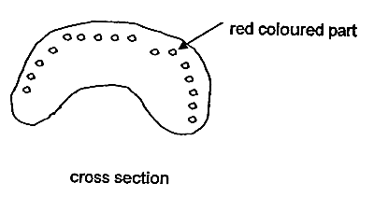
Celery Xylem
Xylem is the stringy bits in celery and the stems of other plants
Celery has been placed in a pink liquid called eosin
This stains the xylem so it is easily seen

Slide 4
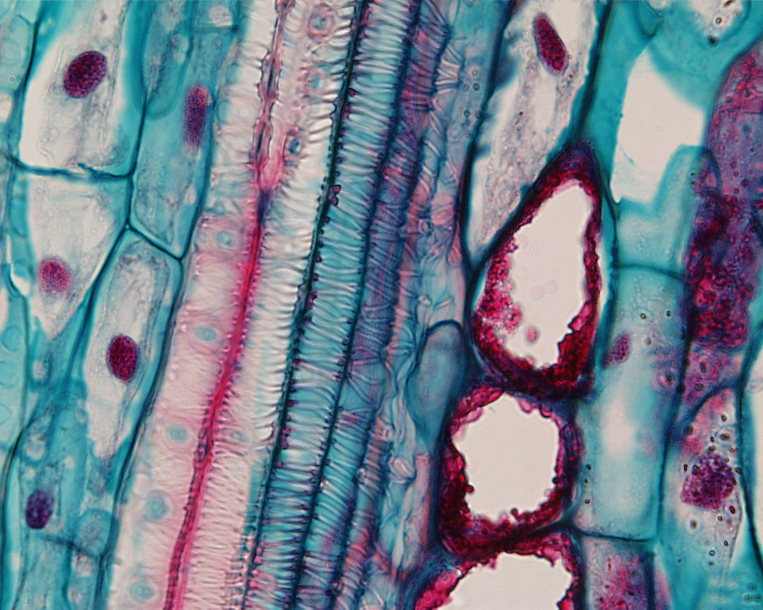
Celery Xylem
Cut out the xylem
Lacerate (cut) lengthwise and squash between two microscope slides.
View underneath the microscope.

Slide 5
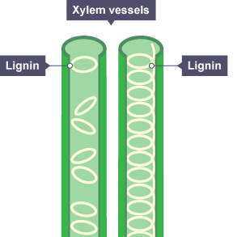
Draw and complete
Xylem transports _____ and ____ from the roots.
The xylem cells form continuous xylem ______.
The walls of the xylem are strengthened by a substance called _________

Slide 6
Quickfire Questions!
Name the pigment used to stain the xylem
Name two substances transported in the xylem
Define “lacerate”

