Slide 1
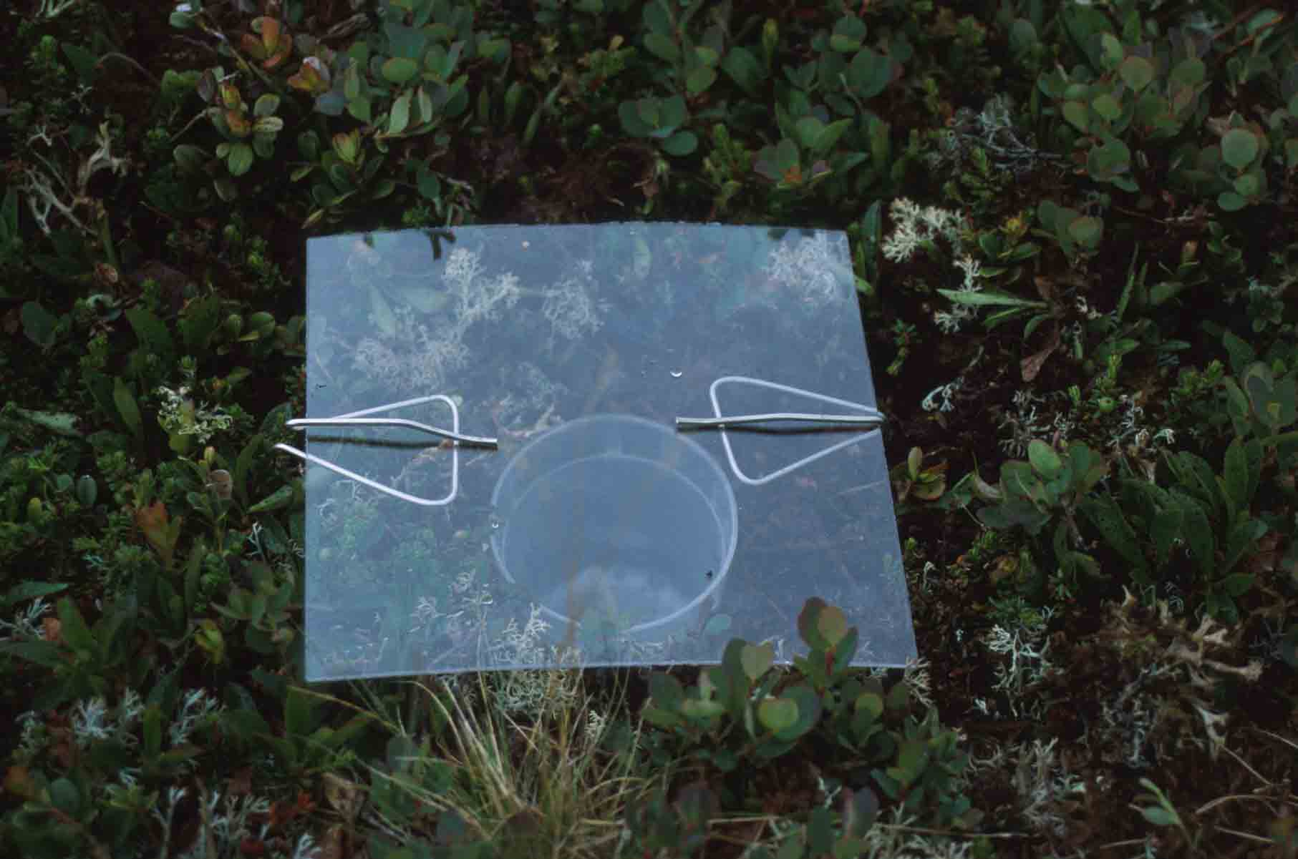
Sampling techniques for animals
Advanced Higher Biology

Slide 2
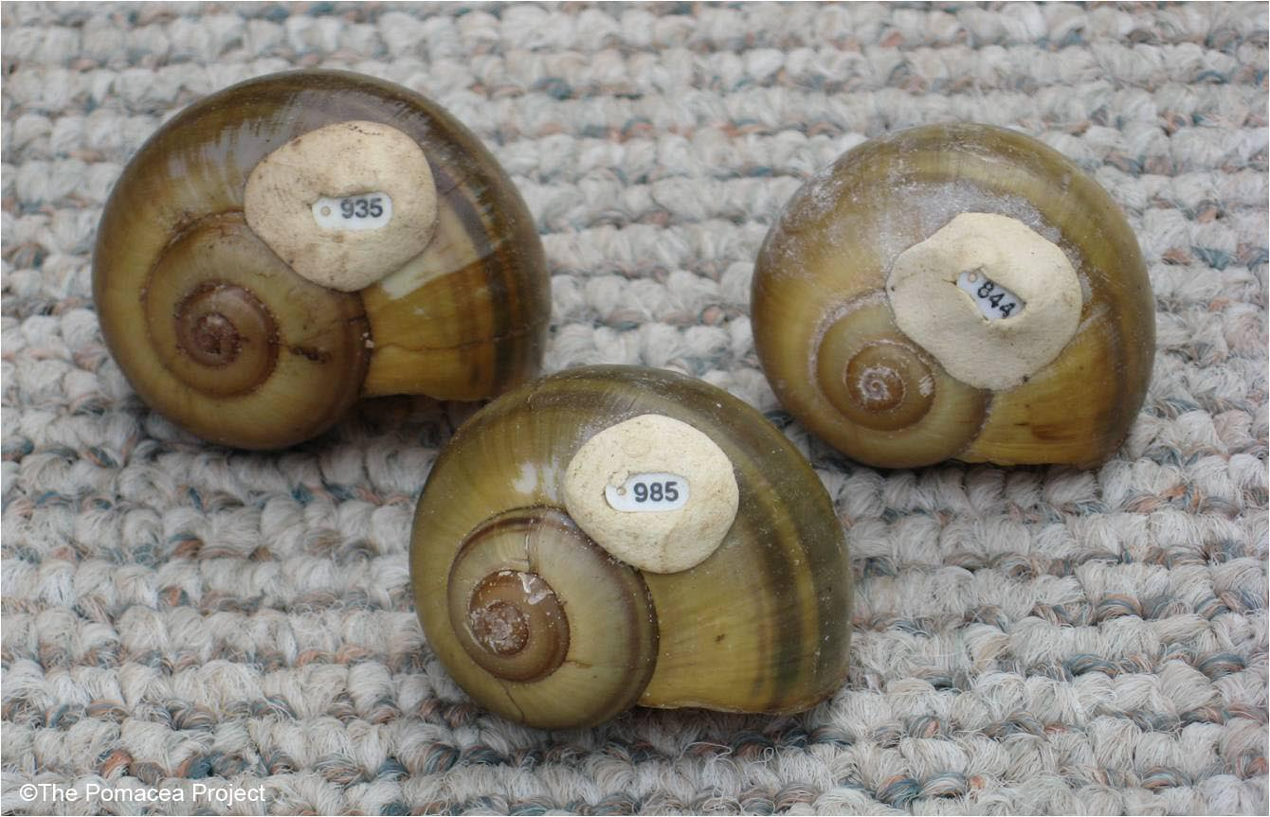
Capture-mark-release techniques

Slide 3
Lincoln Index
n₁ x n₂
n₃
Population =
Where:
n1 = number of individuals initially caught, marked and released,
n2 = total number of individuals caught in the second sample, and
n3 = number of marked individuals in the second sample.

Slide 4
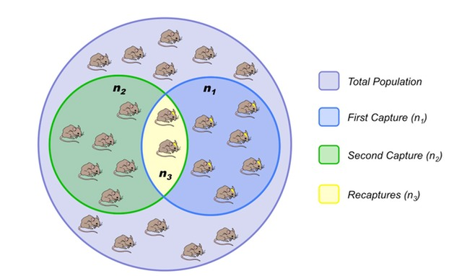
Limitations
The Lincoln index assumes that all individuals have an equal chance of selection, marked individuals will be randomly distributed after release and marking will not affect mortality or natality. If the tags fall off, it may lead to an over-estimation of the population size. These points reveal the limitations of the technique.

Slide 5
It is important that students appreciate the need for choosing an appropriate method for marking organisms.
Marking frogs with correction fluid may have a toxic effect of perhaps more significant is that it will affect their chances of survival as bright white “Tippex” will be easily seen by predators.
The larger the sample size, the more reliable is our estimate of the population size.
The samples must be representative so collecting animals from a greater number of randomly selected sites will give an estimate closer to the true value.
Populations fluctuate seasonally and from year to year.
The population must be closed – no emmigration of immigration.
The time between samples must be small compared to the life expectancy of the organism.
A falling population may be the first sign of an environmental problem.

Slide 6
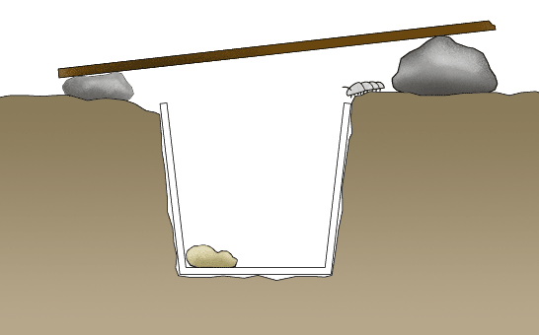
Practice question 1
150 Woodlice were captured within 20 pitfall traps that were carefully placed, hidden in the undergrowth of a woodland habitat. Canes were used to mark their locations. The woodlice were carefully marked with a UV pen. They were then released, being careful to ensure that they were evenly distributed over the area being studied and avoiding open spaces. Fresh bait was placed in the traps. On returning the next day, another 115 woodlice had been captured. These were studied under a UV light and 11 were found to be marked animals.
Estimate the number of woodlice.
What assumptions have been made?
What are the limitations of the procedure?

Slide 7
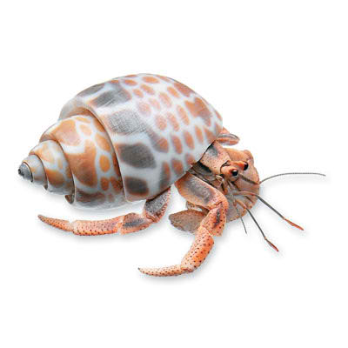
Practice Question 2
31 hermit crabs were captured by students at Gorah rocks and marked by making a small scratch on the shells (adopted homes). All were captured within an area of 100m x 100m, the corners being marked by four painted iron weights. They were then released where found. The students returned the same day and found a further 33 crabs. Two of these had scratch marks on their shells. This was then extrapolated to the total area of the rocky shore to determine the population of the entire shoreline.
Estimate the population of the hermit crabs.
Evaluate the procedure used.

Slide 8
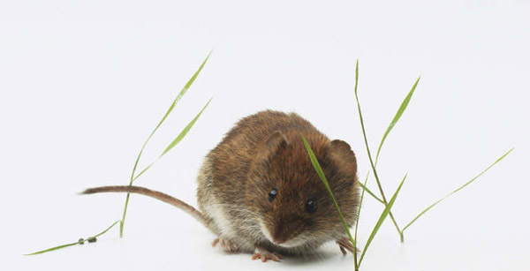
Practice Questions 3
While studying field voles, an ecologist caught 500 and ringed a foot before releasing them. Every day for the next two weeks he examined the waste materials in the nests of their predators. He collected a total of 300 field vole skulls and 15 rings.
Estimate the field vole population within the area.

Slide 9
Scat sampling
“Ever wonder how scientists collect much-needed DNA samples from endangered species? Their repertoire of non-invasive sampling methods is growing with leaps and bounds, but one of the most popular techniques involves scooping up their poop. (Um, the animals‘ poop that is.) Except, field biologists call it “scat” which somehow seems more palatable. (One animal’s trash is another animal’s treasure?) But to get DNA from scat requires a gifted touch. Just any old scat lying on the forest floor will not do. It is best fresh. And with a good smear of intestinal mucus. Or so says a new study out in the Journal of Wildlife Management.”

