Slide 1
Statistics
For biologists . . . .

Slide 2
Standard Deviation
Standard deviation shows us the spread of the values about the mean. Both of these graphs show normal distributions.
The standard deviation can be shown as error bars on graphs

Slide 3
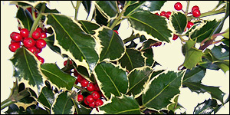
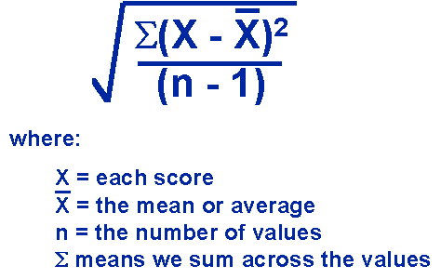
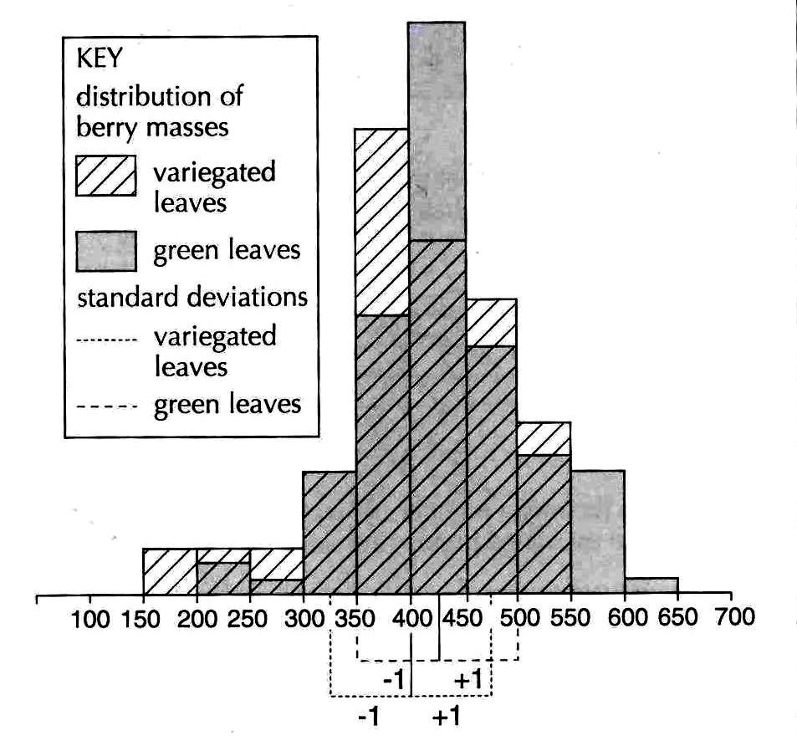
Hypothesis
The holly berries form Ilex aquifolium trees with variegated leaves are smaller than berries from a non variegated tree.
Tree | Mean berry mass ± 1mg | Standard deviation mg
Green leaves | 427 | 73
Variegated leaves | 399 | 80

Slide 4
Null Hypothesis
The holly berries form Ilex aquifolium trees with variegated leaves are not smaller than berries from a non variegated tree.
This means that any differences are due to chance. In this instance, it would be reasonable to suggest that the null hypothesis is supported.

Slide 5
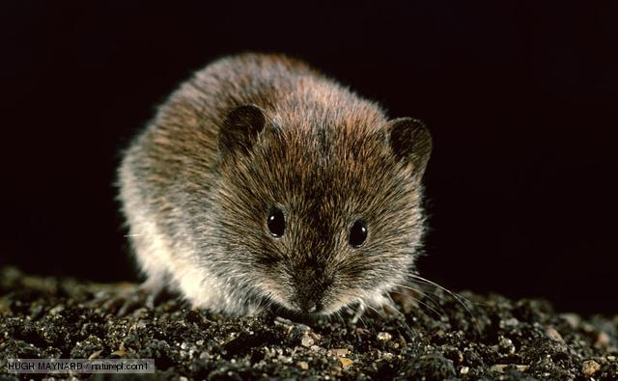
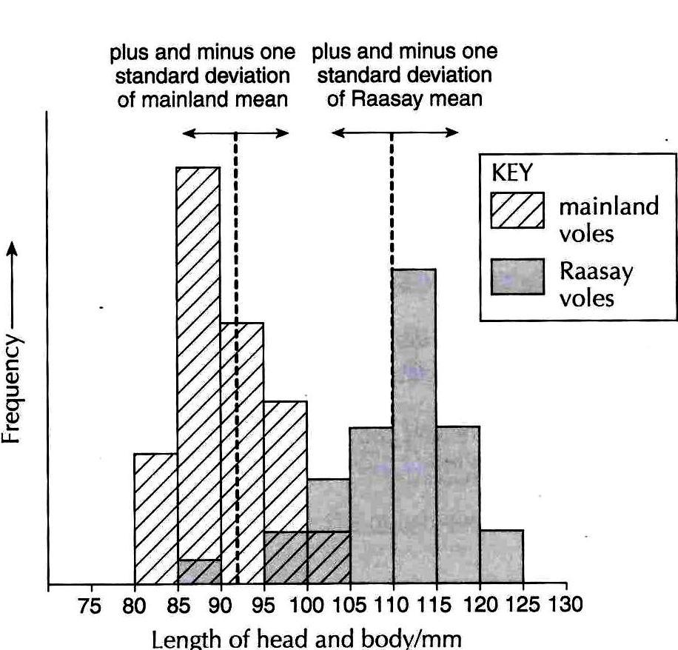
Hypothesis
Bank voles Clethrionomys glareolus on the Scottish Island of Raasay are larger than those on the Scottish mainland.
Vole population | Mean length ± 1mm | Standard deviation mm
Mainland | 82 | 5.2
Raasay | 110 | 7.1

Slide 6
Null Hypothesis
The bank voles on Raasay are not larger than those on the mainland.
This means that any differences are due to chance. In this instance, it would be reasonable to suggest that the hypothesis is supported and there is a difference between the two populations. We can be almost certain about this!

Slide 7
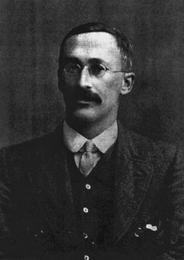
T-test
A statistical test was required to determine the probability of the difference between two populations or two sets of results being due to chance.
Mr W.S. Gosset came up with the student’s t-test:

Slide 8
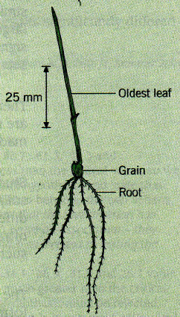
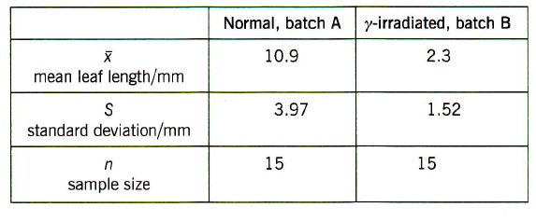
Example
Now let us deal with some data obtained by Open University students, who measured the Iengths of leaves in 3-day germinated wheat seedlings that had been given different treatments. Batch A were grown from normal seeds and batch B from seeds that had been subjected to γ-radiation; here are their results:

Slide 9
Substitute these values into the equation:
Degrees of freedom:
The degrees of freedom = (number in sample A – 1) + (number in sample B – 1)
In this case d.f. = (15-1) + (15-1) = 28
Now use the student t-test table . . . .

Slide 10
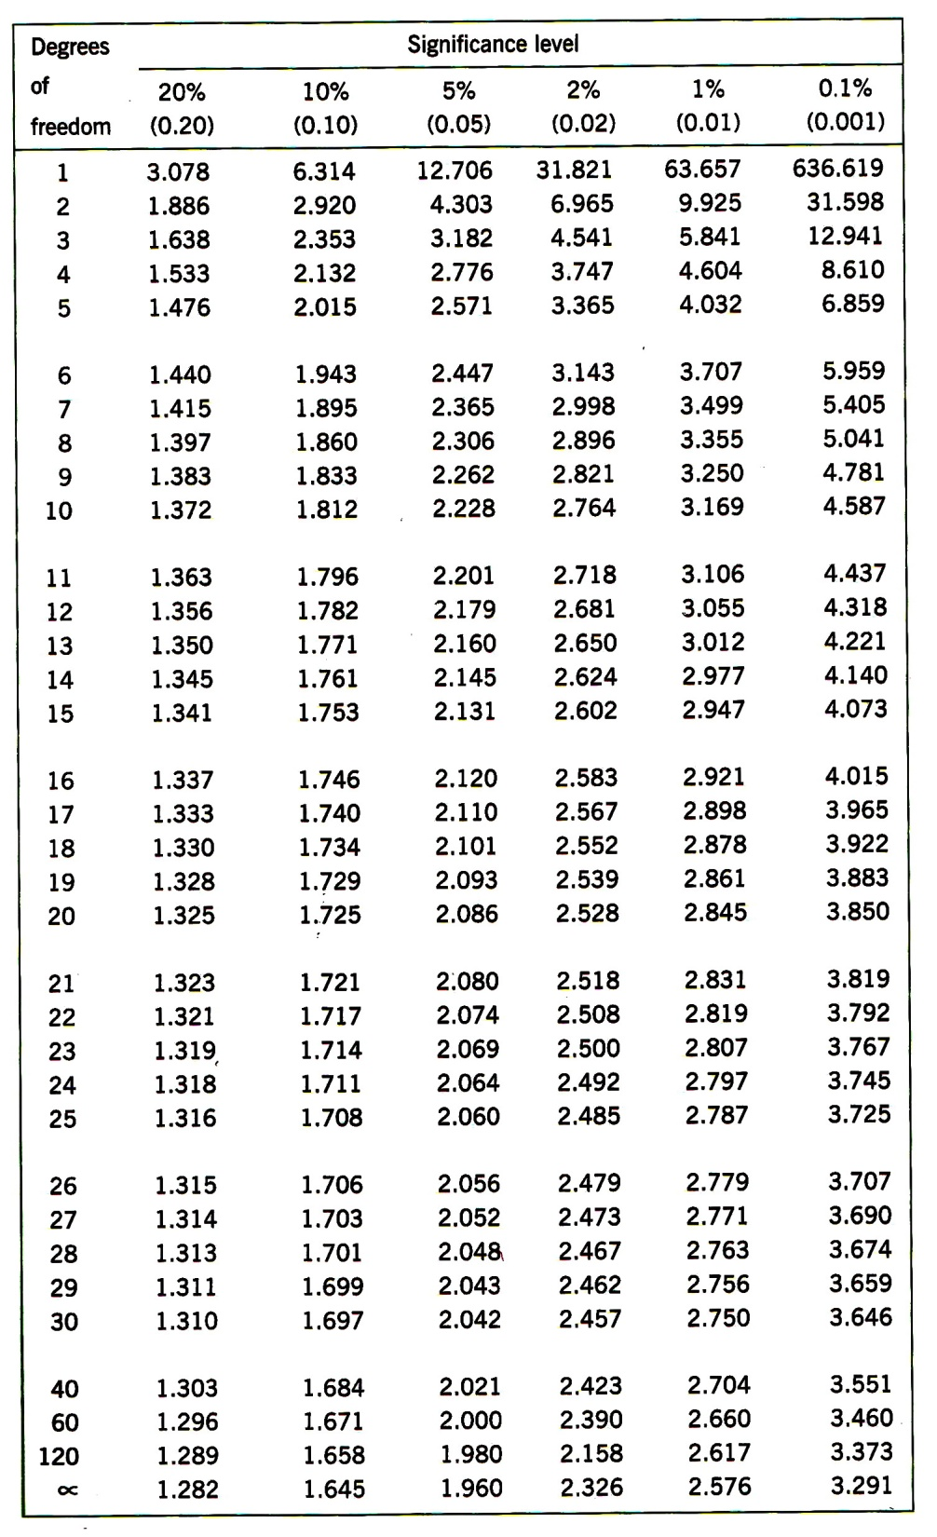
The t-test for matched and unmatched samples showing critical values of t at various significance levels.
Reject the null hypothesis if your value of t is larger than the tabulated value at the chosen significance levels for the calculated number of degrees of freedom.

Slide 11
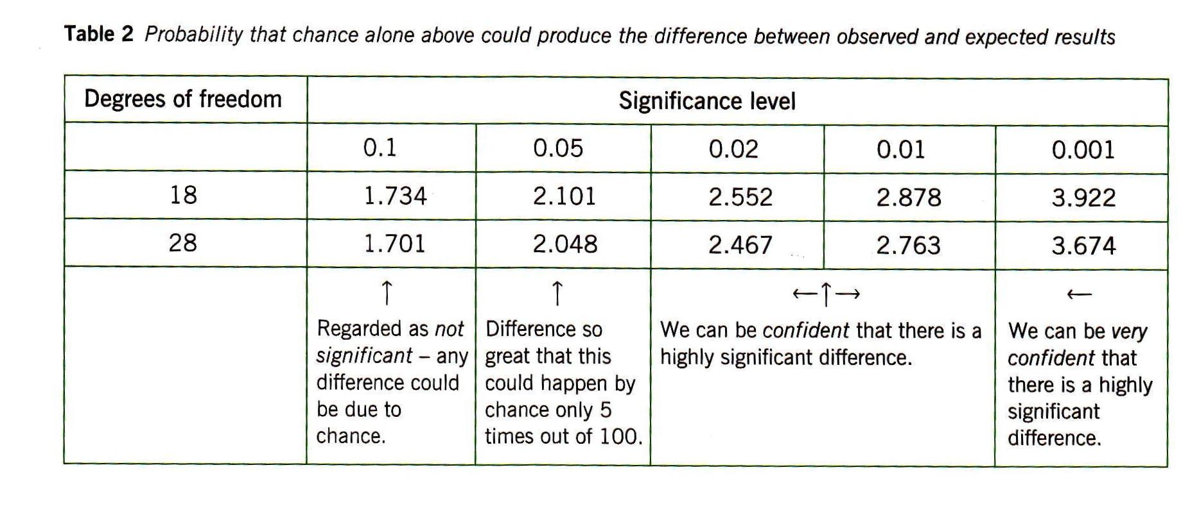

Slide 12
Conclusion
So the probability of getting a value of t at least as large as 7.89 is less than 0.05 - in fact it is much less than 0.01. So it is extremely unlikely that the difference in these two sets of data could have arisen by chance. We can reject the null hypothesis and describe the difference in the means of A and B as being highly significant.

Slide 13
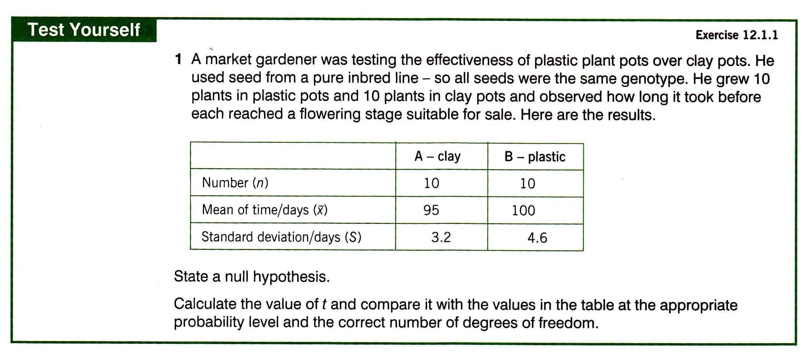

Slide 14
Task
Hypothesis 1: The needles on male yew trees are longer than on female yew trees
Hypothesis 2: The needles on female yew trees are longer than on male yew trees
Null hypothesis: There is no significant difference between the length of needle on male and female yew trees.

Slide 15
Task
Collect at least 30 needles (leaves) from the male (outside house 1) and at least 30 from the female (outside house 2). Measure the lengths to the nearest millimetre. Record the values in an Excel document. Carry out a t-test and comment on which hypothesis is supported.

Slide 16
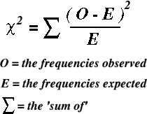
Chi-squared test (χ²)
The Chi-square test is intended to test how likely it is that an observed distribution is due to chance. It is also called a "goodness of fit" statistic, because it measures how well the observed distribution of data fits with the distribution that is expected if the variables are independent.

Slide 17
Chi-squared test (χ²)
You have just returned from a 3 year stint in the jungles western Africa, where you studied the habitat selected by the native bee eaters (a family of birds that specialize in catching bees and wasps on the wing, taking them to a perch, bashing their stingers out, and devouring them. At a pinch, they will eat other flying or hopping insects, such as grasshoppers. Three habitats were available to the bee eaters:
Hypothesis: The birds have a preference for certain habitats.
Null hypothesis: The birds do not have a preference for a certain habitat.
Calculate the value for χ²
Habitat | Jungle | Grassland | Fields
% Area | 75 | 10 | 15
# birds | 86 | 3 | 11

Slide 18
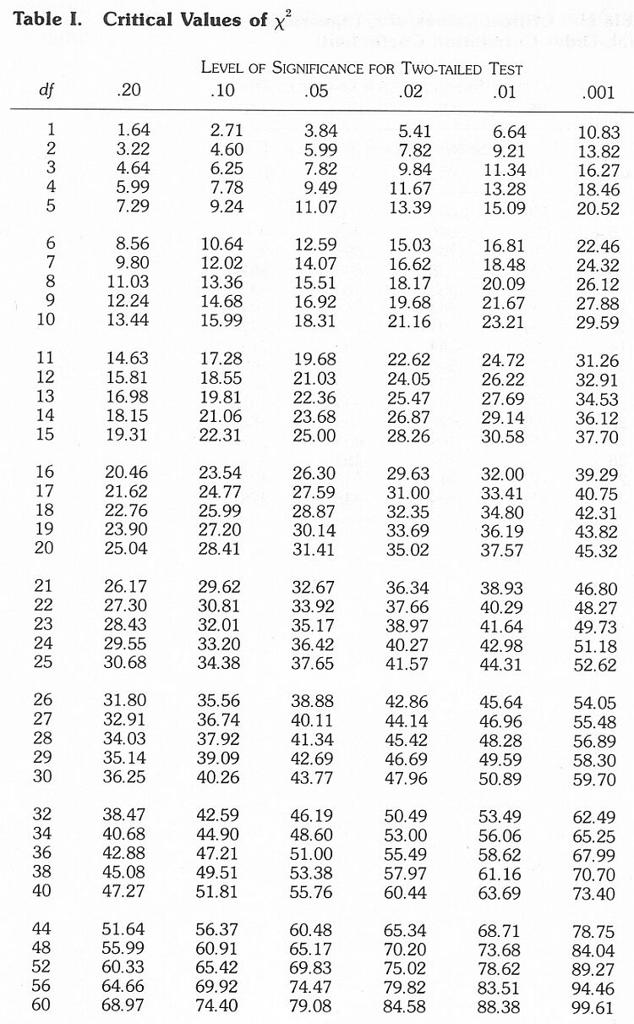
Chi-squared test (χ²)
What are the degrees of freedom?
Is the null hypothesis supported by the data (use the p=0.05 column)

Slide 19
Chi-squared test (χ²)
null hypothesis
hypothesis
χ² = 7.580
Using p = 0.05, χ² < 5.99 means that he null hypothesis is supported, χ² > 5.99 means that the hypothesis is supported. The chance of the observed results differing from the expected results for the null hypothesis is less than 5%.
The statistical test indicates that the birds really do prefer the jungle.

Slide 20
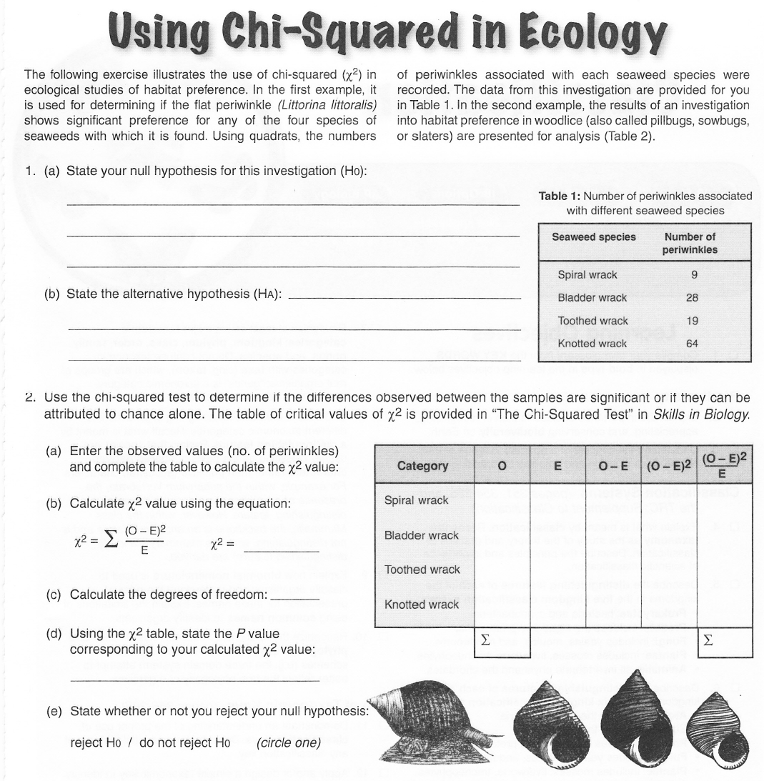

Slide 21
Online statistical analysis
http://graphpad.com/quickcalcs/catMenu/

Slide 22
Simpson’s Diversity Index
G.3.1 Calculate the Simpson diversity index for two local communities.
N(N-1)
D =
Σn(n-1)
D = Diversity index
N= total number of organisms of all species found
n= number of individuals of a particular species

Slide 23
G.3.2 Analyse the biodiversity of the two local communities using the Simpson index.
Species | Number, n | n(n-1)
A | 10
B | 6
C | 3
D | 4
E | 1
 | N = | Σn(n-1) =
Complete the table above and use the formula to determine D
N.B. A greater number of species and greater evenness in the numbers of individual species means a higher diversity.

Slide 24
Simpson Diversity Index
Key points
It is a measure of species richness;
A high value of D indicates an ancient and stable site;
A low value of D suggests recent colonisation, agricultural management or pollution;
Simpson’s Diversity Index allows monitoring of ecosystems for –
damage by agricultural or industrial pollution;
the effect of improvement schemes;
providing evidence for conserving valuable ecosystems against planning
applications for, e.g. housing or a road or a marina.

Slide 25
Biological Diversity - the great variety of life
Biological diversity can be quantified in many different ways. The two main factors taken into account when measuring diversity are richness and evenness. Richness is a measure of the number of different kinds of organisms present in a particular area. For example, species richness is the number of different species present. However, diversity depends not only on richness, but also on evenness. Evenness compares the similarity of the population size of each of the species present.
1. Richness
The number of species per sample is a measure of richness. The more species present in a sample, the 'richer' the sample.
Species richness as a measure on its own takes no account of the number of individuals of each species present. It gives as much weight to those species which have very few individuals as to those which have many individuals. Thus, one daisy has as much influence on the richness of an area as 1000 buttercups.
2. Evenness
Evenness is a measure of the relative abundance of the different species making up the richness of an area.
To give an example, we might have sampled two different fields for wildflowers.
 | Number
Flower species | Site 1 | Site 2
Daisey | 300 | 15
Dandelion | 250 | 210
Buttercup | 0 | 605
Plantain | 310 | 10

