Slide 1
Variation
S3 Science

Slide 2
Outcomes and Experiences
By exploring the characteristics offspring inherit when living things reproduce, I can distinguish between inherited and non-inherited characteristics.
SCN 2-14b

Slide 3
Learning intentions
Identify some of the differences between people.
Distinguish between discrete and continuous variation.
Distinguish between a histogram and a bar chart.
Select the correct type of graph for a given set of data.
Identify if variation is the result of genetic differences only or influenced by the environment.
Define the term polygenic

Slide 4
Variation
Variation can be continuous or discrete
Continuous variation is gradual and is partly influenced by the environment
Discrete variation is clear cut and is controlled by genes

Slide 5
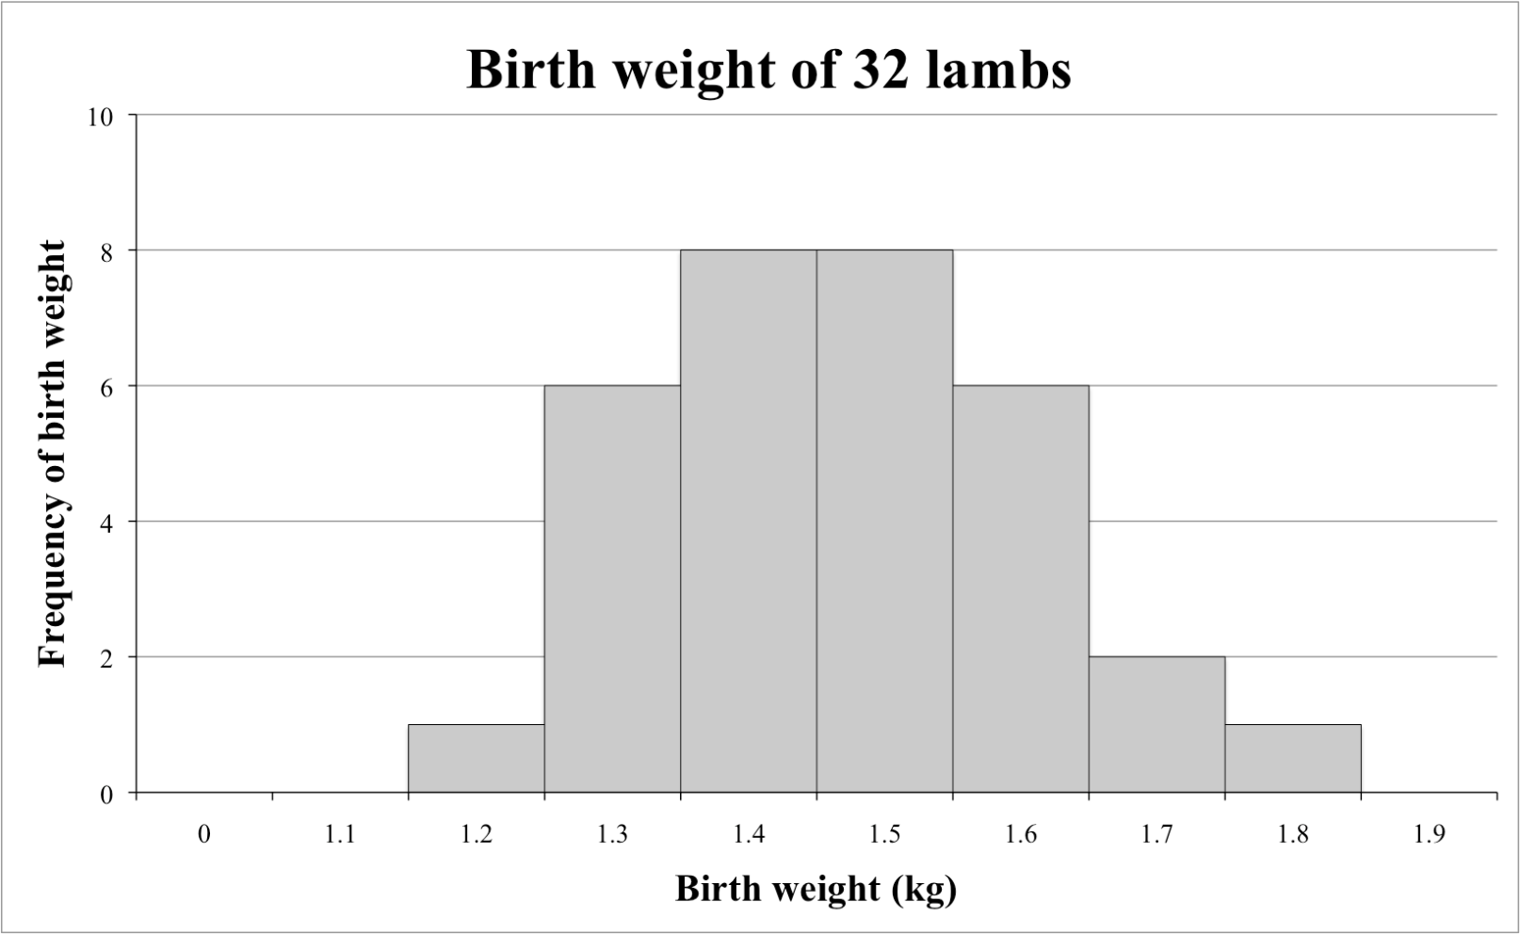
Graphs
Continuous variation is shown as a histogram

Slide 6
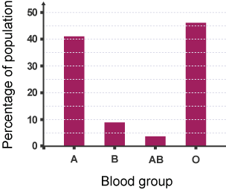
Graphs
Discontinuous variation is shown as a bar chart

Slide 7
Length of index finger
Length of index finger (cm) | Your result | Class results
6.0-6.5 |  | 1
6.5-7.0 |  | 0
7.0-7.5 |  | 3
7.5-8.0 |  | 1
8.0-8.5 |  | 2
8.5-9.0 |  | 1
9.0 or above |  | 3
Draw a graph

Slide 8
Using a pen
Left or right handed | Your result | Class results
Left |  | 3
Right |  | 14
Draw a graph

Slide 9
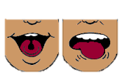
Tongue-rolling
Ability to roll your tongue | Your result | Class results
Can |  | 8
Can not |  | 4
Draw a graph

Slide 10
Height
Height in cm | Your result | Class results
<150 |  | 0
150 - 154 |  | 1
155 - 159 |  | 3
160 - 164 |  | 6
165 - 169 |  | 7
170 - 174 |  | 2
175 - 179 |  | 1
Draw a graph

Slide 11
Eye colour
Eye colour | Your result | Class results
Blue
Brown
Green
Hazel | /
Grey
Draw a graph

Slide 12
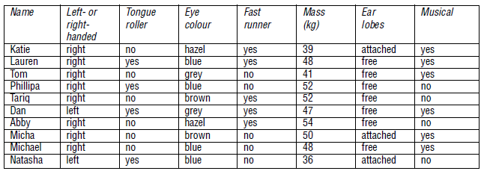
Which of these characteristics are inherited?
Giving a reason, identify the two identical twins

Slide 13
Genetic or environmental?
Speak French
Scar on chin
height
Eye colour
Curly hair
Blood group
Bad breath
Freckles
Tongue rolling
Weight
Skin colour
Genetic | Both | Environmental

Slide 14
Variation

Slide 15
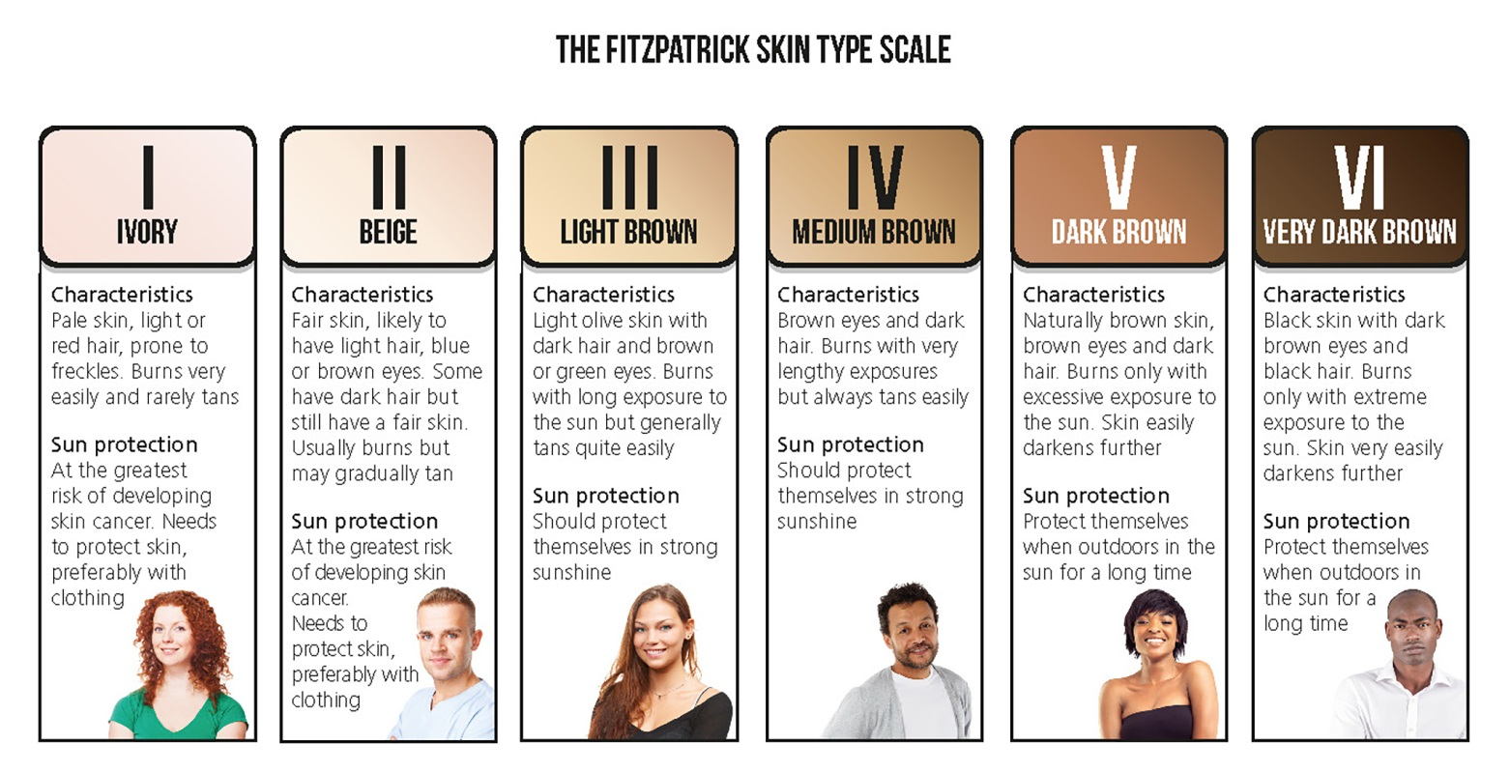
1. Discrete or continuous?

Slide 16
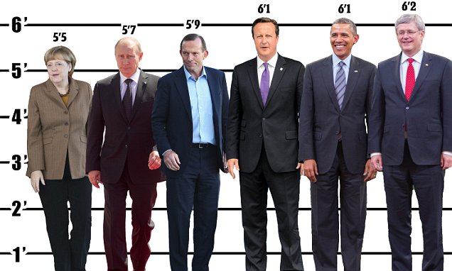
2. Bar chart or histogram?

Slide 17
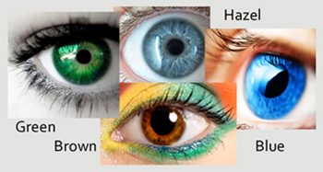
3. Genetic or environmental?

Slide 18
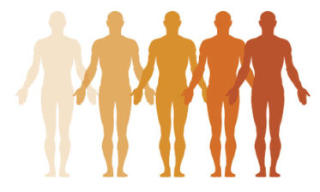
4. Give the term used for a characteristic controlled by many genes?

Slide 19
5. Which of the following are influenced by the environment
Tongue rolling
Scars
Hair colour
Blood group
Weight
Language spoken
Eye colour

